Slide 1
Delivering our new strategy
Caroline Stevens
Chief Executive

Slide 2
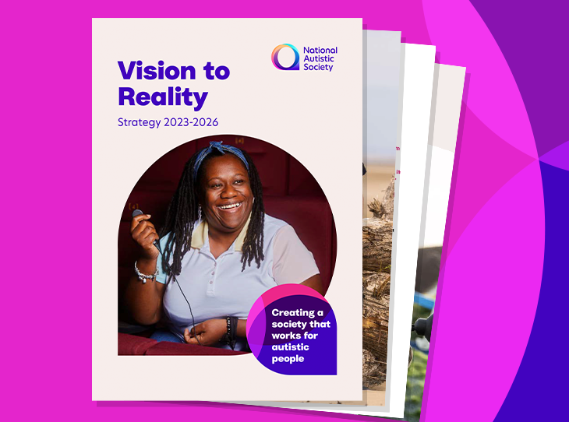
Our new Vision to Reality strategy
Builds on our Moonshot vision.
Outlines the beliefs, ambitions and priorities that will guide our work for 2023-26.
Scottish strategy now live and Northern Ireland strategy is in development.
Notes:
In 2023, we were delighted to launch our new strategy that will guide our charity’s work for the next three years. The strategy builds on our Moonshot vision, which I spoke about at last year’s AGM. In 2022 we embarked on a major exercise to set out what a society that works for autistic people would actually look like, by asking autistic people, their families and professionals about the challenges they face and the changes they most want to see. This led to the publication of our shared vision of an autism-friendly society. We called it 'The Moonshot Vision' because of the scale of ambition and collaboration needed to achieve it.
In our Moonshot research, autistic people and family members told us powerful stories about the barriers and discrimination they face every day, in all areas of life. They told us that a society that works for autistic people:
values autistic individuals
maximises autistic power
guarantees support
adapts public services and spaces
is free from discrimination.
Our new organisational strategy puts us on a pathway to make this Moonshot Vision into a reality. It defines the unique role the National Autistic Society will play in creating a society that works for autistic people. And it outlines the beliefs, ambitions and priorities that will guide our work from 2023-2026.
Now I’m going to show a short video which summarises the strategy. https://youtu.be/pBNA6Zi69oM
Our Scottish strategy now live and our NI strategy is in development.

Slide 3
Financial context
Post-pandemic, energy and cost-of-living crisis.
Incredibly challenging social care environment – available funding decrease, significant sector-wide drop in workforce.
We provide complex, high-value services within our social care business.
We had to make difficult decisions when setting our budget for 2023/24 to ensure that the organisation did not incur further financial losses.
The Moonshot vision and our new strategy commit us to creating a society that works for autistic people.
We must ensure the sustainability and viability of the organisation now and in the future, so we are around to work toward the change autistic people have told us they want to see.
Notes:
Now I need to talk about the financial context we’re working in. Like many other organisations, we are operating in very challenging circumstances. We are post-pandemic and have faced huge energy price rises and the cost-of-living crisis.
In common with all providers of social care, available funding for social care has decreased and there’s been a significant sector-wide drop in available workforce.
Additionally, we provide complex, high-value services within our social care business.
This financial context means that we had to make some difficult decisions when setting our budget for this financial year. This was necessary to ensure that the organisation did not incur further financial losses, as we saw last year.
Through our Moonshot vision and new strategy, we have made a commit to creating a society that works for autistic people. In order to meet this commitment we must make sure that we are sustainable and viable now and in the future, so we are around to work toward the change autistic people have told us they want to see.

Slide 4
Programme of change
We have embarked on a programme of change across the organisation.
Invested in new systems and processes to drive efficiency and strengthen the delivery of our work.
Looked at how we can have the most efficient and effective model for our corporate services, whilst cutting costs in these areas.
Restructured some areas of National Programmes to focus on the delivery of our new strategy.
Notes:
To address these financial challenges, we have embarked on a programme of change across the organisation.
We’ve invested in new systems and processes to drive efficiency and strengthen the delivery of all our work.
And we’ve looked at how we can have the most efficient and effective model for our corporate services, such as HR and Finance, whilst cutting costs in these areas.
We have restructured some areas of National Programmes to ensure we focus on the delivery of our new strategy.

Slide 5
Children’s Residential
Made the difficult but necessary decision to close two of our residential children’s services and put the third up for sale.
The closures of Thurnscoe House and The Lodge were completed by the beginning of the new school year 2023-2024.
We are currently investigating options for the sale of Clayton Croft, which will take place some time in the next financial year.
Notes:
As part of our programme of change, we’ve taken the very difficult decision to close two of our residential children’s services and to put the third up for sale.
There was considerable thought and discussion regarding the impact on both staff and people using the service.
Our Board of Trustees was clear that we have to make difficult decisions like this to ensure our charity does not further deplete our reserves and the viability of the whole organisation is protected.

Slide 6
Adult services
Focused on turnaround activity with a number of rolling parts such as a neutral vendor model and reducing agency costs.
We have been in negotiation with funders whose level of funding has not kept pace with the cost of delivering our services.
The quality of our services and the safety of the people we support has been the cornerstone of this work.
Without the necessary uplifts we can no longer provide our services safely and to the high standard that we and families expect and demand.
Some funders were able to meet the increase.
Other funders were not, and we were left with no choice but to serve notice on a number of individual contracts.
In some cases, this impacted the viability of a service as a whole and we had to take the decision to close these services.
Notes:
Our strategy in adult services is focused on turnaround activity. The turnaround project has a number of rolling parts. Alongside our fee negotiations with local authorities, to ensure appropriate funding of contracts for people we support in our services, which I will come on to, other work includes continuation of the neutral vendor agency system to streamline our agency use across our services. We are also working to reduce agency spend by 50% by end of this financial year. These activities are central to building a strong platform for the future, to ensure the long-term sustainability and viability of our charity, and so that we can be around to work towards the goal set out in our charity’s strategy of a society that works for autistic people.
We have also been in contact with all our funders of adult services to discuss our costs as a specialist provider of care. The fees paid by many of them over the past few years have not kept pace with our costs to provide our services safely and to the high standard that we and they expect and demand. Through our discussions with local authorities over the past six of months, many funders have signed up to revised fees. However, we were unable to secure increased funding for all contracts.
In these instances we have had no choice but to serve notice on the underfunded contracts. In some instances, this has impacted the viability of a service as a whole and, extremely regretfully, we have therefore had no choice but to close the service.
Our primary concern at this time is to support the affected individuals, their families and loved ones for the remainder of their contracts with us and through any period of transition.

Slide 7
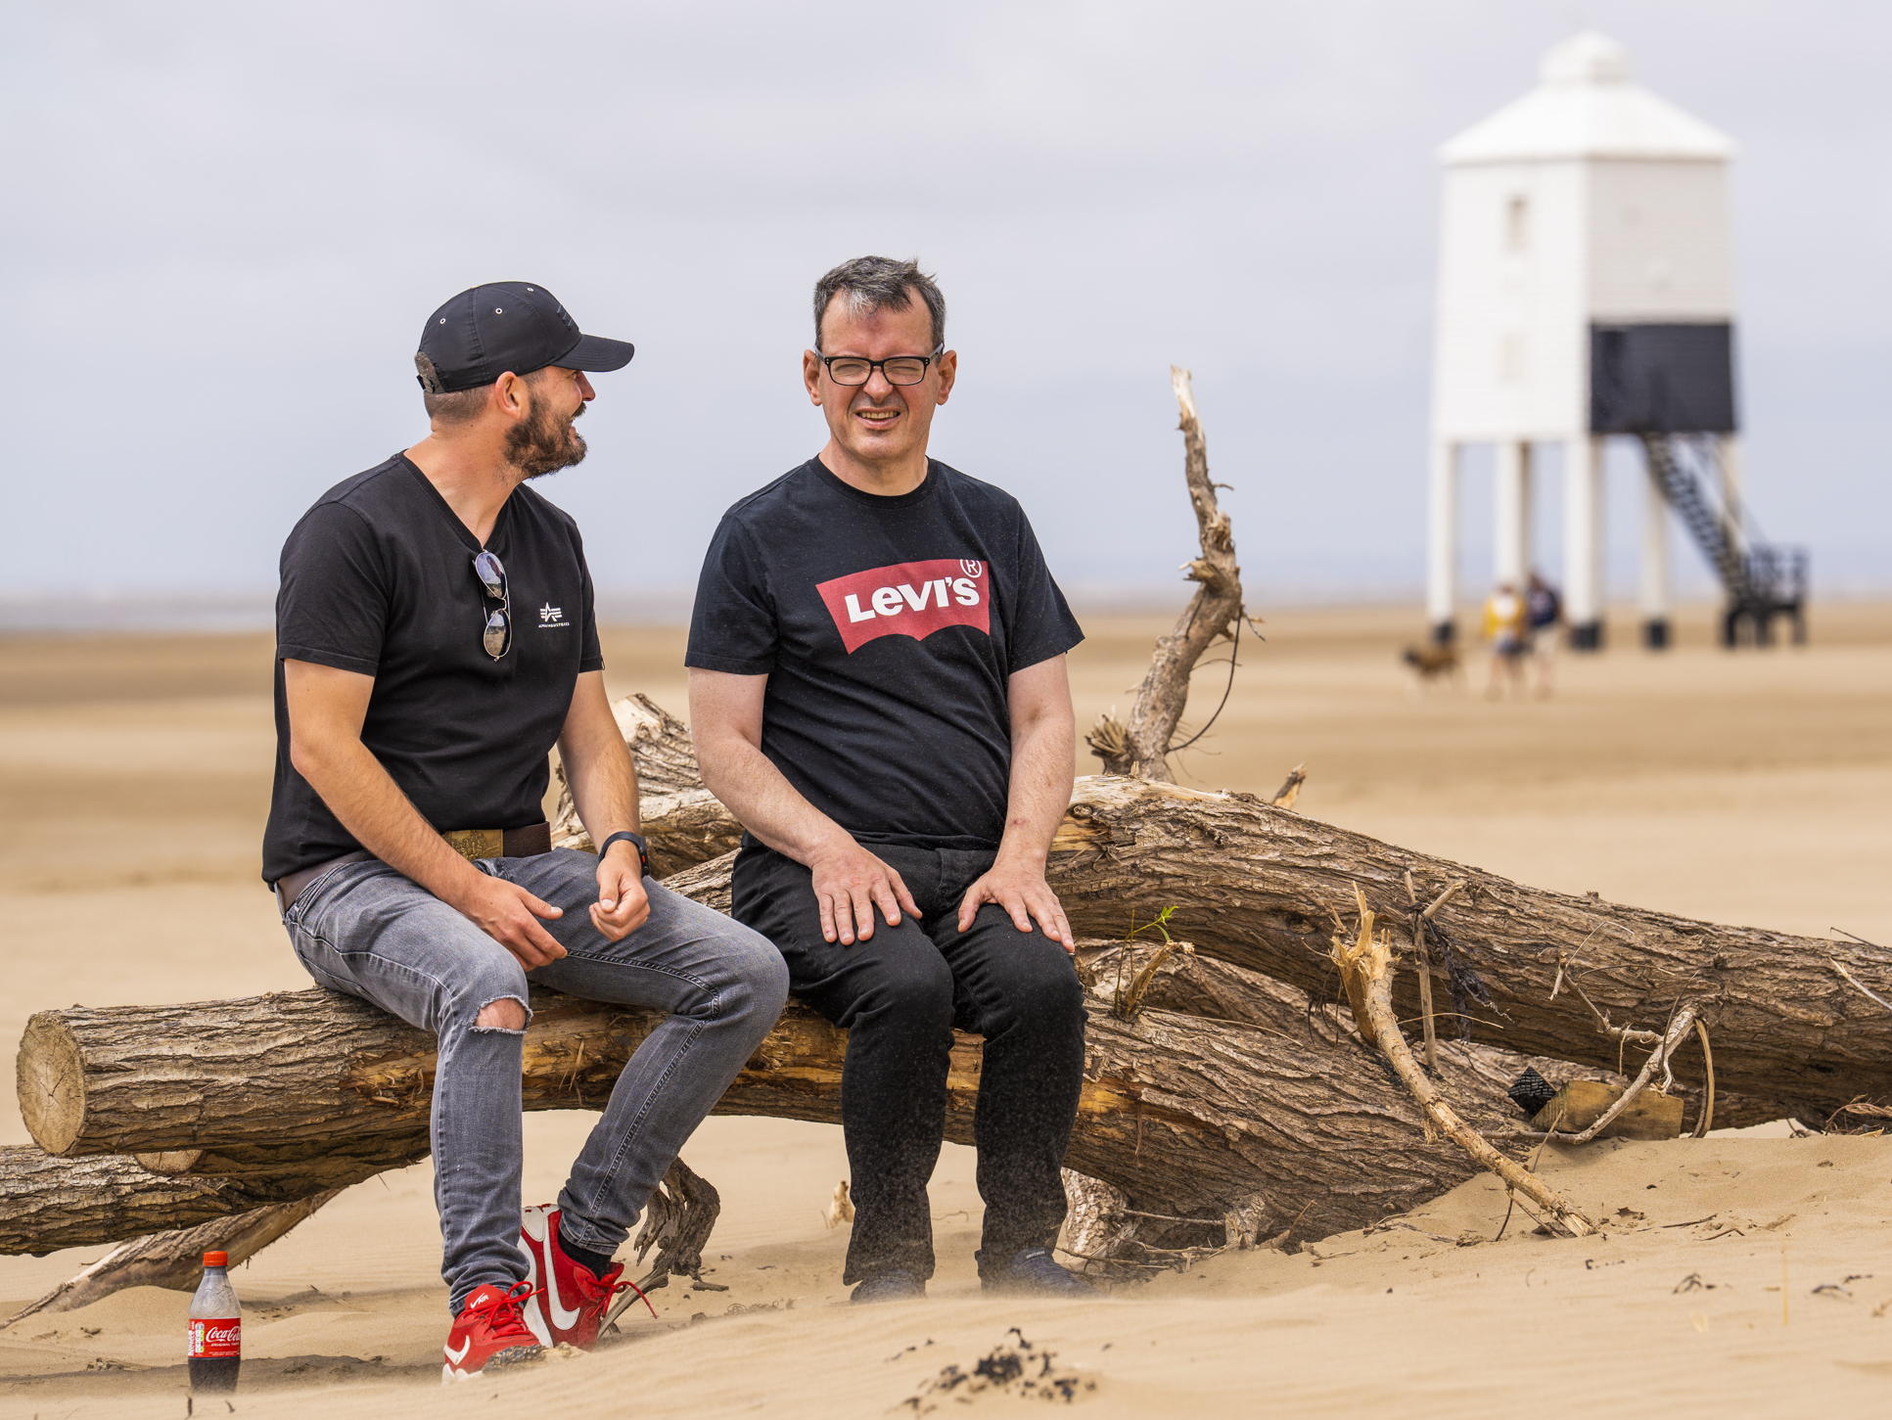
The coming year
An ambitious programme of change but a necessary one.
The actions we take now will ensure a sustainable and viable foundation from which we can move forward to deliver our strategy and build a society that works for autistic people.
Notes:
This is an ambitious programme of change but a necessary one due to the financial context we are operating in.
The actions we take now will ensure a sustainable and viable foundation from which we can move forward to deliver our strategy and achieve our vision of a society that works for autistic people.

