Slide 1
How proposed Welfare Reforms will impact autistic people

Slide 2
Need to Know: Employment
autism employment rate = 3/10
(lowest of any disability group)
biggest pay gap of any disability group
77% of unemployed autistic people want to be working
40% of autistic people in work want to be working more.
Notes:
Mel : (Why we are here)

Slide 3
Need to Know: Employment
Barriers to Employment:
A lack of autism understanding in workplaces
experiences of discrimination
a lack of support in implementing or asking for adjustments
These barriers occur at every stage:
Finding a job
getting a job
Staying in employment (and staying well in employment)
Progressing and promotion
Notes:
Mel

Slide 4
Need to Know: Why autistic people need PIP
217,750 claim PIP for a primary condition of autism
Third most common condition after anxiety/depression and osteoarthritis
PIP is NOT an out-of-work benefit. It is meant to subsidise the additional costs of disability and can be claimed by employed or unemployed disabled people.
In a recent survey, 70% of autistic PIP claimants said the current rate of PIP does not cover the additional costs incurred by their disability
For autistic claimants, PIP is typically spent on:
food and meal items (55%)
additional transport costs (47.5%)
personal assistance (40%)
Notes:
Jessa

Slide 5
“PIP has been a lifeline to me and allowed me to buy equipment such as weighted blankets… With the changes to PIP I will lose it and the health element of UC, I will have to cut back on so much.” N – Autistic man in receipt of PIP
Notes:
Jessa

Slide 6
Need to Know - Reforms
No Consultation
Changes to PIP eligibility
WCA assessment replaced with PIP assessment
UC-Health element reduced/frozen
Consultation
Delaying access to UC-Health until age 22
Right to Try Work
Review of PIP assessment process
Notes:
Joey - PIP changes may affect carer’s allowance, blue badges, other supports

Slide 7
Concerns: Impact
We and the wider sector have some serious concerns about the reforms and their potential impacts on autistic and disabled people.
An additional 250,000 people (including 50,000 children) will live in relative poverty by 2030 because of these changes. Estimates from the Joseph Rowntree Foundation suggest this number could in fact be as high as 400,000.
There are currently 1,325,250 people who would lose access to PIP under these changes. The average loss is £4,500 per year
At least 13,000 autistic people will lose access to PIP where autism is the primary condition, including 4,800 autistic people on the enhanced rate
Notes:
Mel

Slide 8
Concerns: Lack of Evaluation
The Government has not provided a full assessment of the impact of the benefit reforms
We can’t know for sure just how many people will be affected and which conditions will be most severely impacted.
Published DWP data does not show what the impacts could be for autistic UC claimants, carers of autistic people or autistic PIP claimants who claim for a different primary condition.
For UC-Health we have no information on what disabilities are most likely to be affected
We do not have any details of how employment programs will be implemented, and what their impact will be
The Office for Budget Responsibility (OBR) has said the government has not yet provided enough details of their employment programs for them to be evaluated. They have also not been given enough time to develop an analysis of the impact of benefit cuts on the labour market.
An assessment won’t happen before the vote.
Notes:
Jessa

Slide 9
Concerns: Access to Benefits
In its existing format, PIP is a difficult, distressing and inaccessible process for autistic people. In a recent survey of PIP claimants:
70% told us that assessors do not have a sufficient understanding of autism to correctly award entitlements.
97% found the assessment process for PIP somewhat (32%) or extremely (66%) difficult
79% found the process of providing documentation somewhat or extremely difficult
PIP is not an out of work benefit. Many people who stand to lose PIP are not unemployed. These reforms may take away vital support that help autistic people work.
The government has announced that the terms of reference for a PIP assessment review are being drafted
The date of PIP’s assessment consultation has not been announced.
An unsuitable assessment method is going to form the basis of how most people claim disability benefits, including UC-health, from April '27.
Notes:
Jessa

Slide 10
Concerns: Behaviour Change VS Structural Change
The structural factors that make it harder for autistic and disabled people to work and access benefits are not addressed by these reforms
It is unfair and inaccurate to emphasise behavioural change on the part of claimants who are not supported to address discrimination and exclusion.
What behaviours does the government expect autistic people to change?
Some of the rhetoric around these reforms perpetuates harmful stereotypes about benefit claimants – implying that people who access welfare are being incentivised out of work or choosing to be out of work.
A systematic review of benefit systems across seven OECD countries found no correlation between restricting benefit eligibility and improved employment outcomes.
Notes:
Joey

Slide 11
“I have an adult daughter who is autistic and receives PIP payments, which make a huge difference to how she lives her life. PIP allows her to work part-time and still maintain a level of independence… She gets exhausted with having to hide her difficulties in the workplace and I fully expect that this could cause her to be seriously ill again. It will be a massive blow to her independence.” C – Mother of autistic daughter in receipt of PIP
Notes:
Joey

Slide 12
Take a Pause
MPs deserve to have all of the information before voting on such massive reforms.
We want the government to take the time to get reforms right. This includes:
Publishing all impact assessments
consulting on all changes including reforms to PIP eligibility and UC-Health
reforming the PIP assessment process through consultation with disabled people before reforms are implemented
Listening and responding to the concerns shared by disability groups
Notes:
Mel

Slide 13
Employment Support
We are aware that the government is taking some steps to support disabled people into employment.
Both the Mayfield report and the Neurodiversity panel will report after the vote on these reforms.
None of the announced employment programs specifically mention or support autistic people.
A recent evaluation from the Learning & Work Institute and Joseph Rowntree, suggests just 45,000-95,000 people will access work because of these reforms by 2029
Notes:
Joey

Slide 14
What can and should be done to help autistic people into work
We would like the government to address the following key issues before taking away benefits:
Autism training for job coaches, assessors and all DWP staff.
Support moving from school to employment: job coaching, apprenticeships
Co-designed employment support and programs for autistic people
Developing best practice guidance and resources for employers
Guidance and support on implementing reasonable adjustments for employers
Notes:
Jessa

Slide 15
“As a single father of three and a newly diagnosed autistic individual, I rely on these benefits. My background includes working in the Ministry of Justice, military service, cyber security and data protection law. Recent struggles with bullying, burnout, low mood, depression, and anxiety have left me unemployed for two years.” S – Unemployed autistic father of three children.
Notes:
Jessa

Slide 16
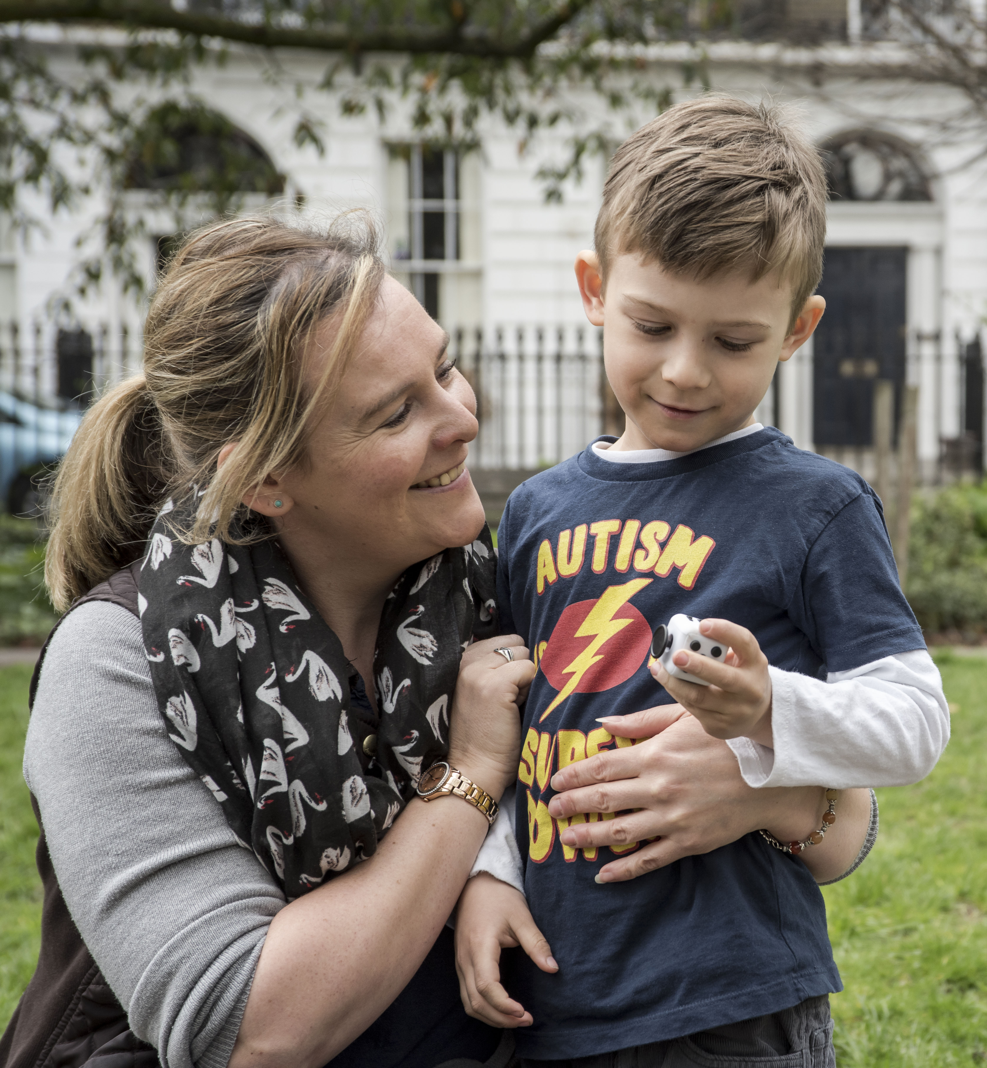
Thank you for listening!

