Slide 1
Plans for 2025-26
Dr Stephen Ladyman
Chair of Trustees
Notes:
Thank you to Caroline for summarising our impact earlier, over the last financial year.
Now, we turn to the present year and our future plans.

Slide 2
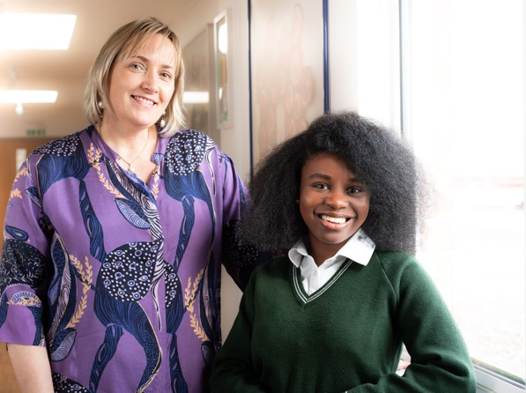
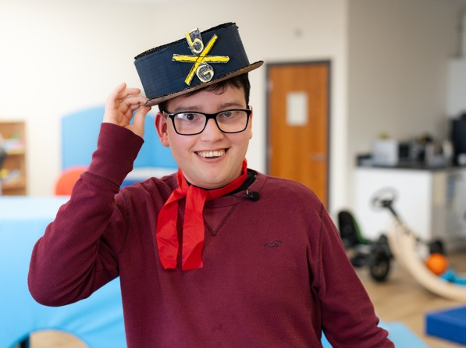
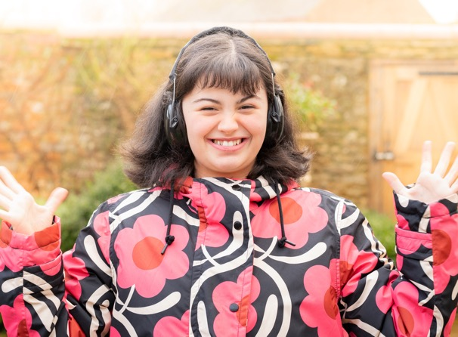
Introduction
2025-26 is the third year of delivering our Vision to Reality strategy to create a society that works for autistic people and their families.
What do we have planned?
Notes:
I’m going to outline our exciting plans for 2025-26, as we continue delivering our Vision to Reality strategy.

Slide 3
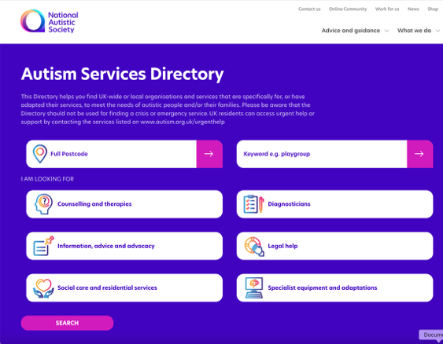
Belief 1: Support
We believe the role of the National Autistic Society is to support all autistic individuals and their families to live a fulfilled life on their terms.
So far, in 2025-26, we have:
updated our 'What is autism?' webpages and core materials
improved our Autism Services Directory experience
for autistic people, families and service providers,
and increased the services listed.
And we plan to:
launch a new education hub of information and resources
develop and launch Ask Ash – an interactive digital tool to help people navigate our autism information and to direct those most in need to one-to-one support.
Notes:
To support all autistic individuals and their families, in 2025-26, we plan to, firstly, continue improving the information on our website. As Caroline mentioned, 1.3 million people viewed our information last year. We have already updated our What is autism webpages and core materials – vital, evidence-based resources that we have been directing people to recently to fight misinformation about autism.
We’ve also launched a new-look Autism Services Directory. The Directory offers families an invaluable way of sourcing local support from professionals and services that understand autism. The new design had input from autistic people and makes it easier for businesses to add themselves and keep their listing up to date.
In 2026, we will launch a new education hub of information and practical resources to help parents get the support their autistic children need in school.
We’ll also launch ‘Ask Ash’, which is a tool to help people navigate the autism information on our website and direct those most in need to our bespoke one-to-one support.
As always, our advice and guidance will be informed by detailed evidence reviews and autistic people’s lived experiences.

Slide 4
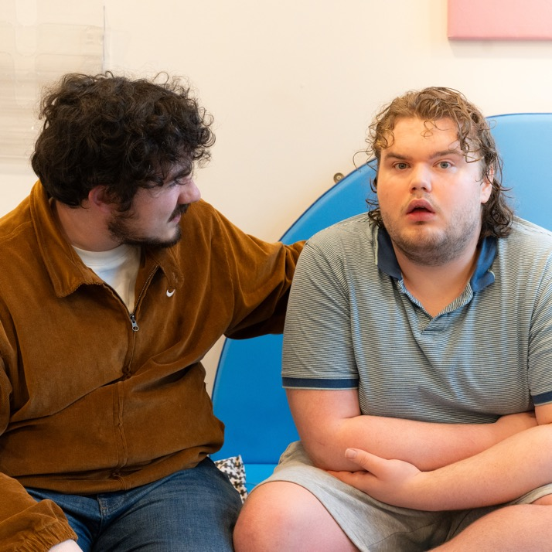
Belief 1: Support
We believe the role of the National Autistic Society is to support all autistic individuals and their families to live a fulfilled life on their terms.
So far, in 2025-26, we have:
built and equipped our new autism centre
in Randalstown in Northern Ireland.
And we plan to:
deliver our 'What's next?' - pre- and post-
diagnostic support for more than 500 adults
in Scotland
run our Moving Forward programme, delivering
support to 180 autistic young people from
disadvantaged parts of Scotland.
Notes:
We are thrilled that our new autism centre in Randalstown, Northern Ireland, is due to open in March 2026. The core of the centre will be day provision for adults with high support needs.
In Scotland, we will deliver 'What's next?’ – a pre- and post-diagnostic support programme for more than 500 adults over two and a half years. The programme aims to empower autistic people by deepening their understanding of autism and autistic identity, improving wellbeing and fostering connections.
We’ll run our Moving Forward programme until the end of March 2026 too, delivering support to 180 autistic young people from disadvantaged parts of Scotland.
We will also deliver our Empower Up programme to a further 45 young people. And we’ll conclude our Growing Up programme, supporting 135 carers whose young people are approaching the transition to adulthood.

Slide 5
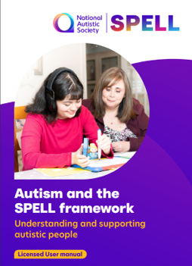
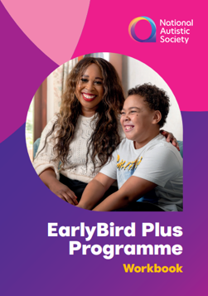
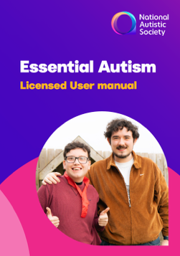
Belief 2: Influence
We believe the role of the National Autistic Society is to influence and collaborate with others to improve standards and adjustments.
So far, in 2025-26, we have:
launched updated training materials, including refreshed e-learning modules and manuals.
And we plan to:
deliver an online Professionals’ Conference
on the theme of ‘Rethinking support through
neuroinclusive practice’.
Notes:
As Caroline mentioned, creating a society that works for autistic people involves training and collaborating with other professionals such as teachers, healthcare professionals and employers.
We have already launched updated online learning modules in Understanding autism and Autism and sensory experiences, and new versions of our Essential Autism and SPELL training courses. They’ve all been fully updated and refreshed with new content, insights and films, offering the latest autism knowledge to professionals.
And for the rest of the financial year, we are going to:
deliver an online Professionals’ Conference in March, themed around ‘Rethinking support through neuroinclusive practice’
develop a new framework for our Employer Award
expand our mainstream school training offer to include wider neuroinclusive practice for education professionals.

Slide 6
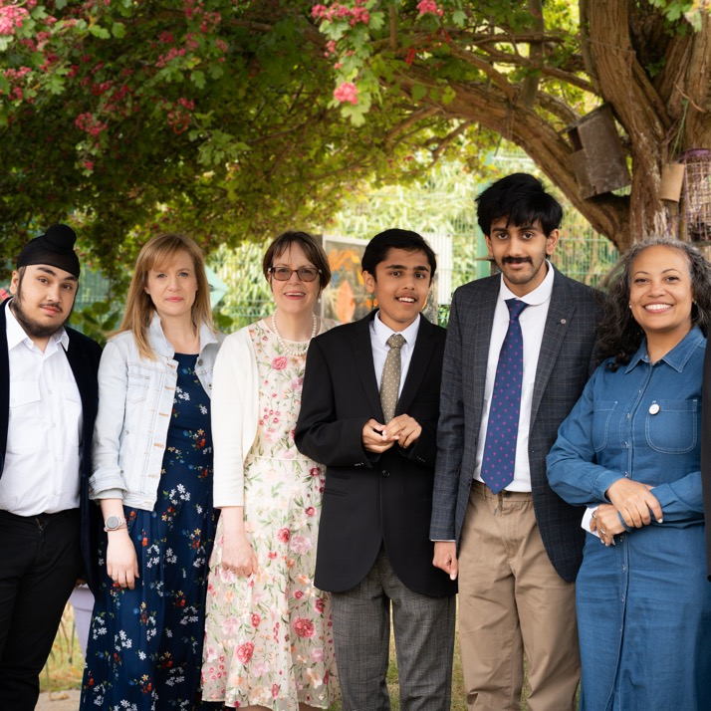
Belief 2: Influence
We believe the role of the National Autistic Society is to influence and collaborate with others to improve standards and adjustments.
So far, in 2025-26, we have:
worked with three new potential sites for Cullum Centres in Norfolk and East Sussex
celebrated the 60th anniversary for our Sybil Elgar School and the 50th of Radlett Lodge.
And we plan to:
develop plans for an exciting redevelopment at our Robert Ogden School
roll out our Inclusive Spaces initiative to a wider range of mainstream schools.
Notes:
To expand our Cullum Centres in mainstream schools, we have been working with three new potential centre sites in Norfolk and East Sussex, with the hope that builds can start by 2026.
We’ve celebrated both the 60th anniversary of our Sybil Elgar School and the 50th of Radlett Lodge with amazing summer events. This coincided with the launch of our Heritage project and underpinned the importance of the schools in our charity’s foundation.
Further exciting plans are ahead as we look to refurbish the residential areas of Radlett Lodge School in 2026, and develop plans for an exciting redevelopment of our Robert Ogden School.
We also plan to secure further funding and roll out our Inclusive Spaces initiative to a wider range of mainstream schools, using learning gained from the pilot scheme.

Slide 7
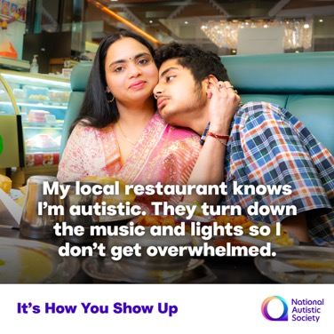
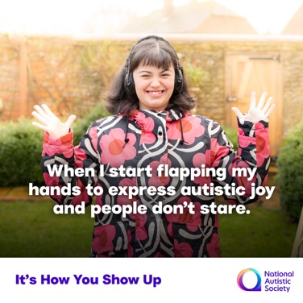
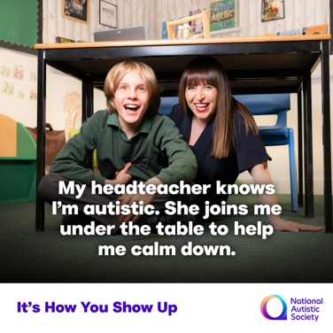
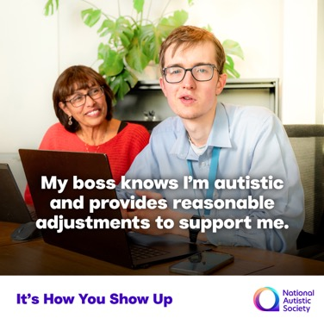
Belief 3: Transform
We believe the role of the National Autistic Society is to transform society by building understanding, acceptance and respect
for all autistic people.
So far, in 2025-26, we have:
launched our It’s How You Show Up public awareness campaign – with a brand new film, and advertising on billboards and digital screens across the country.
Notes:
The role of the National Autistic Society is also to transform society by building understanding, acceptance and respect for all autistic people.
In April 2025, we launched our It’s How You Show Up public awareness campaign – with a brand new film, advertising and a social media campaign. This campaign will run through the next two years. It’s based on what more than 8,000 autistic people and their families told us they want the public to know about autism: that they want the public to make small changes that could have a big impact on autistic people. I know Chrystyna is going to tell you a lot more about this campaign later.

Slide 8
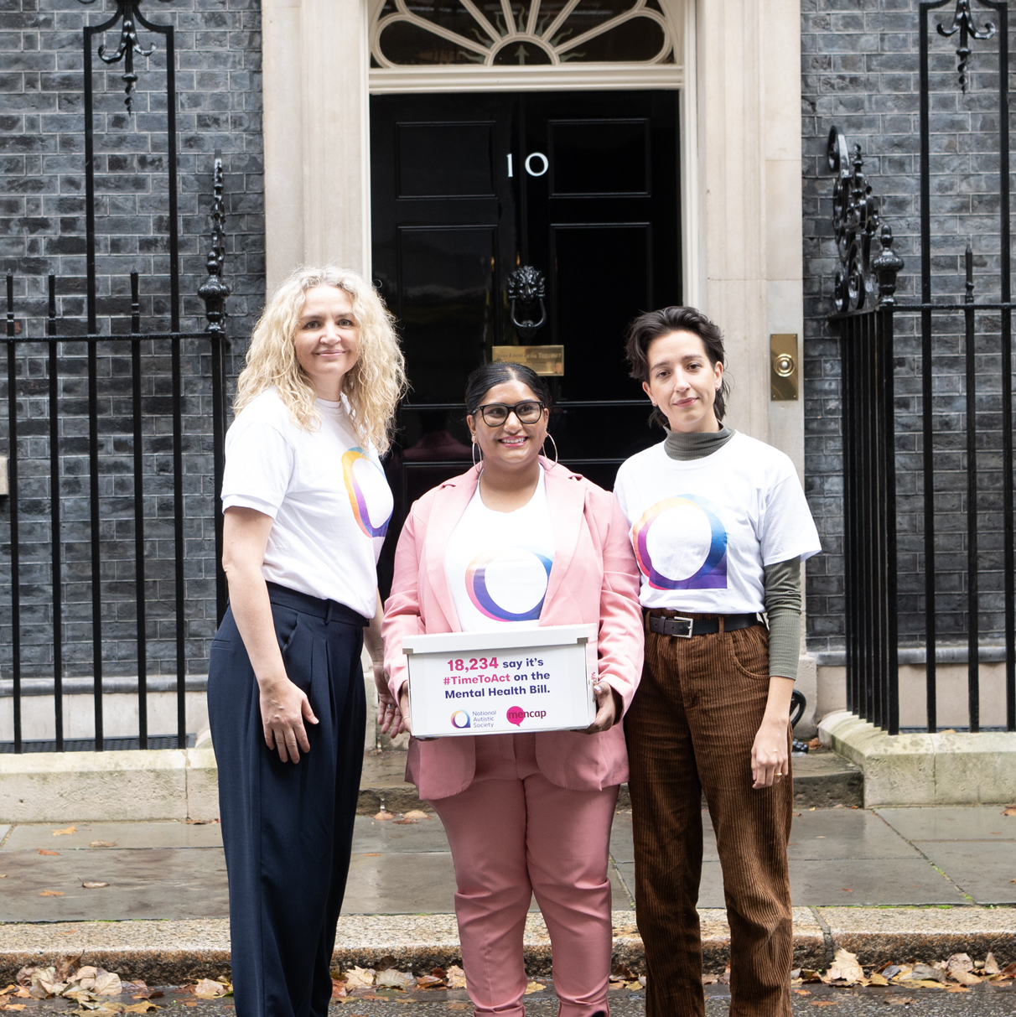
Belief 3: Transform
We believe the role of the National Autistic Society is to transform society by building understanding, acceptance and respect for all autistic people.
So far, in 2025-26, we have:
robustly challenged false stories about autism.
When untruths were spread that paracetamol and vaccines cause autism, we acted quickly and mobilised nearly 30,000 campaigners to join our Truth. It Matters. Autistic people deserve better campaign.
And we plan to:
launch a major new SEND campaign
campaign for change in the lead-up to the 2026 elections in Scotland and Wales.
Notes:
I hope you’ve seen that we have been challenging inaccurate stories about autism in the media and from politicians. This includes false claims that taking paracetamol in pregnancy causes autism. Nearly 30,000 have signed our Truth. It matters petition against this.
Our next major campaign will be ‘SEND help’ to fix the broken and brutal SEND system. We are showing the reality of parents’ experiences with films and a new policy report, and calling on our members and supporters to respond to the Government’s forthcoming consultation on the Schools’ White Paper.

Slide 9
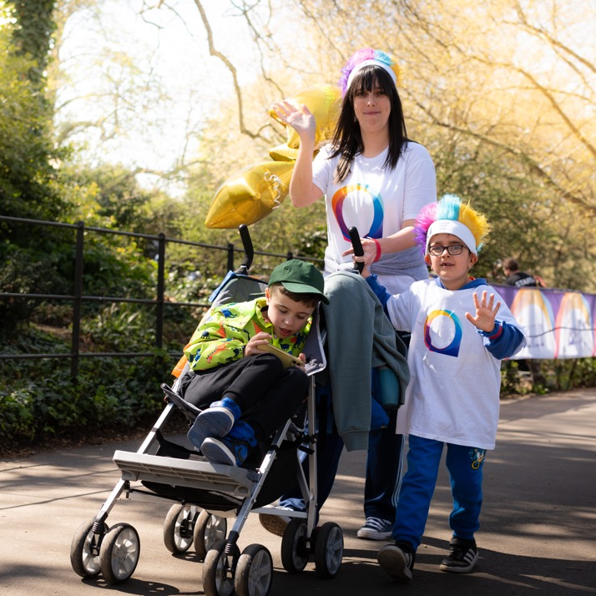
Strong foundations
Building strong foundations to help deliver our ambitions
In 2025-26, in Fundraising, we plan to:
expand our virtual challenge portfolio
launch a new, innovative fundraising product to resonate with new audiences – watch this space!
grow our corporate partnerships
continue to enhance our supporters’ experience.
Notes:
To help us deliver these ambitious plans, in Fundraising, we plan to firstly expand our virtual challenge events portfolio. We’ll build on the outstanding success of our ‘100 Miles in October’ campaign to inspire even more people to get involved and fundraise in ways that suit their lifestyles. We’ve already launched ‘60 Miles in June’, which was highly successful, and in February, we’re planning a new challenge in which we are asking our followers to exercise for 28 minutes per day in February!
We will also launch an innovative fundraising product designed to reach and resonate with new audiences.
Other plans to increase fundraising include accelerating the growth of our corporate partnerships, and continuing to enhance our supporters’ experience through tailored communications and more interactive content.
We want all our members and supporters to feel valued and to be able to see the difference you make.

Slide 10
Strong foundations
What we have done in Membership:
continued our new series of members-only webinars. We’ve had successful webinars on getting the most out of your membership and volunteering opportunities.
What are we doing next in 2025-6:
scheduling and planning for further webinars: topics will include our Online Community and Policy and Campaigns work.
Any questions, please reach out to the team on membership@nas.org.uk
Notes:
As members, you are an especially valued part of our supporter base, one which plays a vital role in the pursuit of our charity’s vision.
We’ve been pleased to launch a new series of members-only webinars and are planning more throughout 2025-26, featuring exclusive updates and insight from across our charity.

Slide 11
Survey Results
Notes:
We are always looking for ways to develop and improve your membership experience. To gain an insight into how we can do this, we asked our a few questions in a survey prior to this AGM.
We didn't receive many responses, so we are treating the results as indicative rather than conclusive. We have pulled some highlights from these responses, which I will share now.

Slide 12

Top answers
Exclusive resources and insight into the work of the National Autistic Society
Supporting autistic people and their families with the information and guidance provided by your membership
What is the most important thing for you about your National Autistic Society membership?
Notes:
We asked- What is the most important thing for you about your National Autistic Society membership?
The top two responses were:-
- Exclusive resources and insight into the work of the National Autistic Society
And - Supporting autistic people and their families with the information and guidance provided by your membership
This is great to hear because I know the team are committed to adding more exclusivity and insight into the membership package.
And of course, our members will always be a vital and valuable bedrock of our supporter base.

Slide 13
We are continually working on improving the membership experience. To that end, on which areas of your membership do you think we should be focusing our attention?
Top answer
Developing the webinar series
Additional suggestions:-
More chances to connect with autistic people
Political events
Notes:
We asked- We are continually working on improving the membership experience. To that end, on which areas of your membership do you think we should be focusing our attention?
Top answer was developing our webinar series.
You'll be pleased to know that we're already working on the next webinar in February. We're delighted that there has been a great response to these online events so far and please remember to continue to send us your ideas for future sessions – our membership email inbox is always open!
We also received some fantastic ideas for future developments, including more chances to connect with other autistic people and political events with the chance to meet MPs and/or policy makers.

Slide 14
As for the wider charity – what do you believe are the areas of our work that you think we should be focusing on?
Top answer
Raising awareness and acceptance amongst the general public
Notes:
We asked- As for the wider charity –what do you believe are the areas of our work that you think we should be focusing on?
You said, raising awareness and acceptance amongst the general public.
As you heard earlier from Chrys, we are always working on this and the 'It's How You Show Up' campaign will continue to go from strength to strength in the new year.

Slide 15
What could we do to better support our members and other supporters?
Ensure that branches work for their communities
Involve autistic people in your campaigns
More in-person events for autistic supporters
Notes:
We asked- What could we do to better support our members and other supporters?
We received a few great ideas here and we have highlighted some above, including more in-person events for autistic people and some thoughts on our branches.
Some really useful feedback across the board here. We will take these away and share any updates in your quarterly email newsletters.

Slide 16
Plans for the future
Notes:
Before I close this part of today's meeting, I want to touch on our strategy for the future.
Earlier this year, we went about consulting audiences - staff and members, supporters and our wider audiences around our future strategy.
As a result, the board and I have just signed off a refreshed strategy to take us through to 2030.
The new strategy is an extension of the previous one, with the main changes being that we have switched around the beliefs so the first one, and main one is around Understanding, acceptance and respect for autistic people, as the insight clearly showed there is a growing need for us to focus on this, especially in light of significant misinformation around autism.
We are already making great progress on this and as well as the news and plans that Chrys touched on, you will hear a bit more about some specific elements in the presentation by Mel coming up. Our new strategy will be published on our website soon.

Slide 17
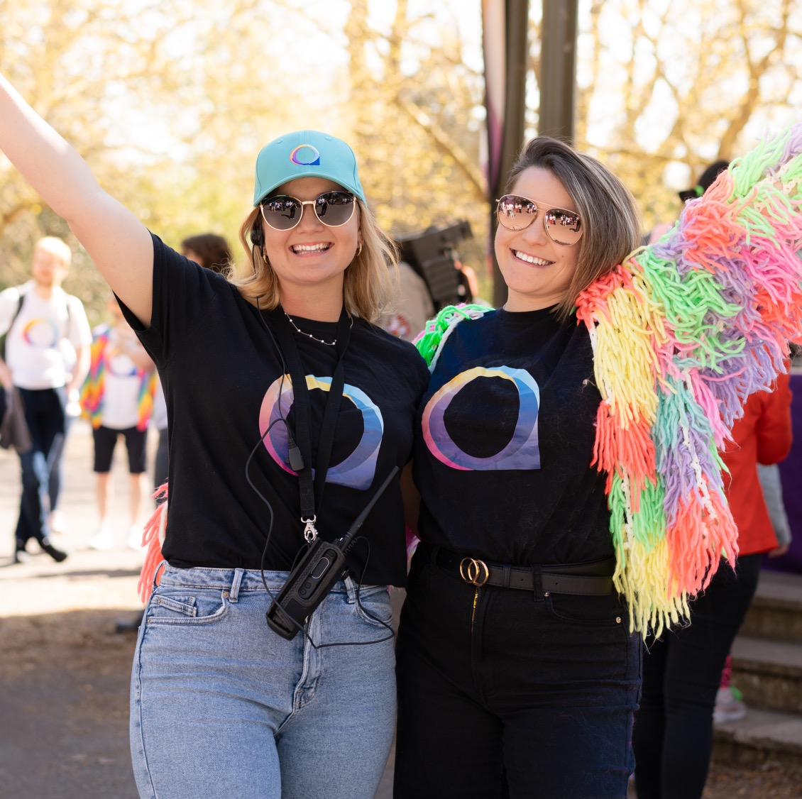
Thank you
Notes:
Finally, I’d like to say a heartfelt thank you to our amazing staff and volunteers for all your hard work and commitment - I’m excited to work with you during the next year to deliver these ambitious plans.
And to you, our members. Thank you for being an essential part of our journey to deliver our Vision to Reality strategy and create a society that works for autistic people. Your ongoing support is highly valued and appreciated by me and all of us at the National Autistic Society. Thank you.

