Slide 1
Reforming the Mental Health Act
Tim Nicholls
Assistant Director of Policy, Research & Strategy

Slide 2
Inpatient statistics
2,050 autistic people and people with learning disabilities are in inpatient mental health hospitals in England
1,410 (69%) of these people are autistic
122% increase in the number of autistic people without a learning disability since 2015
92% detained under the MHA 1983
4.9 years average stay
Notes:
Accessing mental health services is another challenge. Poor mental health should not be an inevitable part of being autistic. For many families, accessing the right care and support services early on is so important, but too often, doesn’t happen.
We know that many autistic people have mental health problems, with the APPGA’s inquiry finding that 76% of autistic adults had reached out for mental health support in the five years preceding 2019.
However, 86% of families say that getting support from mental health services takes too long; and only 11% of families think there are enough mental health services in their area to meet their needs.

Slide 3
A history of missed targets
Target to end inappropriate placements and move people into community-based support by 2014 – missed
New targets to move 35-50% of autistic people and people with learning disabilities into the community by 2019 – missed
NHS Long Term Plan Target to halve the number of autistic people and people with learning disabilities detained in mental health hospitals from 2015 levels by March 2024 – missed

Slide 4
This is a human rights scandal
We are continuing to hear stories of abuse, over-medication, and seclusion
Wards can be over-stimulating and distressing
Lack of therapeutic benefit
Use of restrictive practices
Lengthy stays
Out-of-area placements are common

Slide 5
The Mental Health Bill

Slide 6
Timeline and Principles
Reform of the Mental Health Act has been a long time coming:
2017 – Independent review of the Mental Health Act commissioned
2022 – Draft Mental Health Bill published
2023 – Pre-legislative scrutiny completed
2024 – New Mental Health Bill introduced to the House of Lords
Independent Review Principles adopted in the Mental Health Bill:
Choice and autonomy
Least restriction
Therapeutic benefit
The person as an individual

Slide 7
Definition change
Autism is NOT a mental health condition
The Mental Health Bill brings legislation in line with the modern understanding of autism by establishing that autism is not a psychiatric disorder:
“‘autism’ means a lifelong developmental disorder of the mind that affects how people perceive, communicate and interact with others”
“‘learning disability’ means a state of arrested or incomplete development of the mind which includes significant impairment of intelligence;”;
“‘psychiatric disorder’ means mental disorder other than autism or learning disability;”.

Slide 8
Definition change
The definition change will mean autistic people can no longer be detained under s.3 for treatment (or put on Community Treatment Orders) just because they are autistic.
However…
The definition change does not apply to those under Part 3 of the Act (criminal justice)
The definition change does not apply to s.2 patients (admission for assessment)
For this change to be effective, investment in high-quality and accessible services in the community is crucial!

Slide 9
C(E)TRs
Care (Education) and Treatment Reviews help make sure autistic people and people with a learning disability are receiving the right care and treatment, and can help to speed up discharges.
C(E)TRs will be made statutory for autistic people and/or people with a learning disability detained in a mental health hospital
C(E)TRs must take place every 12 months
Responsible clinicians, commissioners, ICBs, and Local Authorities must have ‘regard’ to the recommendations set out in the report arising from a C(E)TR report

Slide 10
Risk Registers
Risk registers are crucial in making sure the needs of autistic people and people with a learning disability are being met in the community and they are not ‘falling through the gaps’.
Risk registers for autistic people and people with a learning disability will be made statutory
ICBs must maintain a register of autistic people and people with a learning disability who are at risk of detention under Part 2 (civil sections)
ICBs and Local Authorities must have ‘regard’ to the register to ensure the needs of autistic people and people with learning disabilities are met in the community

Slide 11
Our Response and Amendments

Slide 12
NAS response
The Mental Health Bill is a clear step in the right direction, but there are still improvements to be made.
There is a risk of unintended consequences if implemented badly:
Risk of more autistic people being criminalised and being sent to hospital under Part 3
Risk that autistic people will be incorrectly diagnosed with a co-existing mental health condition to justify detention
Risk that there will be displacement from MHA to MCA
But detentions under the MHA are being used as a backstop for system failure – these are risks we need to work to mitigate alongside reform.
Failure in one part of the system cannot be used to justify human rights abuses in another

Slide 13
Community support is crucial!
The changes to detentions under s.3 for autistic people and people with a learning disability are expected to be commenced in 2026/27.
This time should be used to build up capacity in the community to ensure autistic people and people with a learning disability are supported.
Services are needed at five critical points:
Preventative services
General mental health support
Crisis support in the community
Services to move out of hospital into, including housing
Advice and support for families to get their relatives out

Slide 14
Possible Amendments
We would like to see the Bill amended, including:
A plan to be laid before Parliament on commissioning sufficient community services for autistic people and people with a learning disability
Provisions to prevent the Mental Capacity Act from being used as an alternative inappropriate route to detention
Strengthening language to ensure C(E)TR recommendations are followed through
Strengthening language to ensure those on a risk register are supported in the community
Improvements made to the new definition of ‘appropriate medical treatment’ to make sure treatment is therapeutically beneficial
Making sure that the criteria for detentions under s.3 state this must be solely due to a co-existing mental health condition

Slide 15
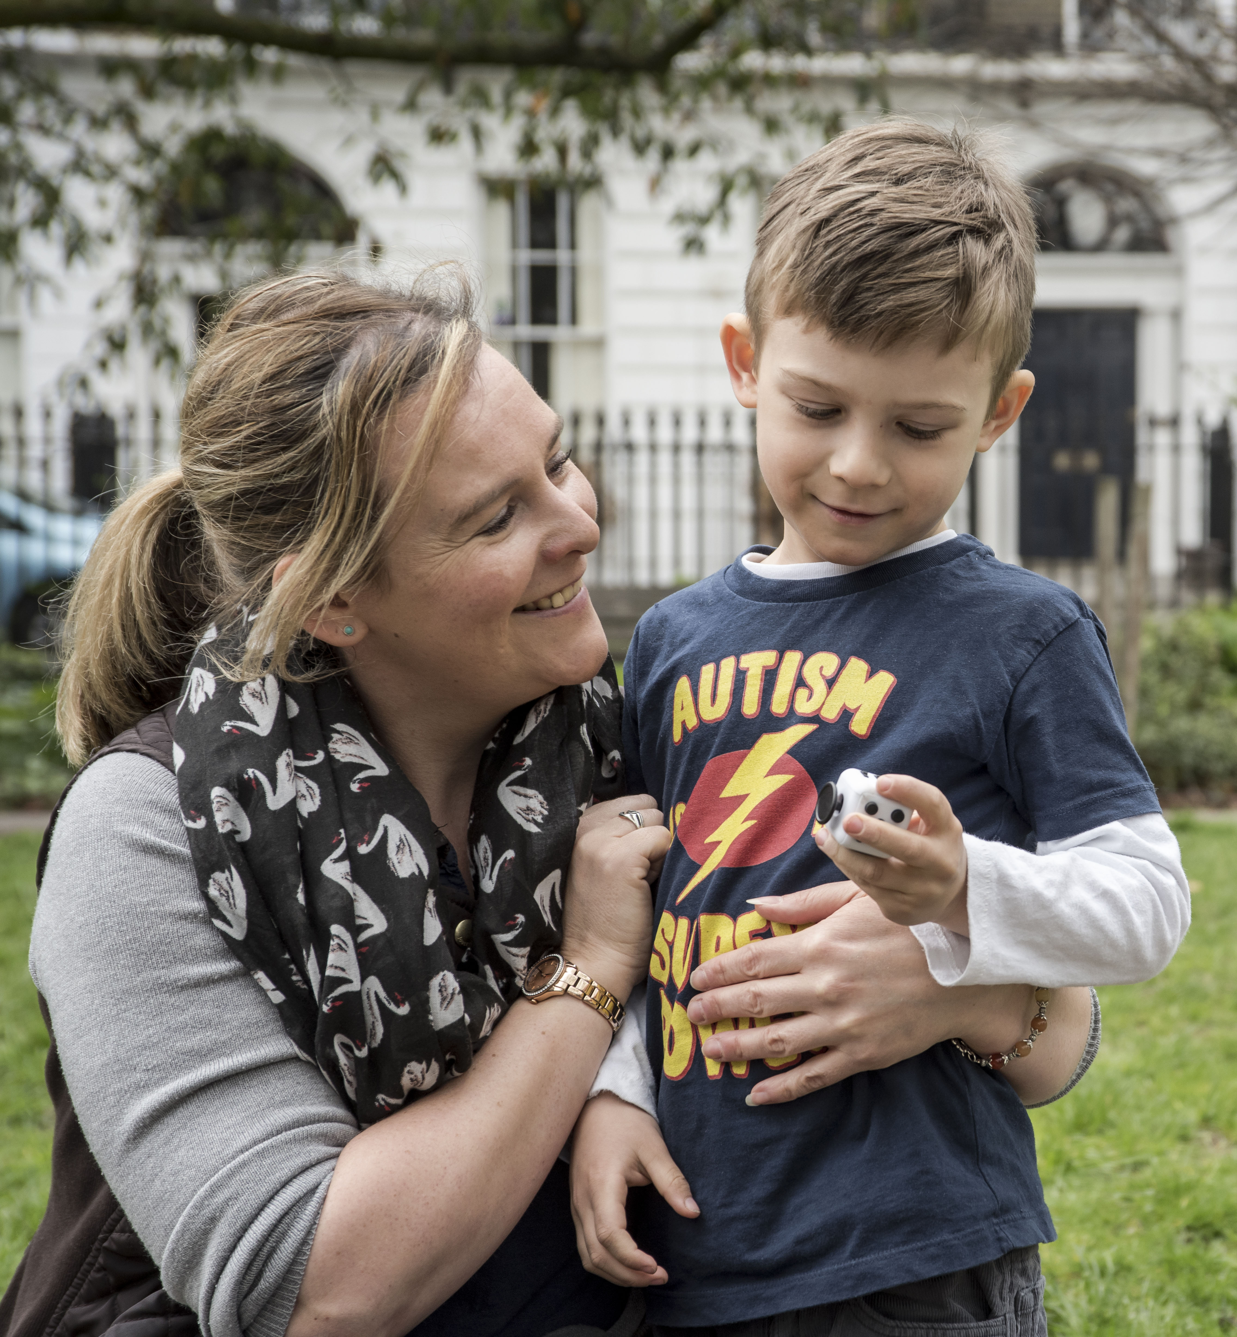
Thank you for listening!

