Slide 1
Our work in 2024-25
Dr Stephen Ladyman
Chair of Trustees

Slide 2
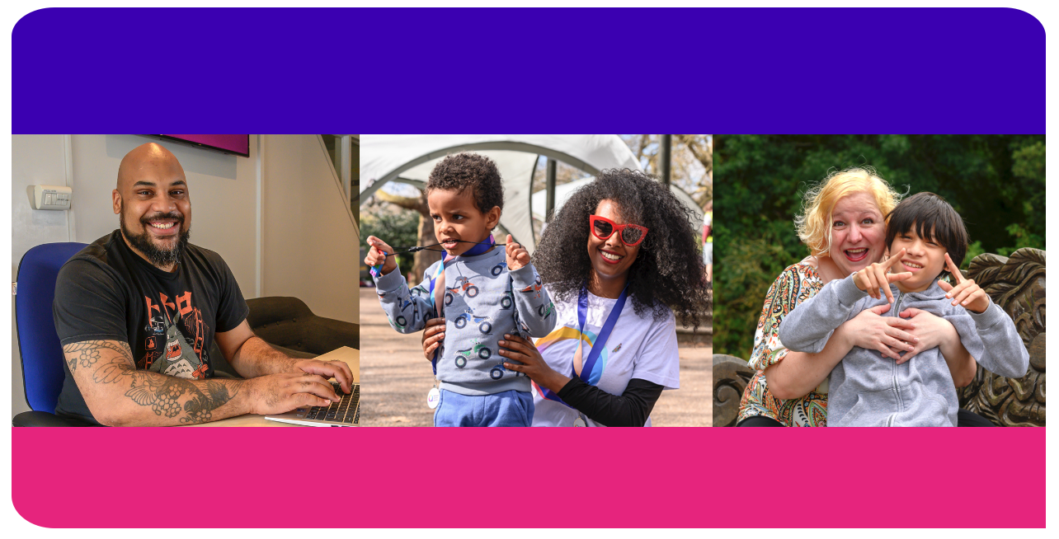
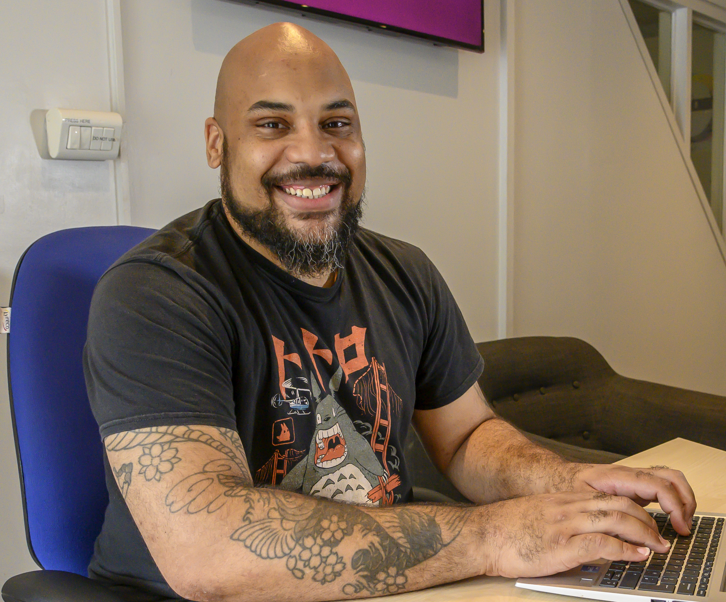
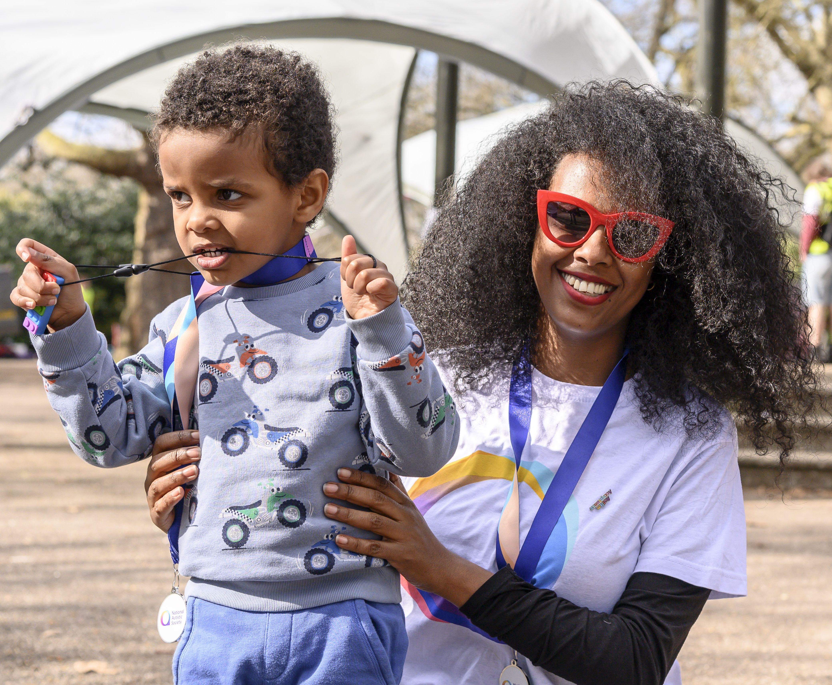
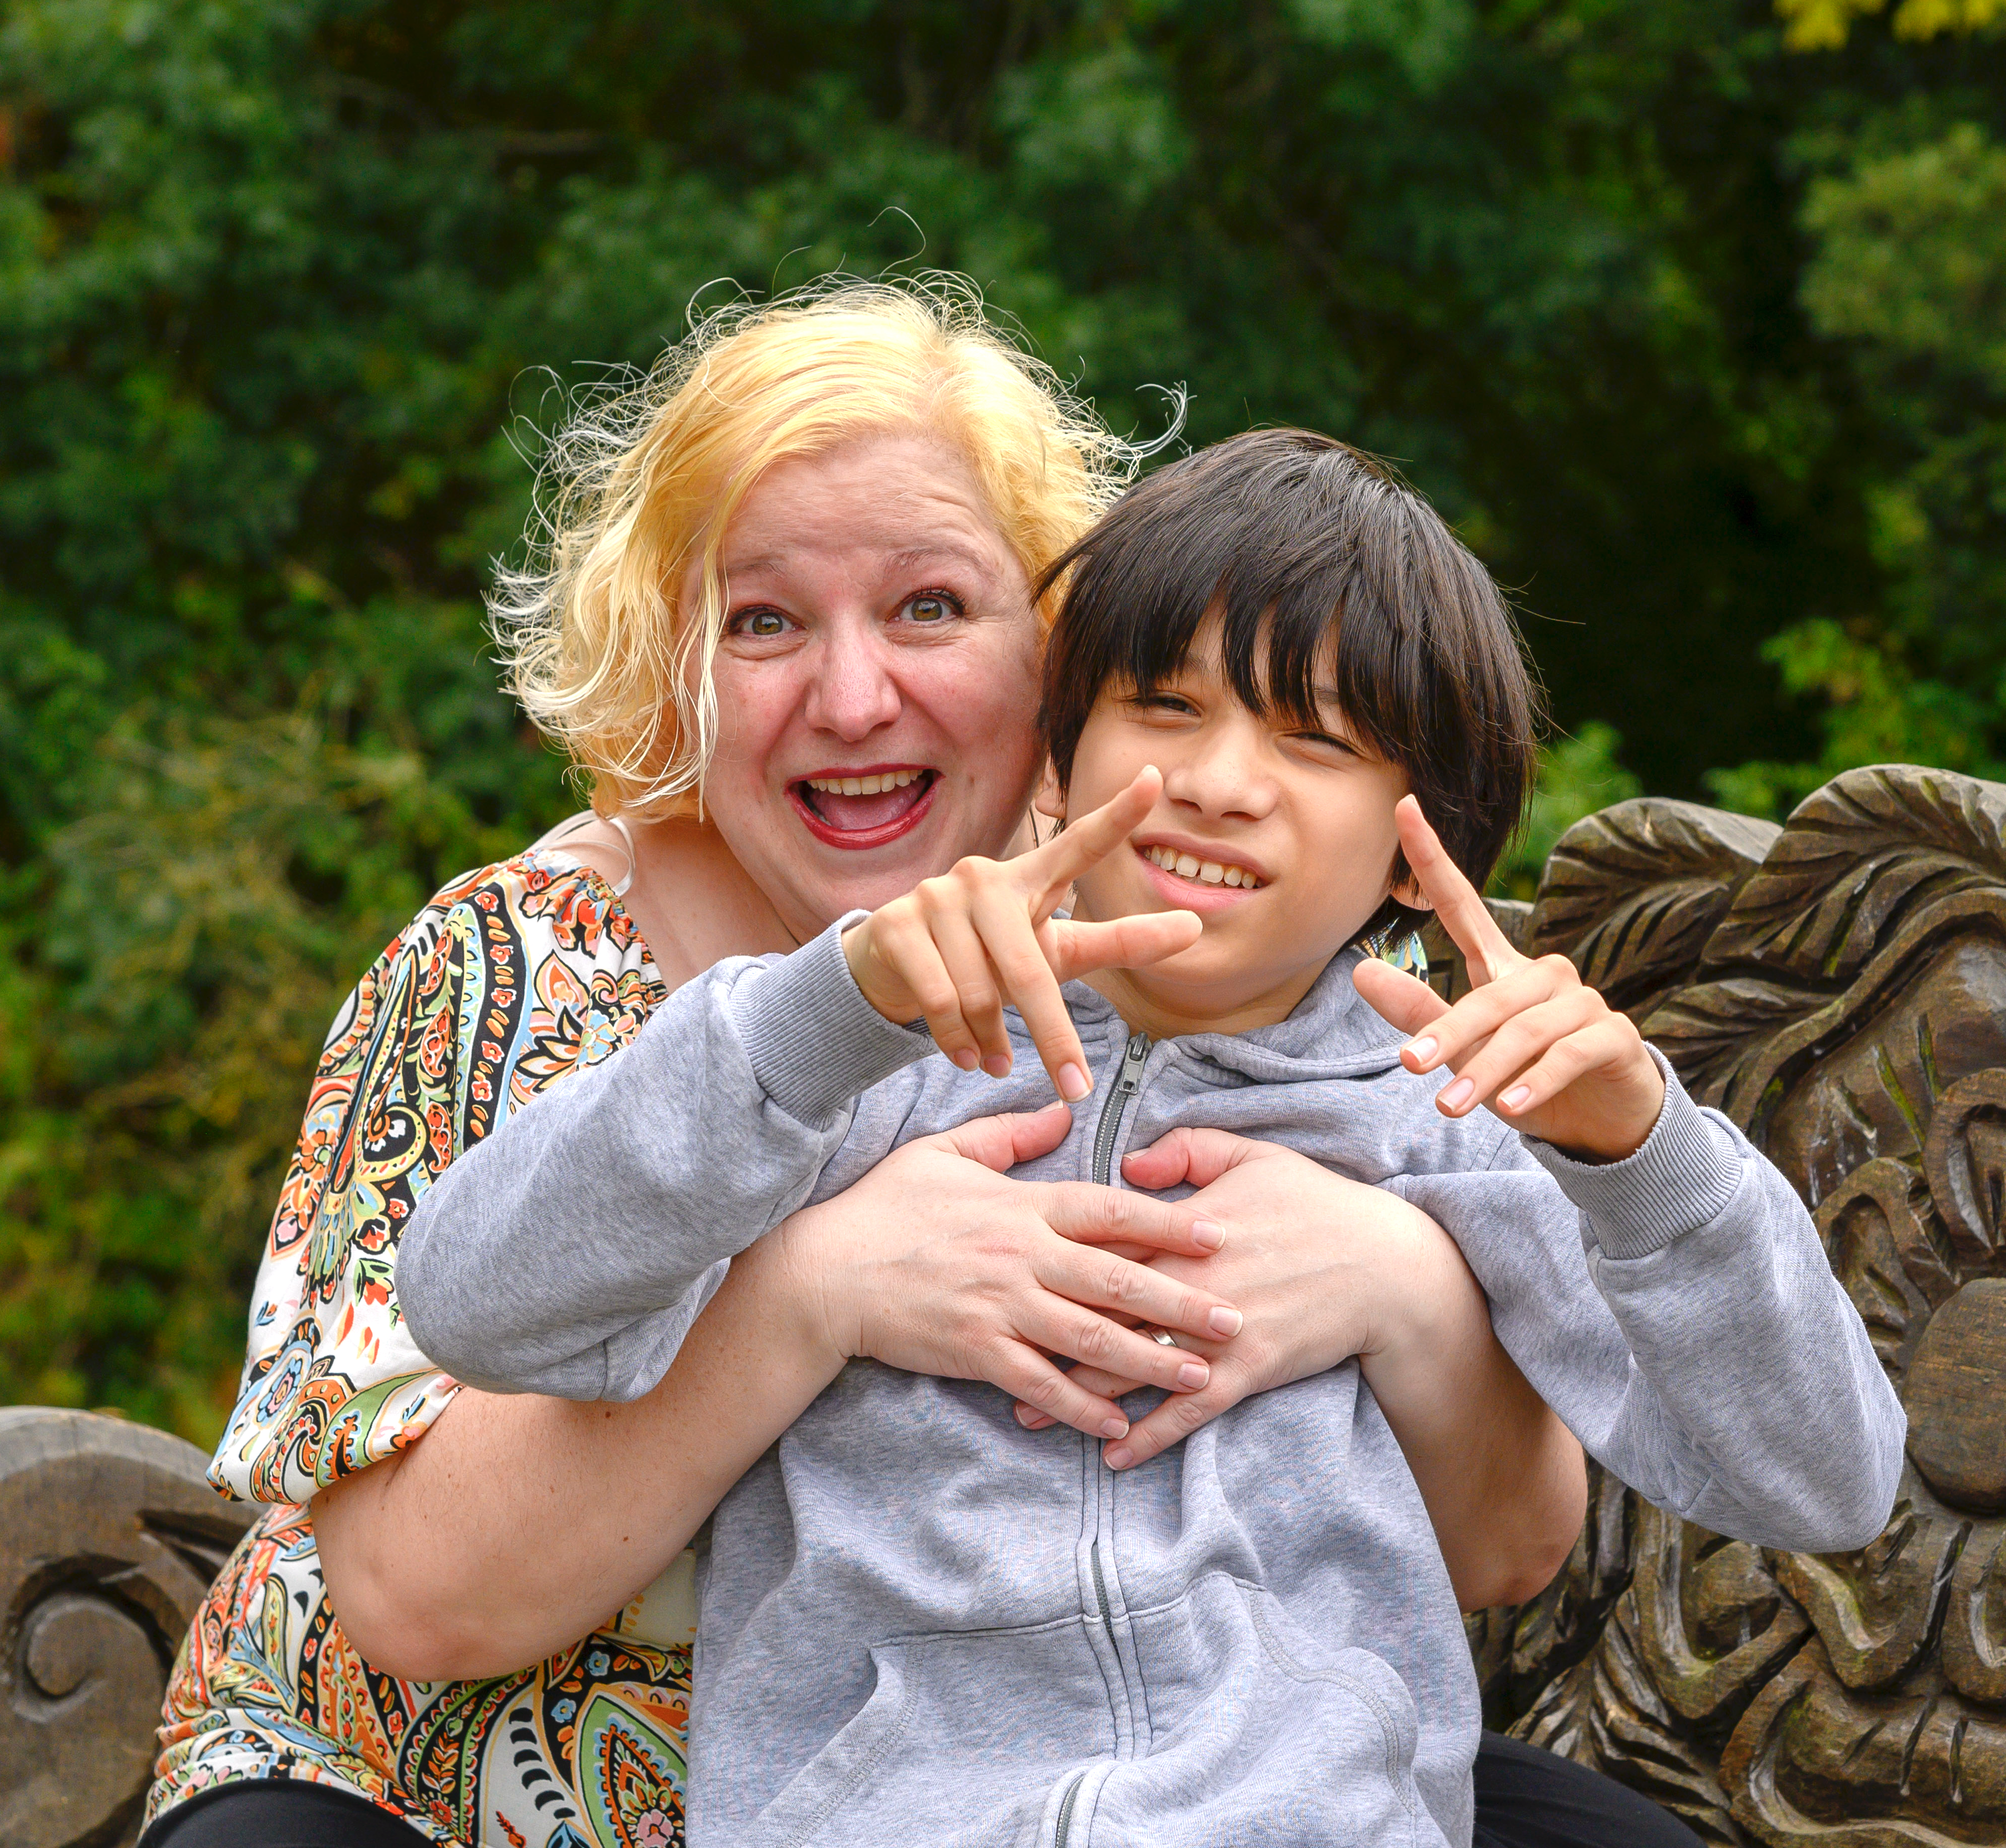
Introduction
2024-25 is the second year of delivering our Vision to Reality strategy to create a society that works for autistic people and their families.
What do we have planned?
Notes:
Thank you to Caroline for summarising our impact over the last financial year.
I’m going to outline our exciting plans for the upcoming year, as we continue delivering our Vision to Reality strategy.

Slide 3

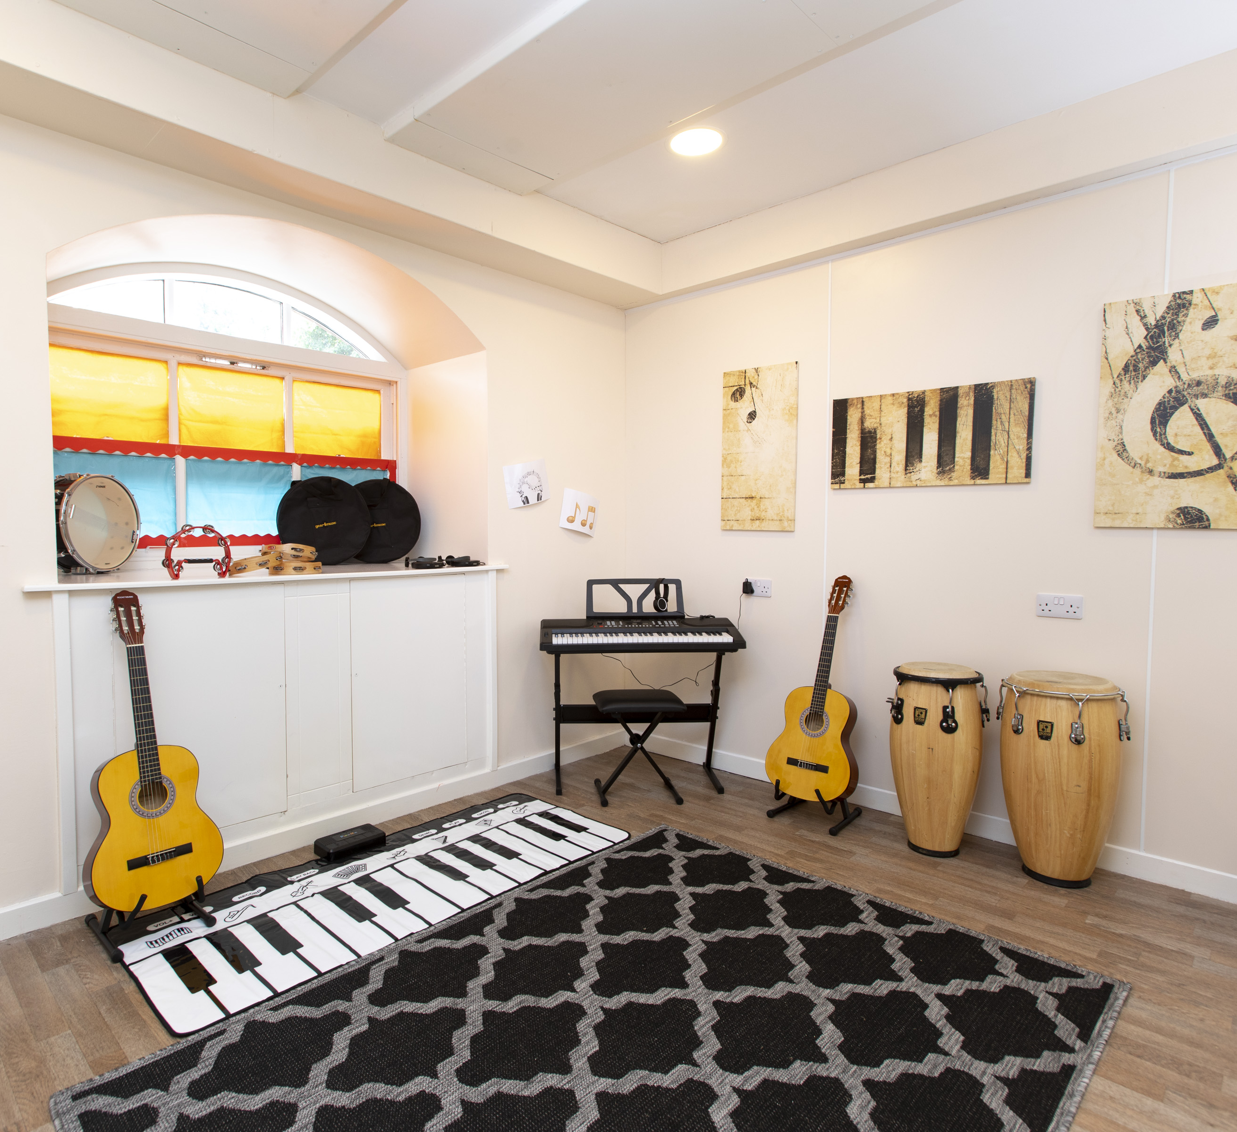
Belief 1: Support
We believe the role of the National Autistic Society is to support all autistic individuals and their families to live a fulfilled life on their terms.
In 2024-25, we:
launched new advice pages on diagnosis including a huge range of new resources
began work on upgrading our Online Community platform
And we plan to:
continue with refurbishments in our adult services
launch newly-revamped areas of our website including a new-look Autism Services Directory and a tool to help people find the right advice for them
launch new advice pages on employment, including a huge range of new resources
increase diagnosis and assessment service capacity
Notes:
To support all autistic individuals and their families to live a fulfilled life on their terms, in 2024-25, we plan to firstly continue with refurbishments in our adult services. In 2023-24, we completed a major refurbishment of Kingsley House in Devon which saw three new flats for the people we support. This renovation programme continues and will see 14 individual self-contained flats with adjoining support staff areas and private outside spaces completed in 2025. Numerous other refurbishment and general improvement works will be delivered across the charity.
We’ll continue to improve our website, with one change being a new-look Autism Services Directory. The Directory offers families an invaluable way of sourcing local support from professionals and services that understand autism. The new, user-friendly design had input from autistic people and makes it easier for businesses to add themselves and keep their listing up to date.
We’ll also launch an upgraded platform for our much-loved Online Community and a tool to help people find the right social care advice for them.
You may have seen our new diagnosis hub on the website. Offering toolkits, video stories and advice, it’s a really important resource to help autistic people and their families navigate this complex and, as we all know, often difficult and lengthy process.
In January 2025, we will launch an employment hub too, with updated advice pages and autistic people’s tips on requesting reasonable adjustments at work. All our advice pages are based on comprehensive evidence reviews carried out by our Autism Knowledge Team. We know they are a vital and trusted source of advice for millions of people who visit our website every year.
We have also agreed investment to develop our diagnostic services. This will increase diagnosis and assessment service capacity at our National Diagnostic Centre (also known as the Lorna Wing Centre).

Slide 4
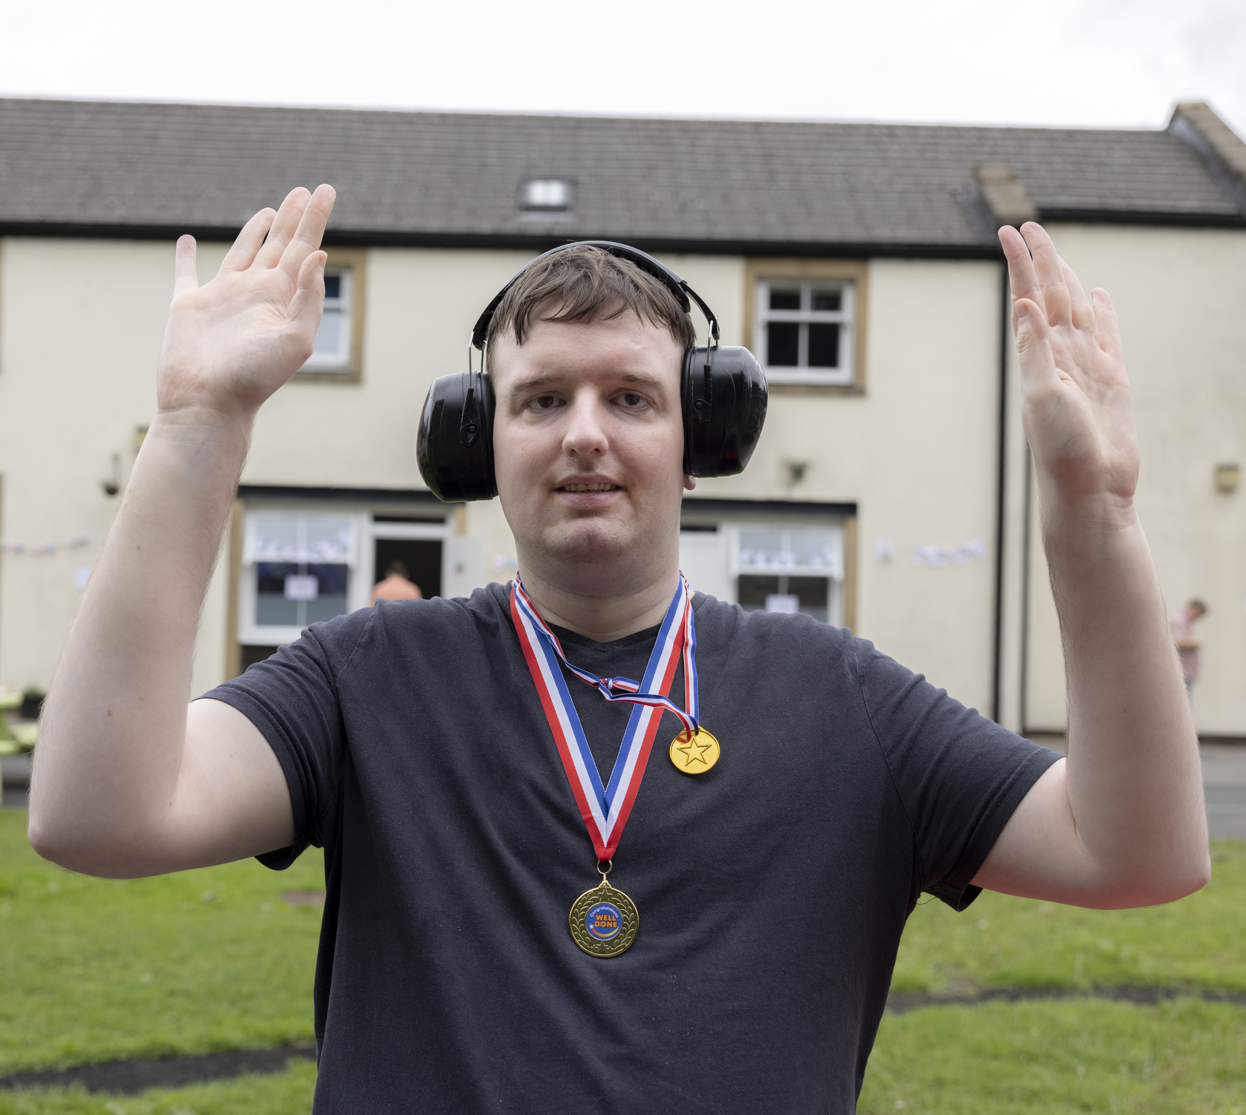
Belief 1: Support
We believe the role of the National Autistic Society is to support all autistic individuals and their families to live a fulfilled life on their terms.
In 2024-25, we:
begin building our new centre in Randalstown in Northern Ireland
And we plan to:
build on the positive evaluation of our Embrace Autism programme in Scotland and deliver it to a further 100 people
develop a peer-support and volunteer strategy which includes branches.
Notes:
We are thrilled that building work has begun on our new autism centre in Randalstown in Northern Ireland. Like our state-of-the-art Belfast Centre, it will offer a mix of daytime activities and family support. In Northern Ireland, we also plan to train other organisations to deliver our Skills for Life programme to help more autistic young people to develop skills for independence. We also want to expand the number of parent support branches in Northern Ireland.
In Scotland, we will deliver our successful Embrace Autism programme to more people. It’s for autistic adults who have been recently diagnosed and are looking to explore their autistic identity. The groups connect autistic adults, creating peer-support networks that last well beyond the programme.
Lastly, we are developing a new peer-support and volunteer strategy which will include our branches.

Slide 5
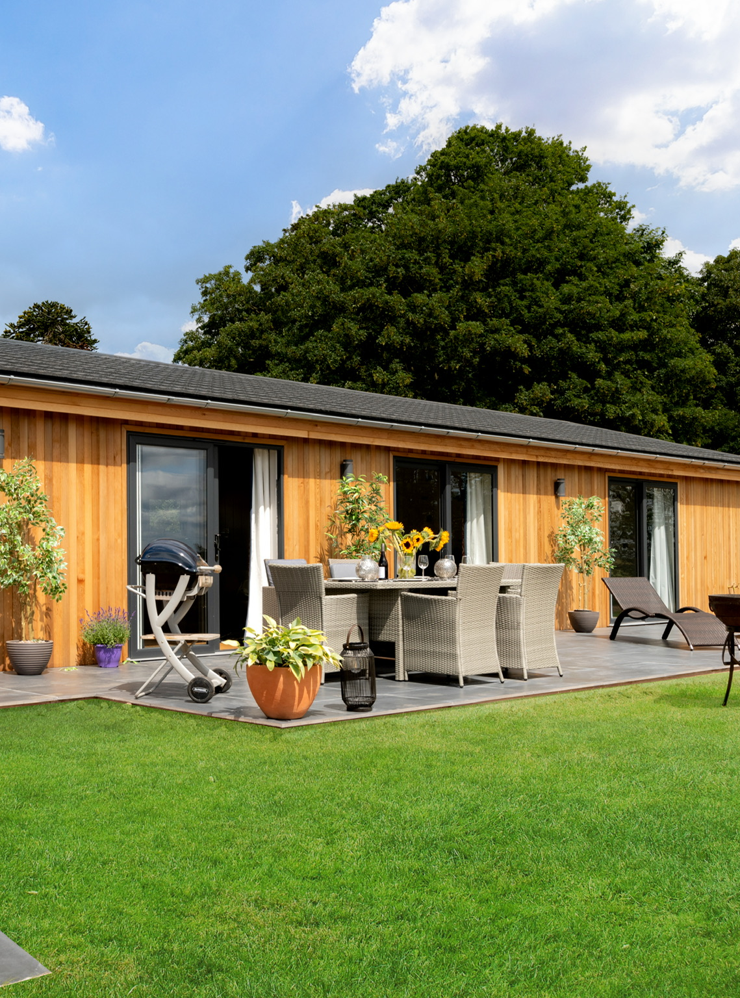

Belief 2: Influence
We believe the role of the National Autistic Society is to influence and collaborate with others to improve standards and adjustments.
In 2024-25, we:
began to grow our work in Autism Know How (our work with upskilling professionals and employers on their autism knowledge, skills and good practice)
And we plan to:
research experiences of autistic people on public transport with funding from Motability
launch and promote the Autism Friendly Award for businesses in Scotland.
Notes:
It’s essential that we work with other professionals to improve standards in society. Our Autism Know How team trains thousands of professionals in understanding autism every year and this work is so vital because it leads to changes at school, in hospitals and in social care. In 2024-25, we plan to invest in our Autism Know How services to position the department for growth in both income and reach. We will undertake an impact evaluation study; ensure meaningful co-production with autistic people in product development and delivery; upgrade our training materials and develop new products for emerging sectors.
With funding from Motability, we are already researching autistic people’s experiences on public transport. The aim of the project is to fully understand the barriers that autistic people face in getting from A to B, and to identify workable solutions.
We also plan to launch and promote our Autism Friendly Award in Scotland. This award supports organisations of all sizes to provide an autism-friendly environment and inclusive customer service. And pictured here is one of the holiday companies which has earned the award and now offers a fabulous experience to autistic holidaymakers.

Slide 6
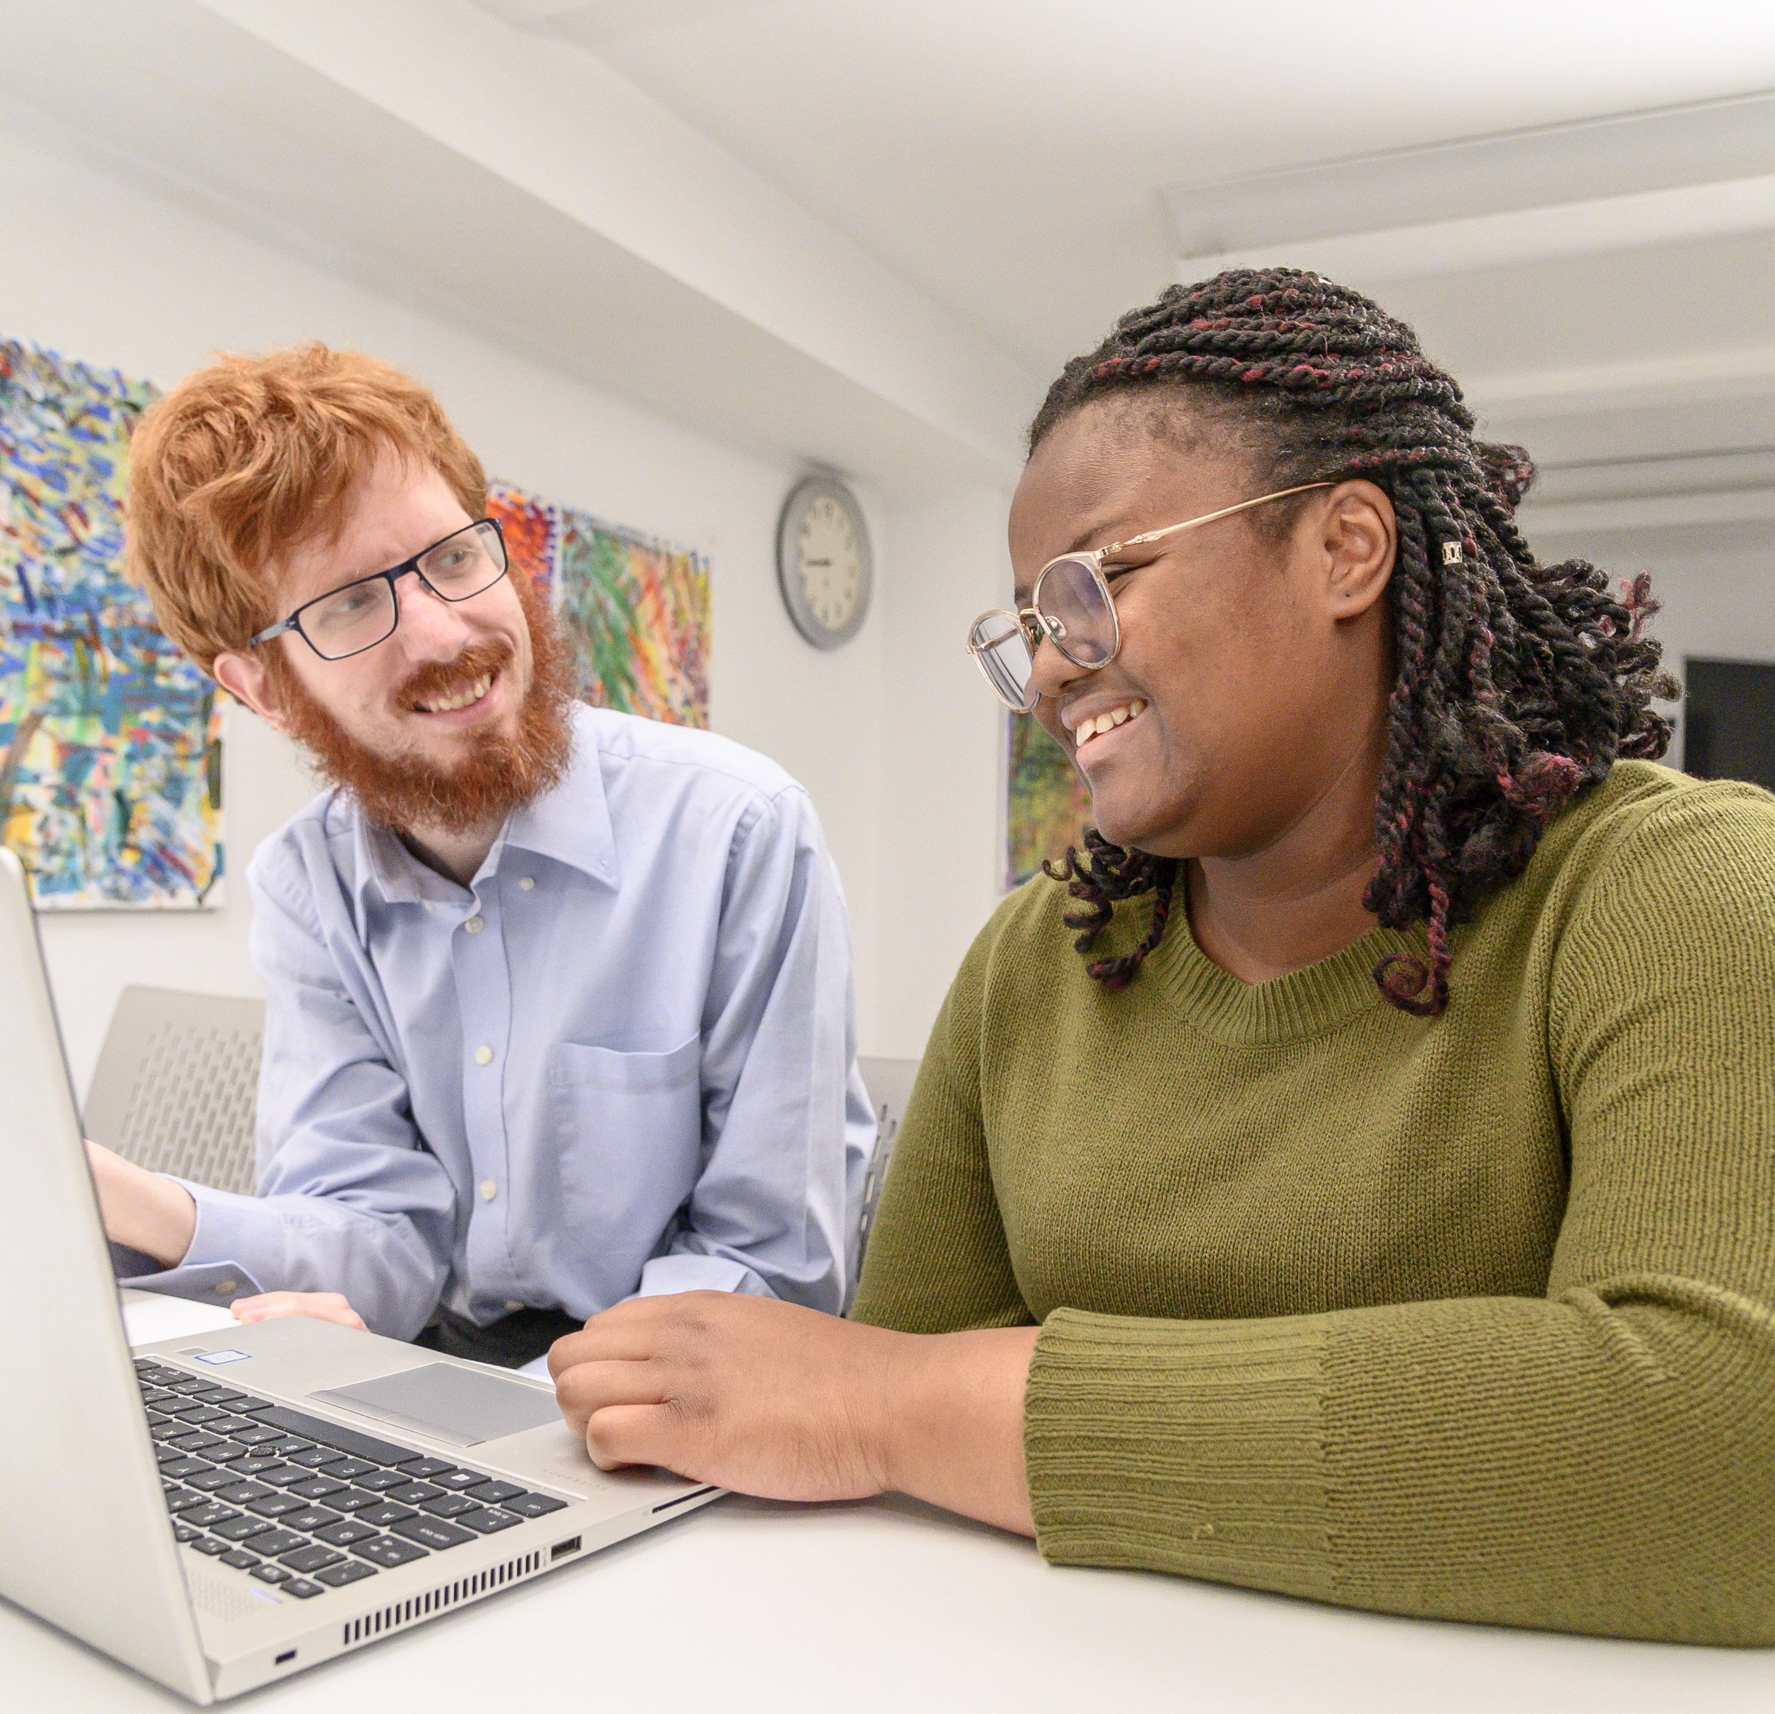
Belief 2: Influence
We believe the role of the National Autistic Society is to influence and collaborate with others to improve standards and adjustments.
In 2024-25, we:
have begun to publicise our new Inclusive Employer Award to encourage employers to sign up
And we plan to:
promote good practice case studies of inclusive employers
increase delivery of employment training and consultancy.
Notes:
We know that employment is a crucial area to improve for autistic people who want to work. Our new Inclusive Employer Award aims to encourage more businesses to welcome and support autistic employees. In 2024-25, we plan to promote it to get as many employers signed up as possible.
We’re also going to promote good practice case studies of inclusive employers - showing what works for autistic employees, both to recruit them and keep them in work.
Finally, we’re going to do more training and consultancy with employers to deliver increased autism awareness and support for autistic employees.

Slide 7
Belief 3: Transform
We believe the role of the National Autistic Society is to transform society by building understanding, acceptance and respect for all autistic people.
In 2024-25, we:
had a garden at the RHS Chelsea Flower Show, funded by Project Giving Back, to raise awareness of the autistic strategy of masking
conducted research with autistic people and the public about public understanding and acceptance of autism, to lay the foundations for a public awareness campaign in April 2025
And we plan to:
shift the focus of future World Autism Acceptance Weeks to World Autism Acceptance Month (from April 2025)
Notes:
The role of the National Autistic Society is also to transform society by building understanding, acceptance and respect for all autistic people.
We’ve already had our garden at the Chelsea Flower Show, to raise awareness of masking. This was a great success, winning a silver gilt medal and featuring in more than 250 items of media coverage, with a combined reach of more than 7.3 million.
In October 2024, we announced that World Autism Acceptance Week is becoming World Autism Acceptance Month from April 2025. This will enable us to do so much more in terms of increasing autism awareness in local communities, at school and at work. We’ll also be running a big campaign at this time around public understanding of autism, and have carried out research with autistic people to lay the foundations for this.

Slide 8
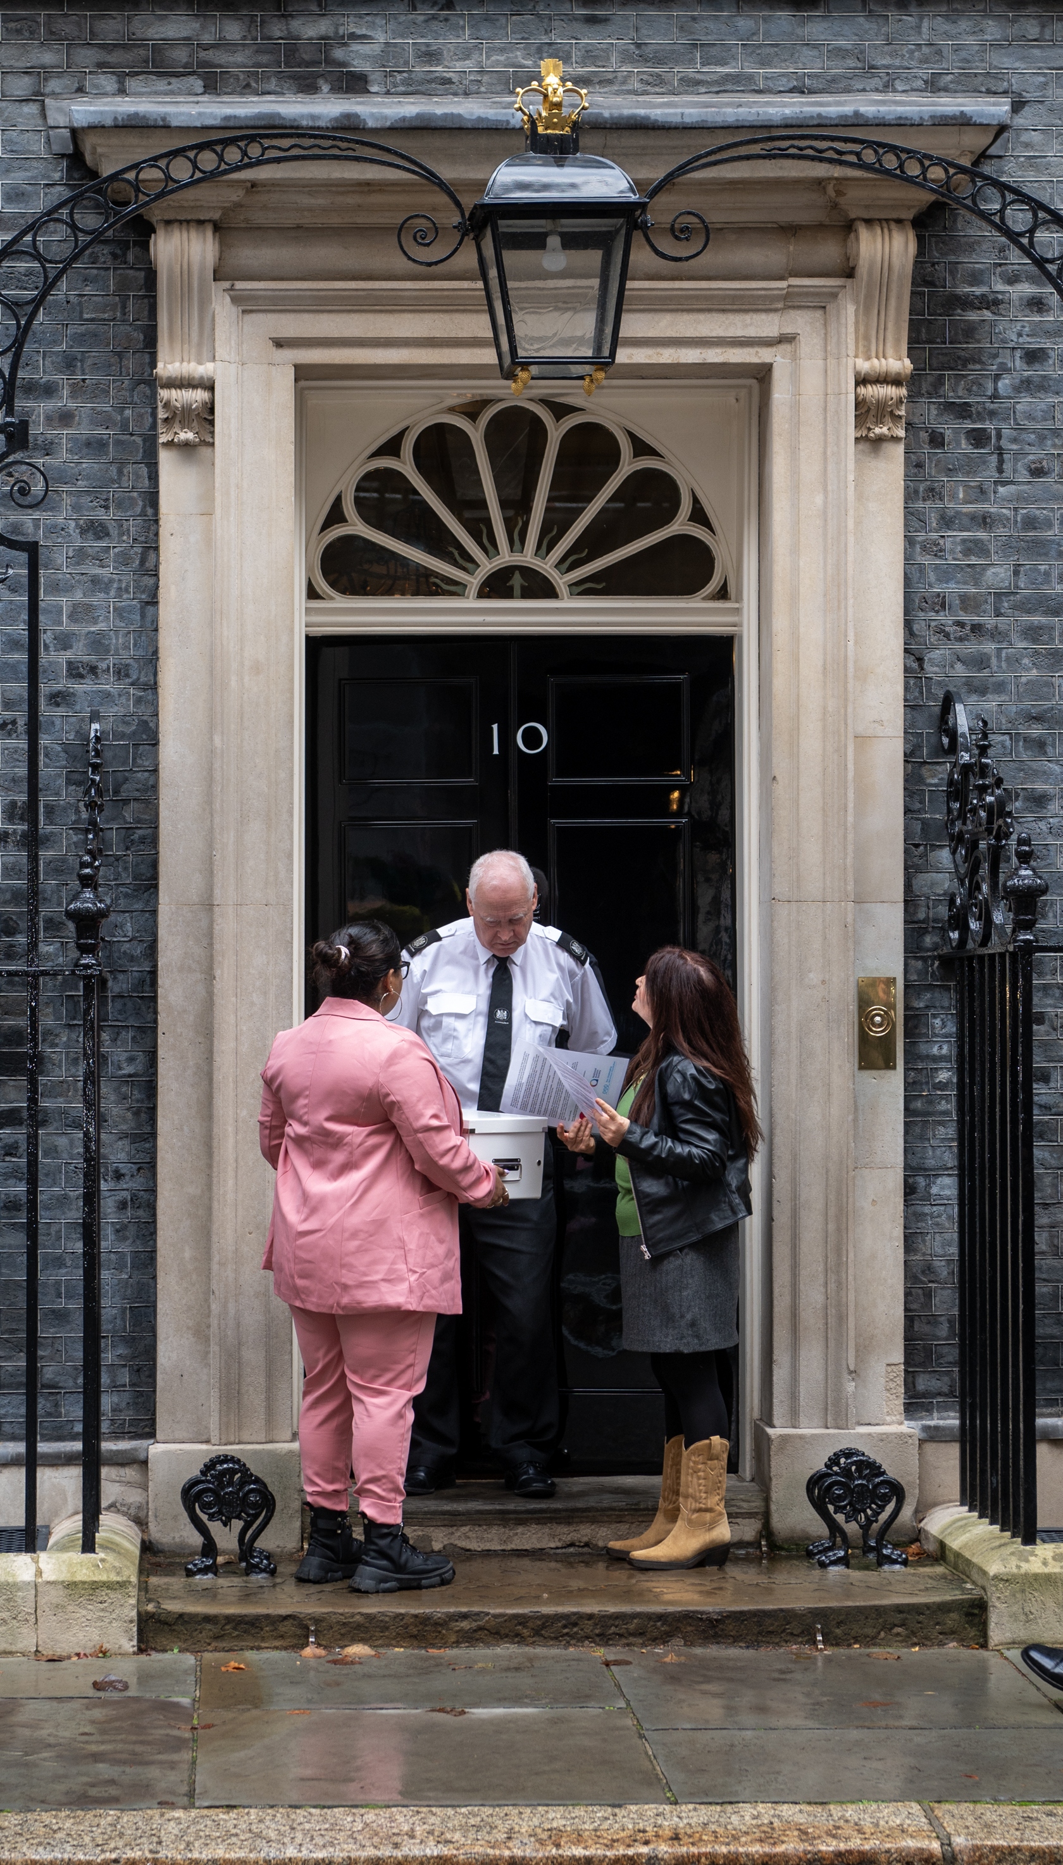
Belief 3: Transform
We believe the role of the National Autistic Society is to transform society by building understanding, acceptance and respect for all autistic people.
In 2024-25, we plan to:
partner with other neurodiversity charities to put pressure on the Government to commission a new prevalence study
launch a UK-wide campaign to tackle long autism diagnosis waits
Secure autistic people's rights in a new Mental Health Act
launch a project focusing on diversity and barriers to support
develop an autism knowledge strategy
develop and relaunch our Autism Insight Panel
continue to develop and empower our volunteer branches to build and grow support around our vision in their local communities.
Notes:
We plan to partner with other neurodiversity charities to pressure the Government to commission a new prevalence of autism study, which is long overdue. This is absolutely essential to planwhat autistic people need over the coming years.
With waiting lists for autism assessments at an all-time high, we will launch a UK-wide campaign to tackle long autism diagnosis waits.
And we’re going to launch a project focusing on diversity and barriers to support; develop an autism knowledge strategy, relaunch our Autism Insight Panel and continue to empower our branches to build support around our vision in their local communities.

Slide 9
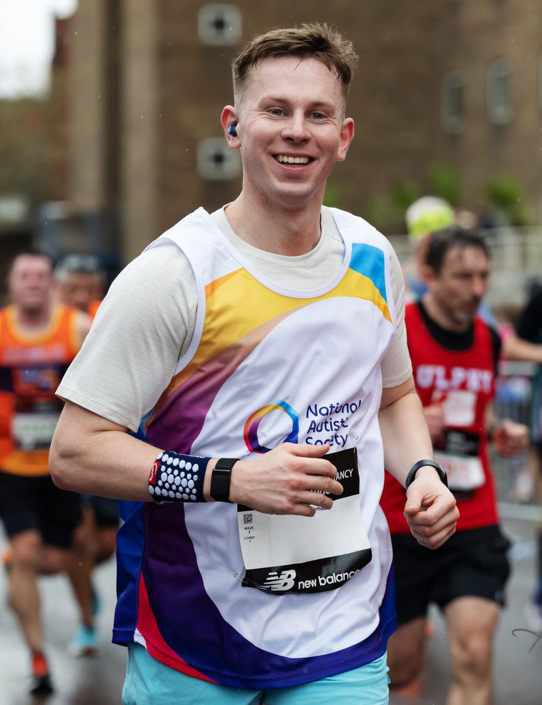
Strong foundations
Building strong foundations to help deliver our ambitions
In 2024-25, in Fundraising, we plan to:
continue to improve our supporter experience
reach new audiences and grow our support base
deliver new rewarding fundraising offers
do more of what works well
Notes:
In Fundraising, we are going to concentrate on ensuring we are giving our supporters the best possible experience. This will include more relevant and timely communications from us, more engaging and personalised thanking, and faster responses from us across the board.
We’re going to innovate and deliver new rewarding fundraising offers; ensuring we have opportunities for supporters to donate or fundraise for us in ways that work for them.
And we’re going to do more of what works well. Where we have fundraising initiatives that work well, we will invest to expand or make these even better. An example is our 100 Miles in October challenge which is enormously popular and growing year on year.

Slide 10

Strong foundations
What we have done in Membership:
kicked off a new series of members-only webinars. The first took place in August and featured exclusive updates and insight from Sophie Parmenter and Dido Milne, who designed our RHS Chelsea Flower Show garden.
begun research on a new online space for members to discuss issues and offer advice and support to one another.
What we are doing next in 2024-25:
scheduling and planning for further webinars
developing a suite of resources to empower members to campaign and enact change in their local communities
further research into online solutions.
Any questions, please reach out to the team on membership@nas.org.uk.
Notes:
Of course, we can’t do any of this unless we have strong foundations underpinning our charity. As members, you are an especially valued part of our supporter base, one which plays a vital role in the pursuit of our charity’s vision.
Following extensive research and feedback from a large sample of our members, we have been working on developing the membership package.
As a starting point, we’ve launched a new series of members-only webinars and are planning more throughout 2025, featuring exclusive updates and insight from across our charity.
We’ve also started to research a new online space for members to discuss issues and share practical advice, and we are also looking into developing a suite of resources for members who are interested in local campaigning.
This work will continue over the coming year.

Slide 11
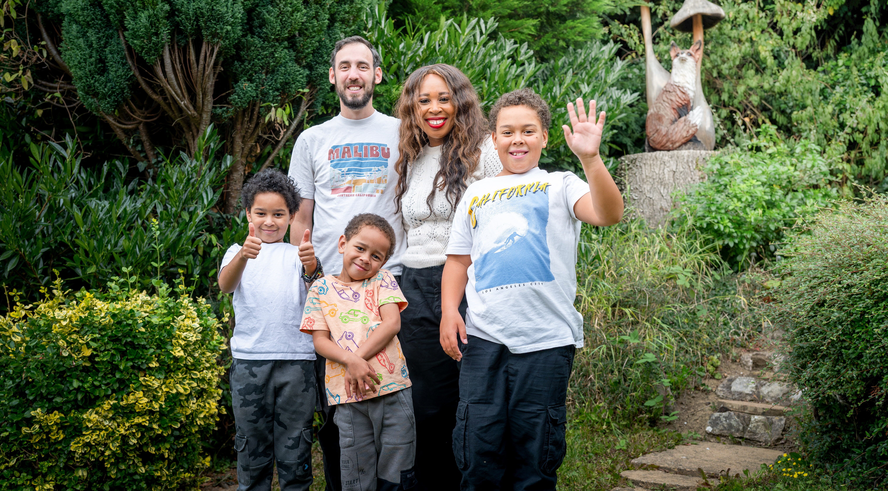

Thank you
Notes:
These are just some of our plans for 2024-25 – believe it or not, we are working on a lot more than I can fit into my presentation today.
I’d like to say a heartfelt thank you to our amazing staff and volunteers for all your hard work and commitment - I’m excited to work with you during the next year to deliver these ambitious plans.
And to you, our members. Thank you for being an essential part of our journey to deliver our Vision to Reality strategy and create a society that works for autistic people. Your ongoing support is valued and appreciated by me and all of us at the National Autistic Society. Thank you.

