Slide 1
It’s How You Show Up campaign
Chrystyna Chymera-Holloway Assistant Director, Communications, Marketing and Support

Slide 2
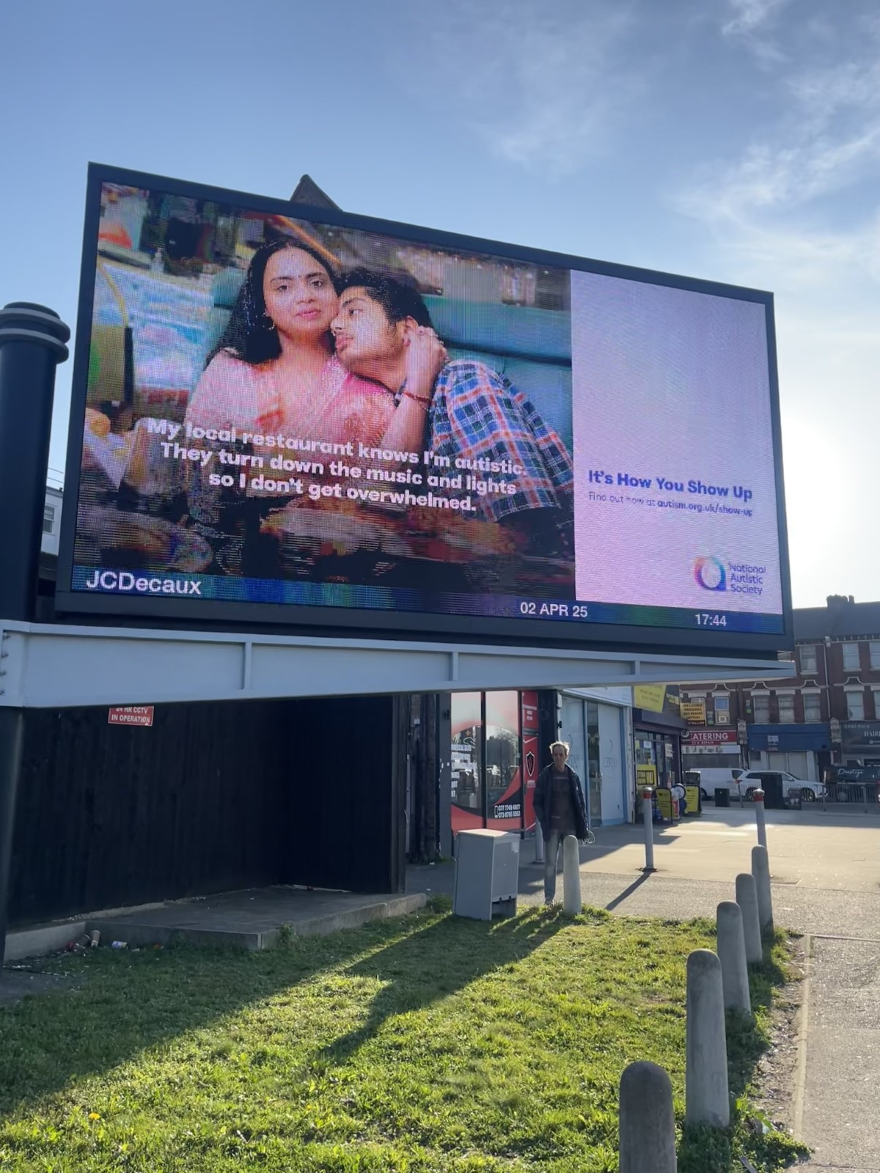
What is it?
A campaign that launched in April 2025
The campaign aims to:
Raise awareness of autism through an advertising campaign
Feature one main campaign film
Encourage people to make a public pledge to show how they will show up for autistic people
Engage MPs with the campaign.
This is a three year project with activity through the year and big moments in April 2025, 2026 and 2027.
Autistic steering groups and research.
Notes:
Core to our strategy Belief 3 which is about changing understanding of and aptitudes towards autistic people
Steering group, survey, public focus groups

Slide 3
Why?
25% of autistic people said they usually get a negative reaction when they say they are autistic
90% have experienced poor mental health due to attitudes or perceptions of autism
84% have experienced social isolation
But there is hope...
62% of UK adults said they want to learn how to help autistic people feel more accepted
My bad experiences have meant that I am afraid to go out or interact with anyone in public
Be patient and give me time to process my reactions.
Be understanding and kind
Reassure me that they aren’t judging and want to help
Notes:
Survey of around 9000 people – parents and autistic ppl
You gov public poll and focus groups
People wanted simple changes to attitudes and understanding

Slide 4
Our key message
For each autistic person you interact with, even the simplest day-to-day gestures of support can make a huge difference. How you take little steps to understand our experiences. How you make time for us to process and space for us to regulate. Shift your expectations of us and make it clear that that’s ok. Advocate for us in the workplace and the world, step by step. It’s the way the cumulative effect of these interactions can transform our capacity to move through what can be a uniquely challenging life. Because for every autistic person…
IT’S HOW YOU SHOW UP
Notes:
The campaign is about telling ppl you don't need to be an autism expert, you just need kindness, empathy and to be prepared to change your own attitudes and behaviors, take simple actions, every day to help create a society that works for autistic people.

Slide 5
Our film

Slide 6
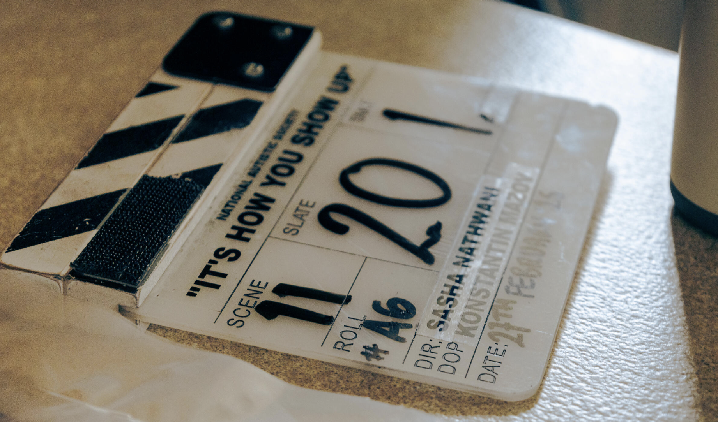
Notes:
The film was core to the campaign, the main story we're sharing. It is routed in real experiences of autistic people, though the script is fictional.

Slide 7
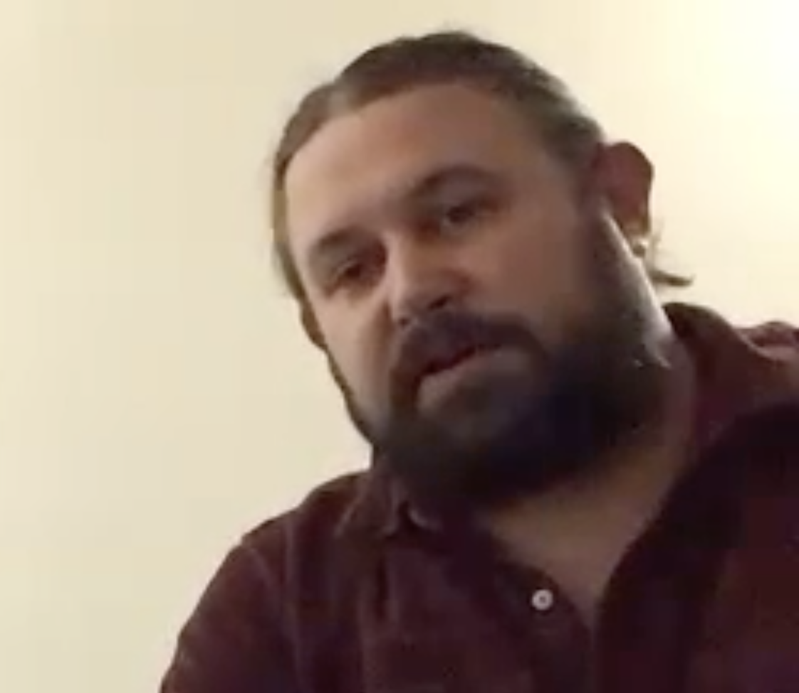
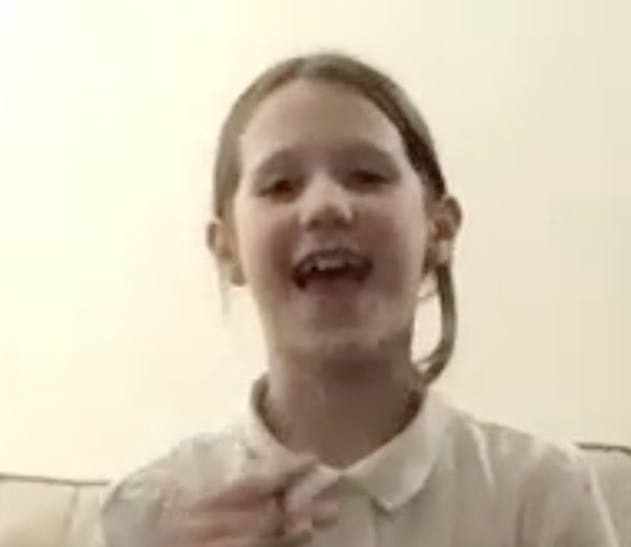
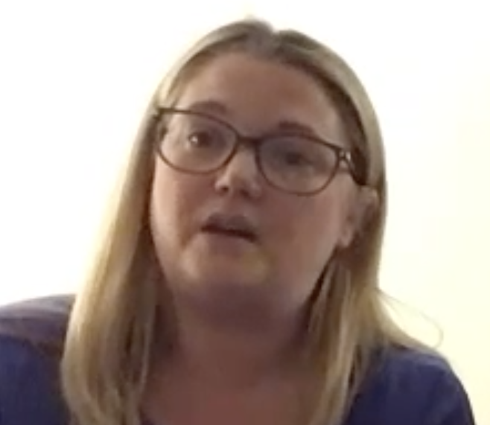
The Wakeman Family
Chris
Penny
Katie
Notes:
The production company we used helped us find a lovely northern family, dad and daughter both autistic, real people, not actors. You will hear from them a bit later.

Slide 8
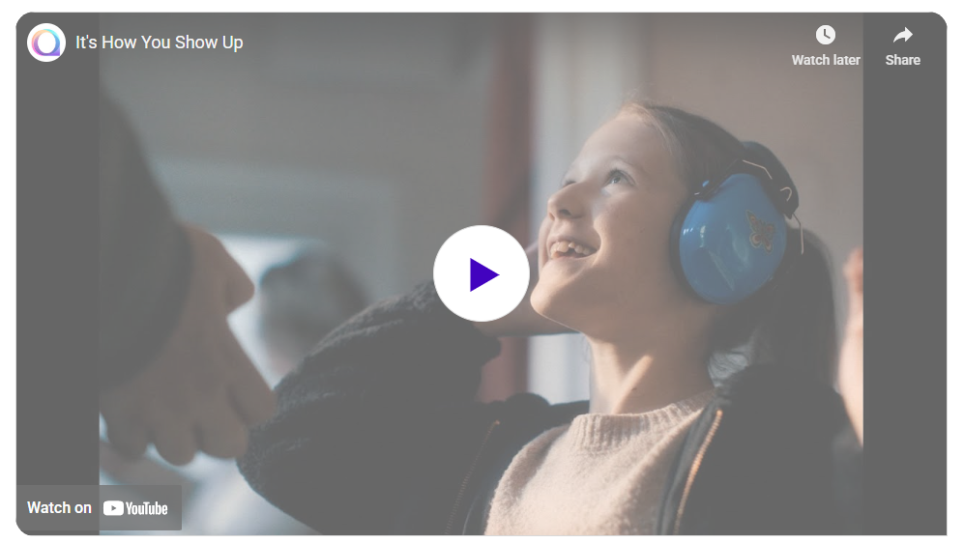

Slide 9
EMBED FILM
Adverts

Slide 10
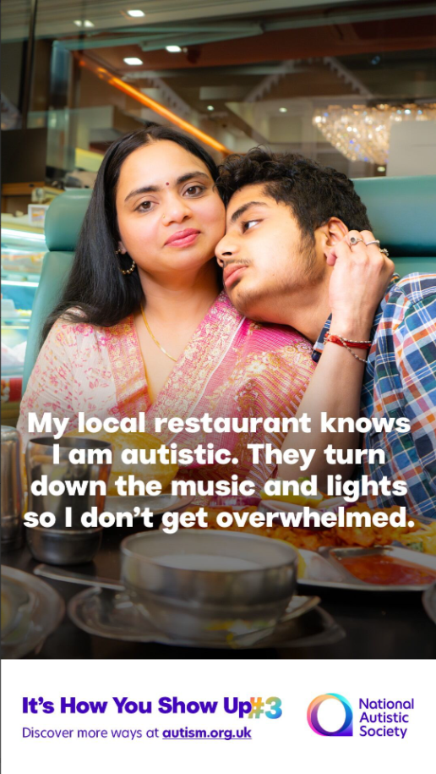
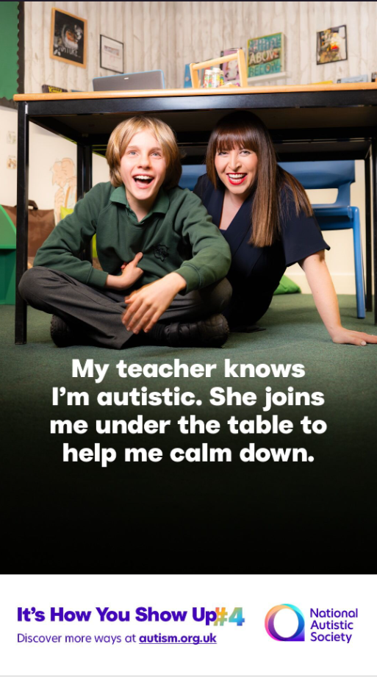
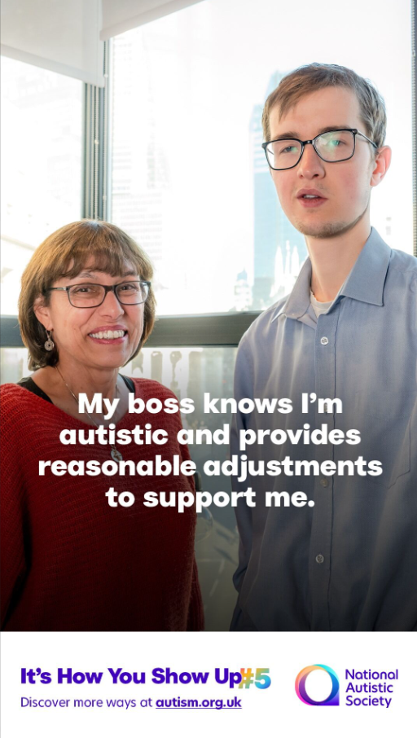

Slide 11
EMBED FILM
Pledge wall

Slide 12
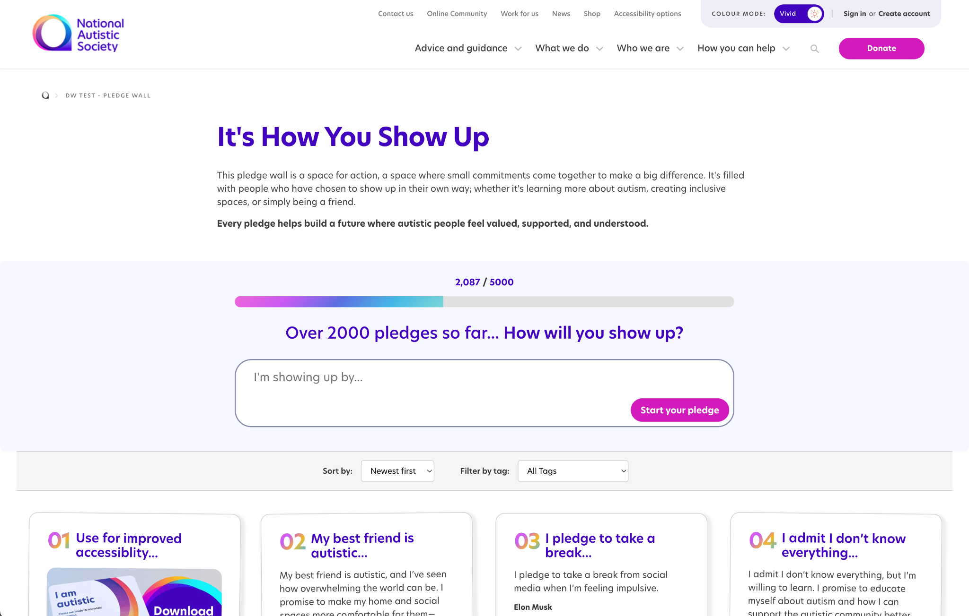
Notes:
We had a digital pledge wall where we encouraged people to come and tell us how they will show up, or how someone showed up for them. People are still adding pledges now. It's a really heartwarming reminder of all the good in the world.

Slide 13
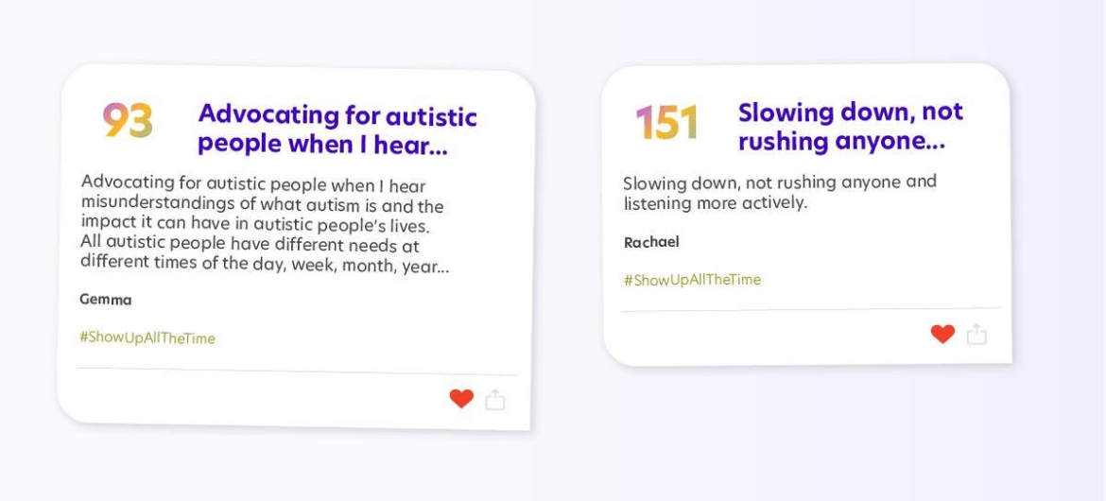
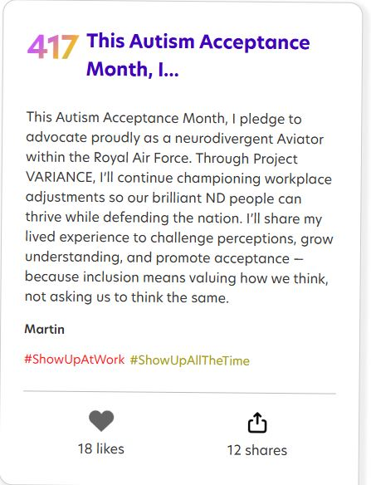
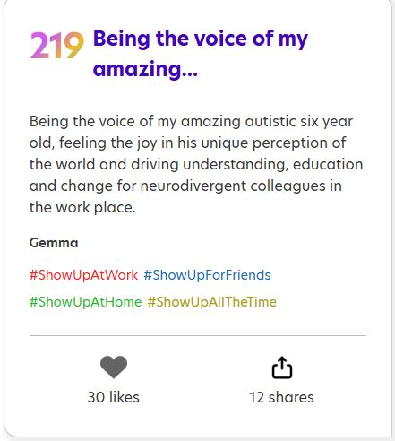
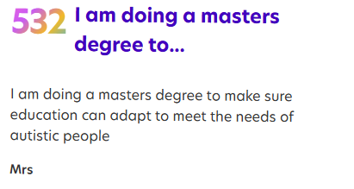
www.autism.org.uk/pledge
Notes:
Here are some examples of some of the pledges www.autism.org.uk/pledge

Slide 14
Headlines:
Total film views in April over 1.5 million combined
1575 people invited their MP and 11 MP's attended training
Total web page visits 5555
5892 supporters and 1817 professionals were added to our databases in April alone – over half the Q1 target
Of these almost 500 pledged on our campaign wall.
PR reach of 1.1 million
In addition, we had an extraordinary volume of very positive and supportive comments on social media and sent via email. Comments on our pledge wall were also very thoughtful and inspiring. We have shared some of these on slide 5.
How did it go?

Slide 15
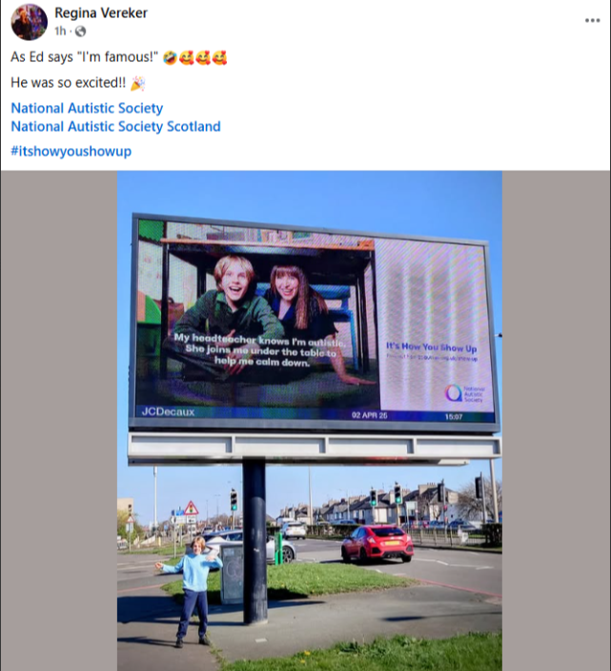
April 2025 results
Headlines:
Total film views in April over 1.5 million combined
Total web page visits 5555
5892 new supporters and 1817 new professionals registered with us
Of these almost 500 pledged on our campaign wall.
PR reach of 1.1 million
1575 people invited their MP and 11 MP's attended training
In addition, we had an extraordinary volume of very positive and supportive comments on social media and sent via email. Comments on our pledge wall were also very thoughtful and inspiring.
Notes:
Just to give you the main results from the very first month of the campaign. We are also doing long term analysis in understanding and attitudes towards autism – it's too early to be able to report on those though.

Slide 16
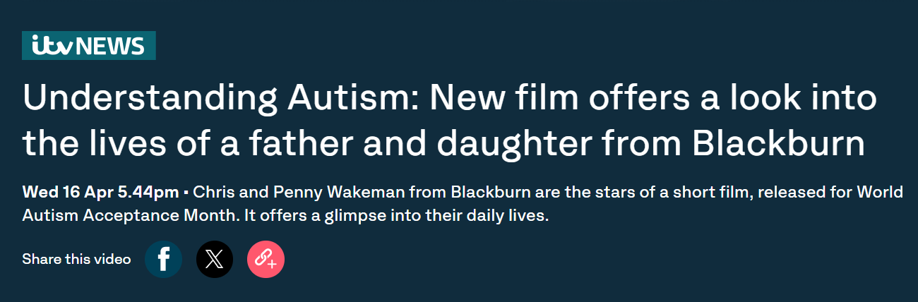

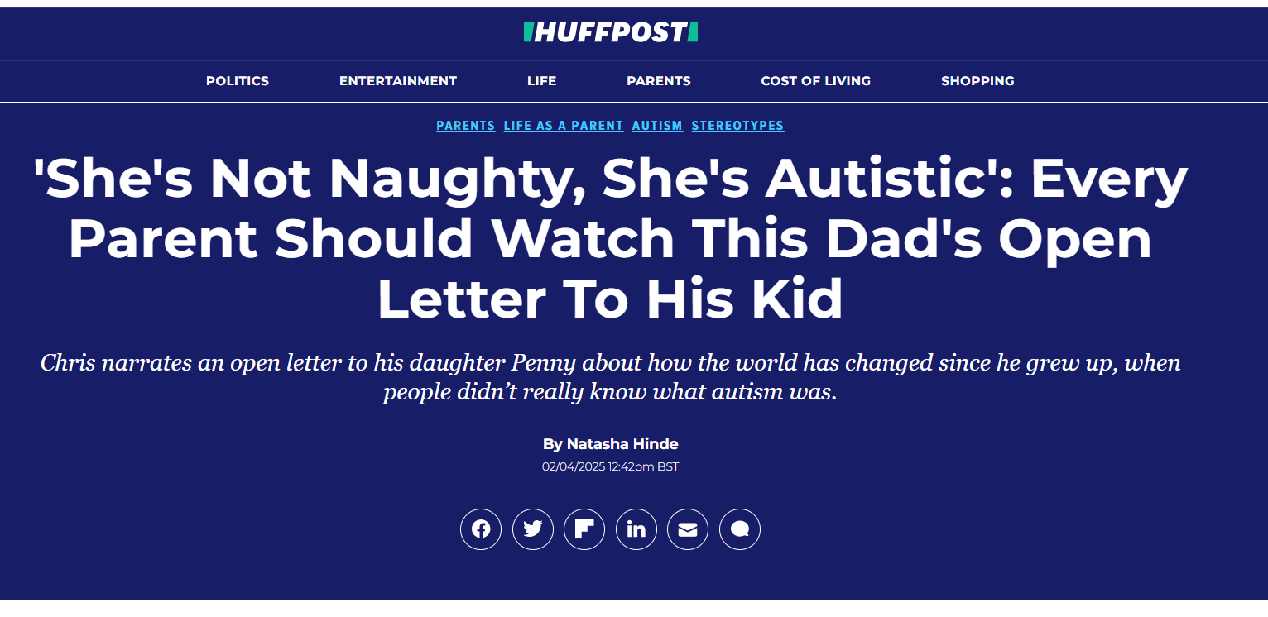
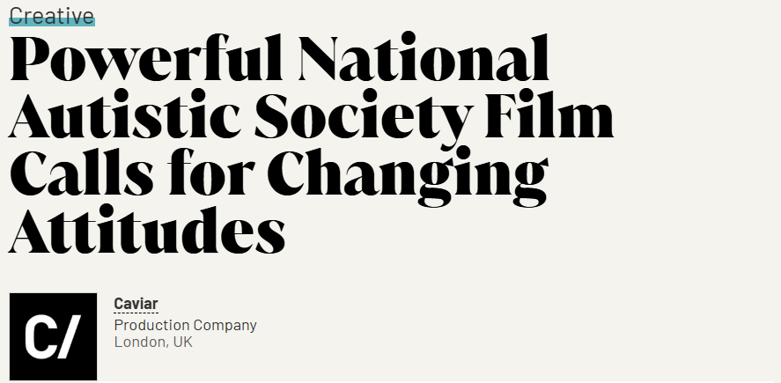

PR/Media performance continued
Top performing outlets
ITV News Online - Reach: 5 million
Huffington Post - Reach: 386,000
Little Black Book - Reach: 209,000

Slide 17
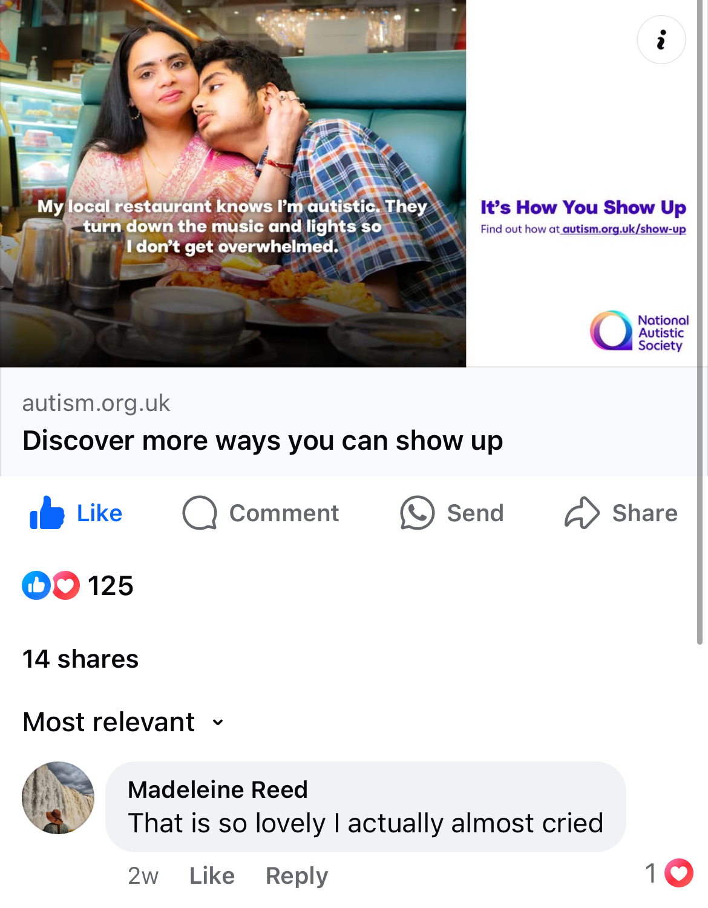
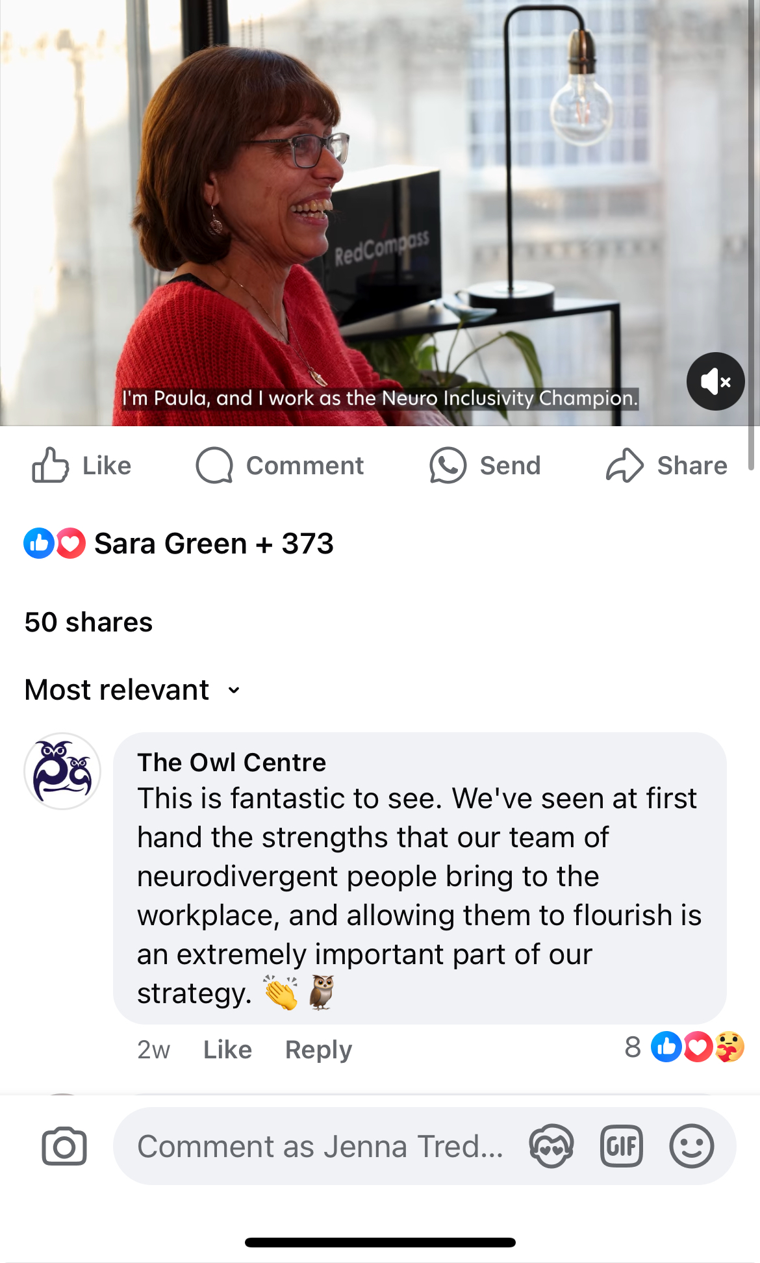
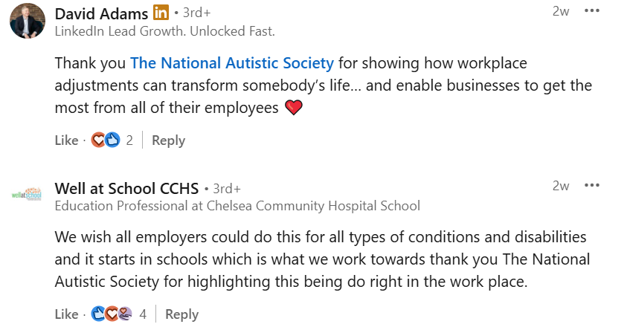
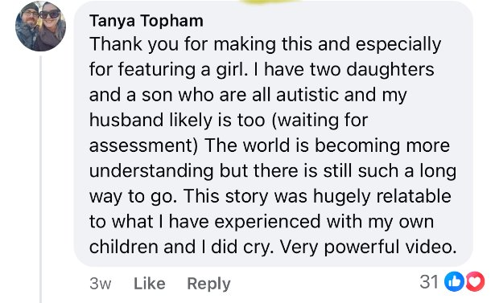
Feedback
Notes:
I wanted to share some of the beautiful comments we got, there were so many more of these I can't do justice to them here

Slide 18
Your title
Write your subhead here
Write your body copy
Bullet points here
Bullet points here
Bullet points here
Meet the Wakemans

Slide 19
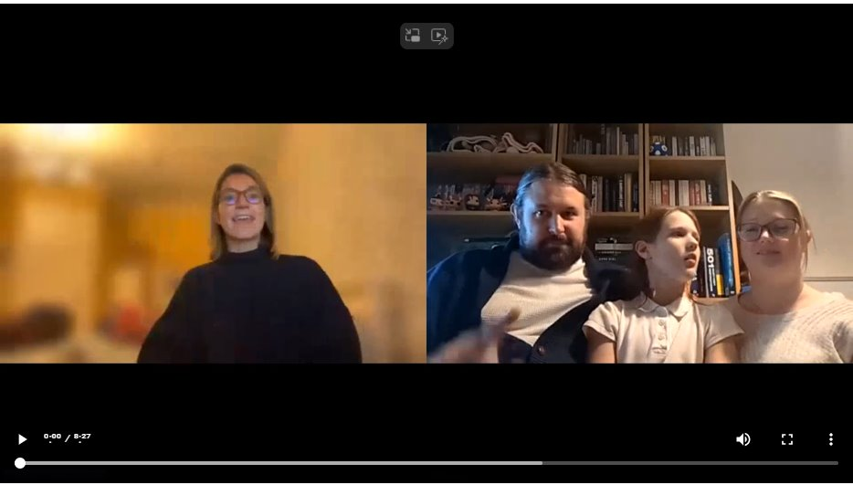

Slide 20
Your title
Write your subhead here
Write your body copy
Bullet points here
Bullet points here
Bullet points here
What next?

Slide 21
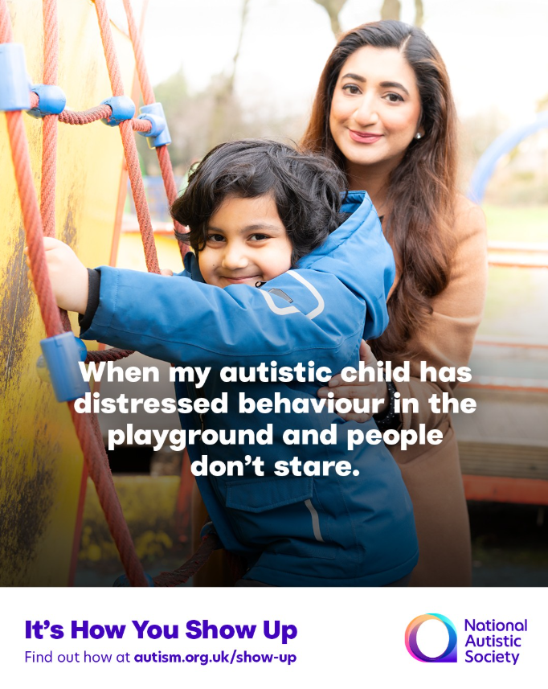
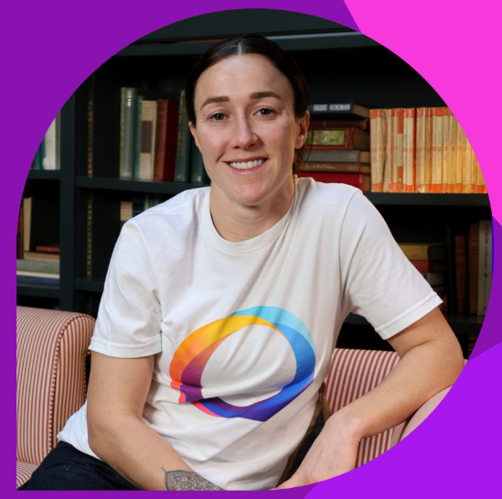
From April 2025 to May 2027…
Celeb and influencer support including Chris Packham, Cat Burns and Lucy Bronze
New stories from real people
Continued advertising Autum 2025
New ‘hero moments’ in April 2026 and April 2027

