Slide 1
Our impact last year 2023-24
Caroline Stevens, Chief Executive
Notes:
Thank you everyone for joining us here this morning.
I’m going to talk about the impact of our work over the last financial year, and the progress we’ve made in the first year of our Vision to Reality strategy.

Slide 2
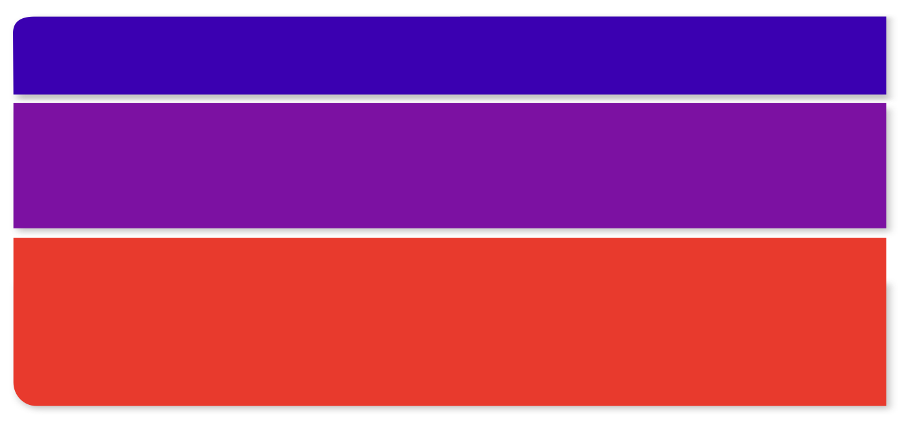
Vision to Reality
Our Vision to Reality strategy set out our bold ambitions for the National Autistic Society to put it on the path to securing our Moonshot Vision.
It is guided by our three Beliefs:
Belief 1: Support all autistic individuals and their families to live a fulfilled life on their terms
Belief 2: Influence and collaborate with others to improve standards and adjustments
Belief 3: Transform society by building understanding, acceptance and respect for all autistic people.
Under these sit our ambitions and projects that we will start, to create a society that works for autistic people. This includes things like:
bringing autistic people and allies together in a movement for change
creating a universal support offer for all autistic people and their families (‘Autism Help’)
establishing a set of financially and operationally viable specialist services for adults with the most complex needs
launching an ‘always on’ campaign for autism awareness.
Notes:
If you remember, when we launched our Vision to Reality strategy in April 2023, we had some very clear beliefs about what we wanted to achieve as a charity.
And we decided that, every year, we would produce an impact report that says ‘this is what we've achieved in our strategy over the previous year’.
As a charity, we have three core beliefs and those beliefs are us saying what we believe our role is.
We believe, first of all, our role is to support all autistic individuals and their families to live a fulfilled life on their terms.
Belief 2 is that we have a key role in influencing and collaborating with other professionals who work with autistic people. And that's the work we do in in education through our schools, but also our ‘Autism Know How’ work, where we’re training other professionals such as teachers, healthcare workers and employers.
And then finally Belief 3, where we believe that we want to transform society by building understanding, acceptance and respect for autistic people. And that's very much our campaigning work.
And then underneath that sit our ambitions. They're not all listed here, but things like creating a support and advice offer for all autistic people and their families. And they're all big tasks.
But of course, the key is impact.

Slide 3
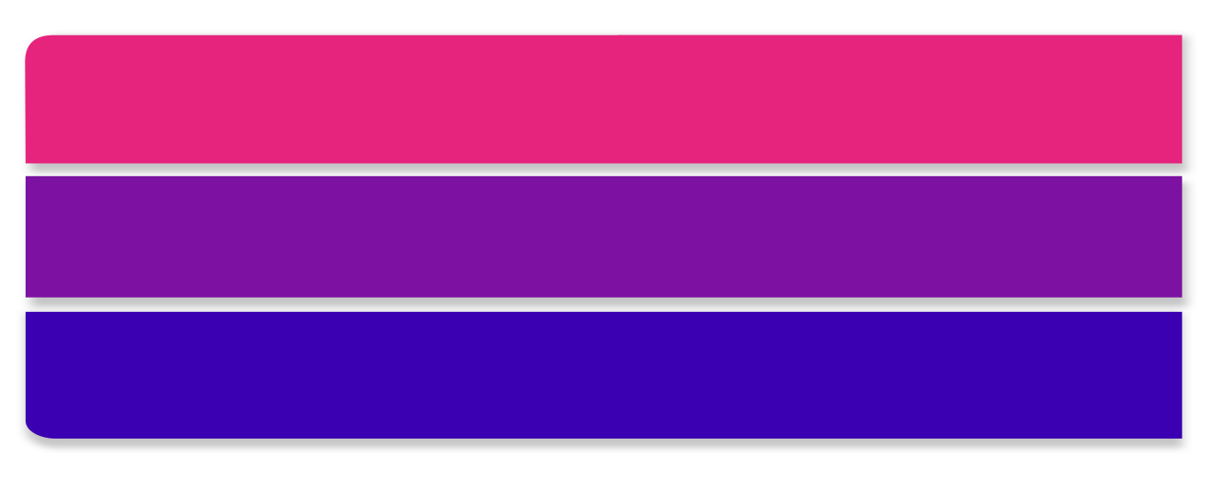
Our impact
Impact means the difference we make to people’s lives – that’s why we exist as a charity.
Against each of our Vision to Reality ambitions, we established a set of measures to track our impact over the life of the strategy and beyond.
This is a summary of what we’ve done so far…
Notes:
And the thing about impact is we're talking about things that make a difference to people's lives.
Ultimately that's why we're here. If we don't have an impact, there's no point in the National Autistic Society existing, but it's quite hard to measure.
What we did was, with the trustees’ approval, we agreed a set of measures against each of the beliefs and ambitions so that we could track those over the lifetime of the strategy and hopefully beyond.
And that will give us a sense of whether we're making progress and if we are, whether we're making progress in the right areas.
And so this isn't all of them. This is just a snapshot summary.
I have to be honest and tell you that it's not been an easy year. Economic and political insecurity, council funding cuts and the cost of living have hit our charity just as they have hit everyone’s lives. We had to make tough decisions to close some services where, after trying everything we could, we just couldn’t afford to keep running them. And it means that we haven’t been able to make all the progress we wanted to in our first year of the new strategy.
Despite this, we've delivered a lot to be proud of, and I am keen to share more about that with you.

Slide 4
Notes:
So we start off with our amazing adult services.
670 autistic adults were supported in our adult services. They include Rebekah, pictured here, who was recently in Your Autism magazine talking about her love of music and singing.

Slide 5
Belief 1: Support
Over a million people visited our website for vital advice or guidance. All together, they looked at our advice pages over four million times.
Over 5,000 people called or emailed our charity for support.
We supported 670 autistic adults in our adult services across the UK, providing expert support in people’s homes and communities so they can thrive.
In our national Diagnostic and Assessment Service, we dealt with over 4,000 enquiries and provided expert clinical consultations and enhanced diagnostic assessments for 264 people.
Notes:
Continuing with our impact under Belief 1, over a million people visited our website for advice and guidance.
Over 5,000 people called or emailed us for support.
Almost 4,000 people got advice from our Diagnostic and Assessment Service, and 264 people got a specialist diagnosis and assessment.
As you saw on the previous slide, we supported 670 adults in our services. Like all adult social care providers, we continue to operate in a very tough financial environment. Council funding cuts and the cost of living crisis have affected us and we’ve had to make some difficult decisions this year to ensure our future stability. This has unfortunately included some service closures.

Slide 6
Belief 1: Support
Our programmes are all across the UK:
In Scotland, our comprehensive range of support programmes have supported almost 170 young people, autistic adults after diagnosis and families.
In Wales, 250 people have taken part in our Peer Support Project which gives people opportunities in a safe environment where you can be yourself and meet others with similar interests and life experiences.
In Northern Ireland, we supported 663 people from our innovative Belfast Centre with a mix of daytime activities, family support and a lending library.
In England, our Autism Inpatient Mental Health Casework Service helped 147 autistic individuals and their families understand their rights and entitlements to prevent or challenge detention in mental health hospitals.
Notes:
So, carrying on with Belief 1, we offer support to autistic people and their families right across the UK.
In Scotland, our programmes supported almost 170 young people, autistic adults after diagnosis and their families.
In Wales, 250 people have taken part in our Peer Support Project, which enables people to meet with and enjoy the company of other autistic individuals who share their interests.
And in Northern Ireland, we supported 663 people from our absolutely incredible Belfast Centre. And that's a mixture of daytime activities, family support and a lending library. The centre is now open pretty much seven days a week because we also have it open for branches and volunteers, evenings and weekends.
In England, I want to mention the work of our Autism Inpatient Mental Health Casework Service. This helped 147 autistic people and their families understand their rights to prevent detention in mental health hospitals.

Slide 7
Notes:
So Belief 2 is around collaboration with the sector.
So first thing, over 100,000 professionals improved their autism knowledge and practice, thanks to our training.
That's an incredible number.

Slide 8
Belief 2: Influence and collaborate
Almost 450 children were taught in our autism-specific specialist schools and our custom-built innovative Cullum Centres in mainstream schools.
Over 100,000 professionals across education, health and social care improved their knowledge and practice by getting training from our expert Autism Know How team and our partners, the Autism Education Trust. Almost 1,000 more people joined our annual conference to develop their insight.
We worked with over 100 organisations and businesses to embed better autism practice through our Accreditation and Inclusion Awards.
Notes:
Almost 450 children were taught in our autism-specific specialist schools and our custom-built Cullum Centres which are in mainstream schools. In summer 2024, we opened our first Cullum Centre in a primary school, in Canterbury. So that number will increase.
Over 100,000 professionals, as I said, trained, and that's both with us, but also with our partners in the Autism Education Trust.
Almost 1,000 people joined our annual conference to develop their insight. And I know from those who attended, it was genuinely a brilliant conference.
We worked with over 100 organisations and businesses to embed better autism practice through our Accreditation and Inclusion Awards. And if you think, each one of those organisations will employ hundreds, if not thousands of people, you know the impact we're having is multiplied.

Slide 9
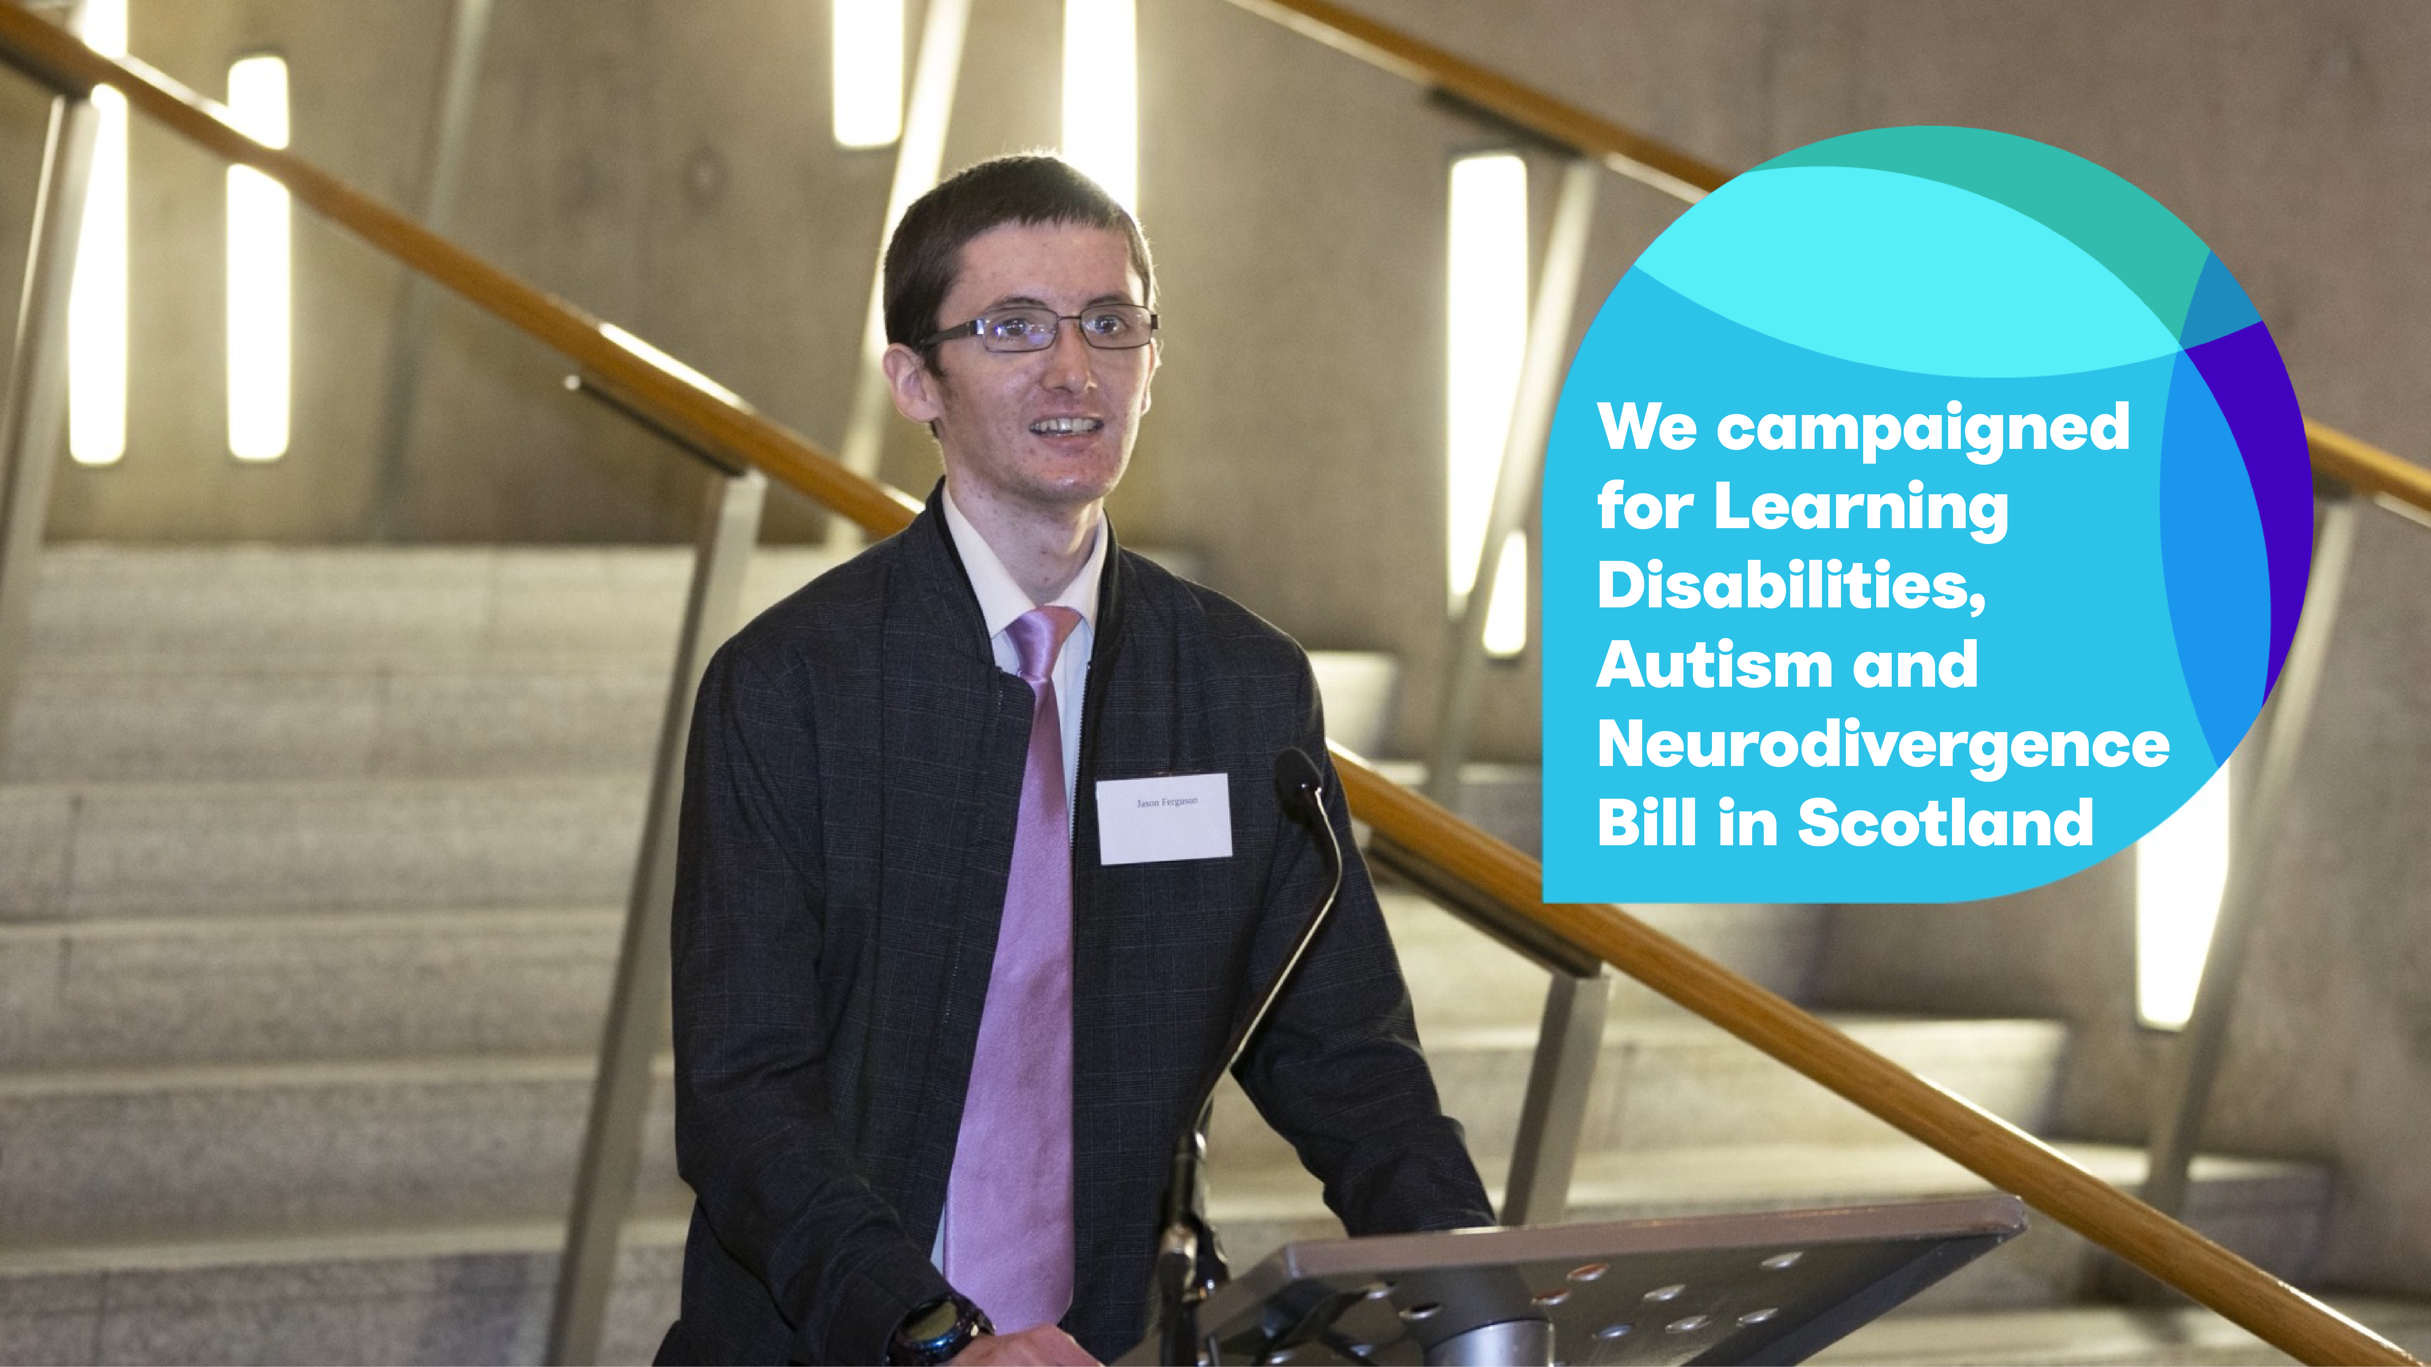
Notes:
OK, Belief 3. So this is around campaigning, public awareness and so on.
In Scotland, we campaigned for the Learning Disabilities, Autism and Neurodivergence Bill – potentially a transformational bill that would introduce a Commissioner for autistic people.
The Scottish Government asked for feedback and our Scottish team did an absolutely incredible job getting feedback from autistic people and their families, from our branches and so on right across Scotland.
We will continue to campaign for this bill and ensure the decisionmakers understand the barriers autistic people face and the support that is needed.

Slide 10
Belief 3: Transform
Almost 25,000 campaigners took action with us to say it’s #TimeToAct, calling out delays to crucial reforms to the Mental Health Act in England and Wales, and to ask their MP to find out more about our #LetEveryAutisticChildrenLearn campaign to fix the education system for autistic children.
In Scotland, following our campaigning, the public consultation on the Learning Disabilities, Autism and Neurodivergence Bill included key proposals for mandatory training and a Commissioner for autistic people.
In April 2023, we worked with local campaigners and successfully reversed the restricted criteria to get an autism diagnosis in Bristol.
2024 saw the launch of our General Election Campaign #ChangeTheConversation, which saw more than 800 autistic people share their campaigning experiences. With the new Government in place, we are currently campaigning on education, social care and mental health.
Notes:
And what else have we done?
Well, we had almost 25,000 campaigners took part in our It's Time to Act campaign and that was all around mental health reform. That legislation was in the King’s Speech and will be going through Parliament shortly.
And then also our Let Every Autistic Children Learn campaign, basically saying that autistic children have the right to education just like any other child does and highlighting that sadly too many don't have the access that they need.
I've mentioned the Scottish bill.
We saw specific local campaigns, smaller campaigns, but really impactful. So in April 2023, for instance, we worked with local campaigners which reversed the restricted criteria that was being used locally, which were essentially preventing people from getting an autism diagnosis. And again, really impactful because the issue was flagged and we went in really hard with local campaigners and it made a difference. It was turned around.
And in the Spring, with the general election campaign, we were working with candidates before they're MPs. Now we're working with those MPs and the new government so that Westminster in particular will become, we hope, the most autism-aware legislature in the world.
And if we get this right, that will make a massive difference to the way that legislators think about autism and the impact they can have.
As part of that work, over 800 people let us know their experiences of campaigning.

Slide 11
Notes:
And then of course, underpinning all that, is your support. We can only do our work and have this impact with the amazing support of you as members, and our brilliant fundraisers.

Slide 12
Supporting our fight for a society that works for autistic people
Generous, passionate and ambitious members, donors and fundraisers make this work possible. Last year, you:
ran over 9,000 miles in marathons and half marathons across the world!
walked and ran nearly 65,000 miles in our 100 Miles in October challenge!
climbed nearly 470,000 feet in treks up the Yorkshire Three Peaks, Snowdon and the Jurassic Coast!
descended over 400,000 feet by skydiving or abseiling!
Meanwhile, another 379 of you fundraised your own way.
Notes:
If you add up all of the activity in fundraising, our generous and passionate supporters ran over 9,000 miles in marathons and half marathons.
They walked nearly 65,000 miles in the 100 Miles in October challenge.
They climbed nearly 470,000 feet with things like our treks up the Yorkshire Three Peaks and Snowdon, Jurassic Coast.
And they descended over 400,000 feet by skydiving or abseiling.

Slide 13
There’s more work to do
The situations faced by many autistic people are as difficult as ever:
In June 2024, 187,567 people were waiting for an autism diagnosis assessment in England. Of these, 163,666 (87%) had been waiting over three months.
In August 2024, 2,015 autistic people and people with learning disabilities were in mental health hospitals in England.
The most recent Government data shows the employment rate for autistic people is 30%.
Our first year was just the start. We have so much more work to do to create a society that truly works for autistic people – and the plans to do it!
Notes:
And the bottom line is, there's still so much left to do.
That's just our first year.
Sadly, in June 2024, 187,567 people were waiting for autism diagnosis in England. Of those 87% have been waiting over three months.
Horrifically, there are still over 2,000 autistic people and people with learning disabilities in mental health hospitals, which is just an absolute national scandal.
And sadly, the latest government figure shows that the employment rate for autistic people is an appalling 29%.
So whilst I think it's right to celebrate what an amazing first year we've had with our strategy, we're not going to be short of work over the coming years.
I look forward to sharing next year's impact report with you, and thank you so much for your continuing support as members.

