Slide 1
AGM - Agenda
11.00am – Welcome from Stephen Ladyman, Chair of Trustees
11.05am – Address from Caroline Stevens, Chief Executive
11.20am – Address from Stephen Ladyman, Chair of Trustees
11.35am – Approval of the minutes of the previous meeting
11.40am – Updated NAS Articles
11.50am – Introduction of new trustee appointments
11.55am – Explanation of the Accounts
12.00pm – Guest speaker: David Carter from our South Hampshire Branch
12.05pm – Questions from members
12.20pm – Close of meeting

Slide 2
Highlights from 2022-23
Dr Stephen Ladyman
Chair of Trustees

Slide 3
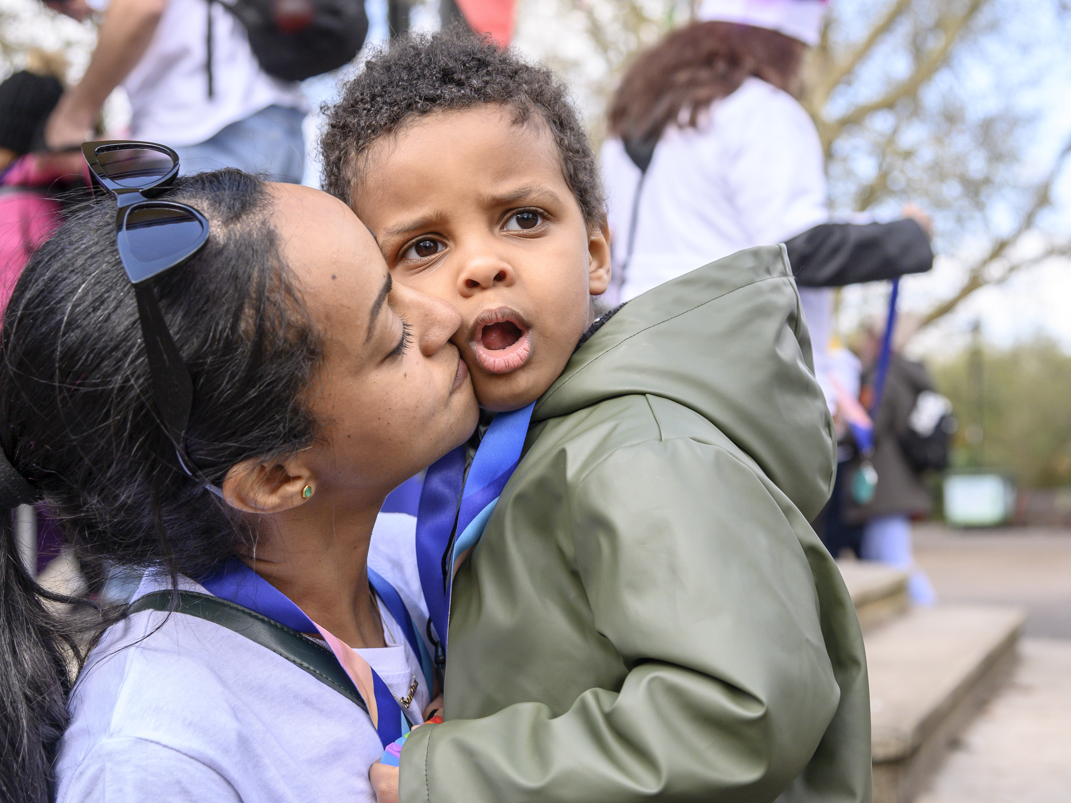
Introduction
Year of great change for our charity.
Starting to turn the Moonshot Vision into a reality through our new strategy.
Notes:
As you have heard, this has been a year that has seen great change, and some difficult decisions for the organisation.
It has also been a year of great achievement and action as we start turning the Moonshot Vision into a reality through our strategy.
I’d like to share some of the highlights of the year with you now.

Slide 4
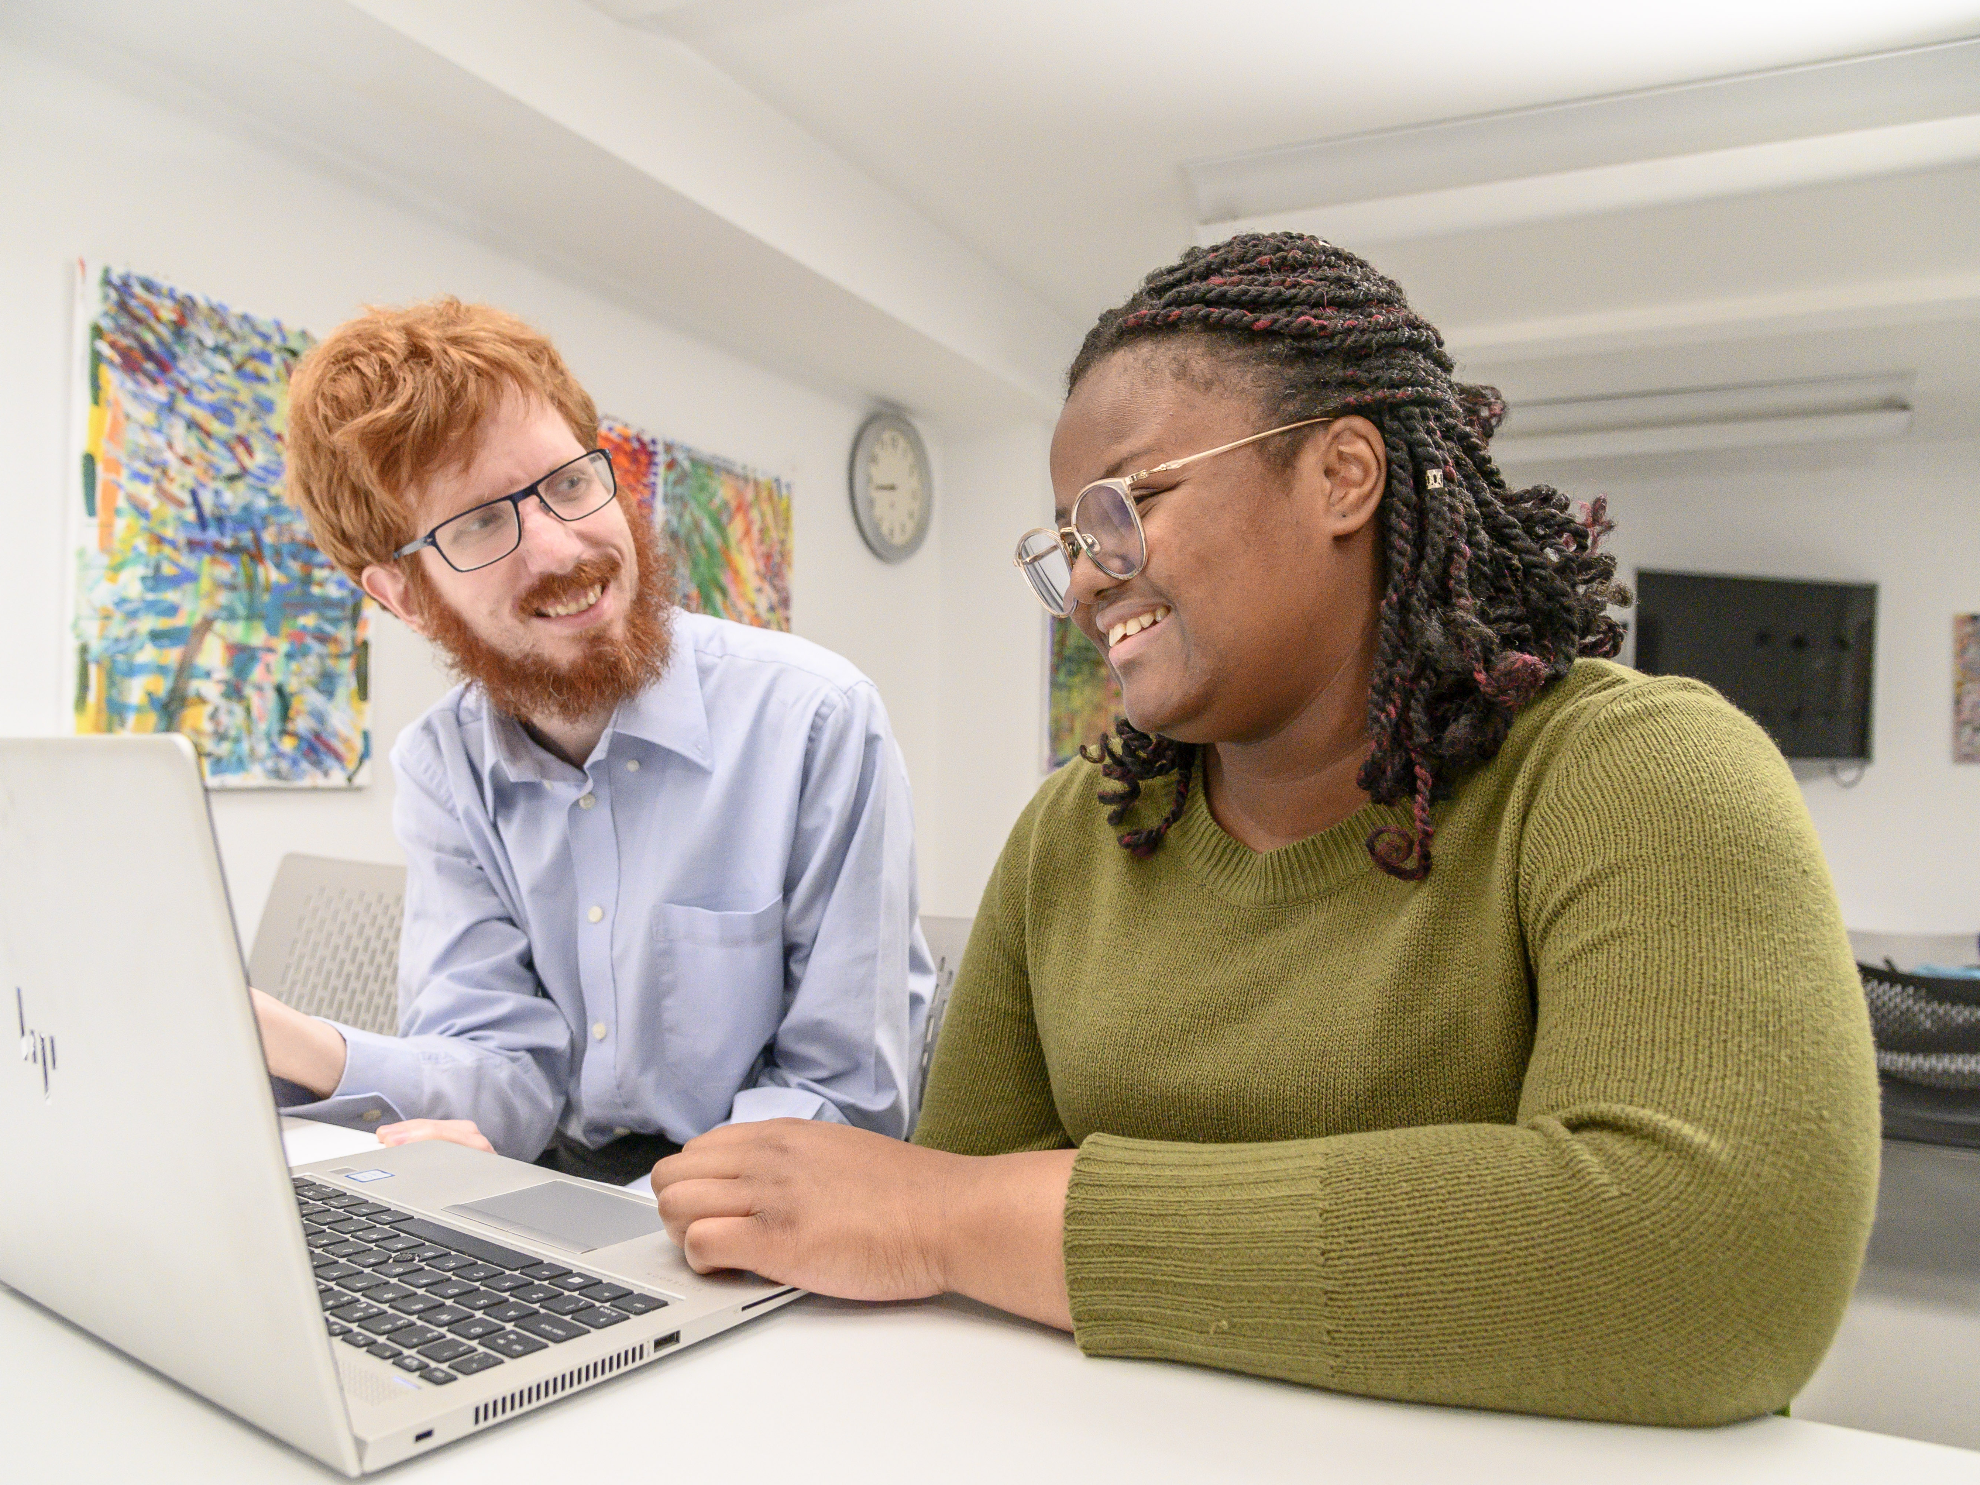
Autism Know How
New department bringing together our services supporting professionals.
Potential to make a difference to all autistic people, transforming experiences in school, at work and in health and social care.
We provided live training for 7,000 health, social care and education professionals in 22-23.
Notes:
This year, we established our Autism Know How department, which brings together all our commercial trading services, projects and products aimed at supporting professionals and developing best practice.
The activities it delivers have the potential to make a difference to the lives of every autistic person across the country.
As an example, as part of its work this year, we provided live training for more than 7,000 professionals in health, social care and education – enabling them to make the adjustments that can transform experiences and outcomes for the thousands of autistic children and adults they support today and in future.

Slide 5
Website and community
9,000 visitors to our website a day (daily average).
3,690 people actively involved in our online community.
116 local volunteer-led branches.
First ever Branches Awards Ceremony.
Notes:
Our website continued to be a vital source of information for autistic people, families and professionals, with a daily average of 9,000 visitors.
Around 3,690 people were actively involved in our online community, where they bonded over shared interests and identities, reducing the social isolation that too often goes hand in hand with autism.
Our local branches across the UK continued to provide a lifeline to autistic individuals and their family members.
The success of branches relies on the time, energy and commitment of our wonderful volunteers, many of whom are parents of the people the branches support.
I was particularly pleased to see their efforts recognised and celebrated at our first ever Branches Awards Ceremony in June 2022.

Slide 6
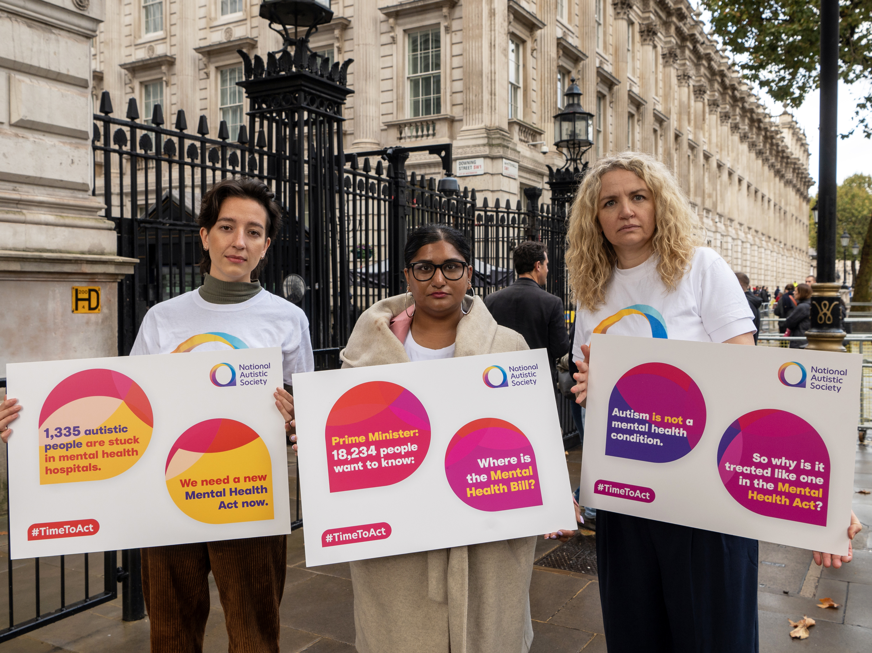
Policy and Public Affairs
We pushed our politicians to make the urgent changes autistic people and their families need – for better education, timely diagnosis and more mental health support.
All policy asks driven by concerns of autistic people and their families.
50,000+ people campaigned with us.
To ensure every autistic person can get the support they’re entitled to.
Notes:
Across the four nations of the UK, we continued to push our politicians to make the changes that autistic people and their families so urgently need to see.
All our policy asks are driven by the concerns and priorities of autistic people and their parents and carers. We are grateful to everyone who signed up to our new Autism Insight Panels to help shape our influencing work.
Not to mention the 50,000+ people who campaigned with us over the year for better education, timely diagnosis and more mental health support.
This is exactly the sort of sustained public pressure we need to create to ensure that every autistic person – whatever their gender or background, or wherever in the UK they happen to live – has access to the support they’re entitled to.

Slide 7
Advice and Guidance
Initiated a programme of activity to develop and enhance our advice, support and guidance offering
Developing a more integrated and joined-up approach, improving the experience
Offering substantial and practical advice for people on the biggest issues they come to us for
Currently developing and expanding our topic offerings and exploring how we can use technology to reach even more people
Notes:
A key plank of our Strategy, is Belief 1 - that we believe that the role of the National Autistic Society is to support all autistic individuals and their families to live a fulfilled life on their terms. Central to this is the advice and support that we offer.
We are moving from a situation where we’ve got a lot of great, but uncoordinated services, to one where the experience of getting advice and support is more joined-up and integrated for people. One where we can offer substantial and practical advice for people on the biggest issues they come to us for, but for which we currently lack resources – diagnosis and employment in particular. And it’s one where we will seek to better utilise technology and the support of volunteers to make sure that the work we do can have the maximum reach and impact possible.
We have made a good start on the programme this year, expanding and developing our topic offerings and internally scoping how we can use technology. Over the coming year we’ll continue to develop our new service to expand the topics we can offer advice on, getting support on the technology from some of the best IT experts in the UK and looking at how our existing services can start reaching more people.

Slide 8
Now I Know campaign
Encouraged many autistic women and non-binary people to share their stories.
Broke down harmful stereotypes about autism that see women often overlooked and undiagnosed.
Continued through our own channels following the initial campaigns, allowing many more people to share their stories
Overall social media reach – over 1 million people, and climbing
Overall media reach – over 2 million people
Notes:
The award-winning Now I Know campaign encouraged so many women and non-binary people to come forward and share their stories of life before diagnosis and the positive impact of finally learning they were autistic.
The campaign was a vital step in breaking down the harmful stereotypes about autism that too often see women overlooked and undiagnosed, with potentially devastating effects on their mental health.
It is stories like theirs that motivate me to keep on fighting for a society in which all autistic people are understood, accepted and respected.

Slide 9
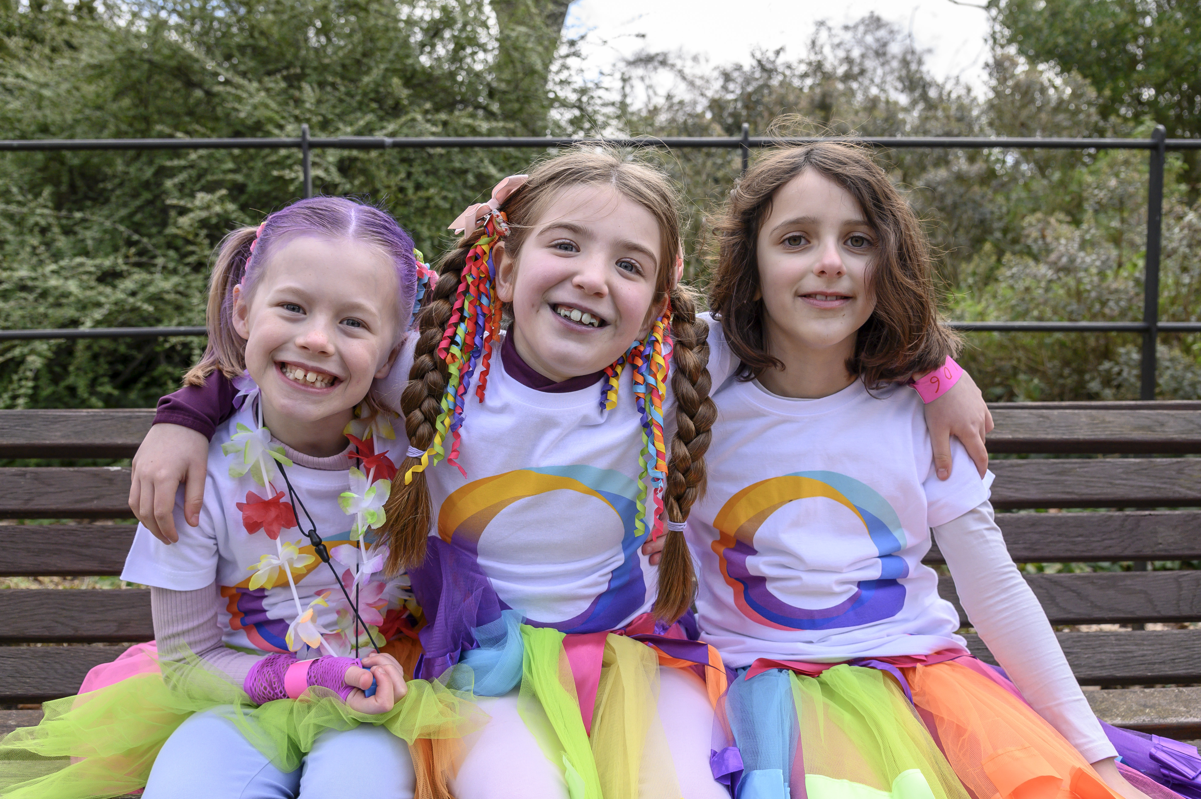
Thank you
Notes:
I would like to say a heartfelt thank you to our amazing staff and volunteers for all your hard work and commitment during yet another challenging year, and to everyone who supported our work by donating, fundraising or campaigning with us.
And to you, our members. Your ongoing support is valued and appreciated by me, and all of us at the National Autistic Society. Thank you.

