Slide 1

In our Words heritage project

Slide 2
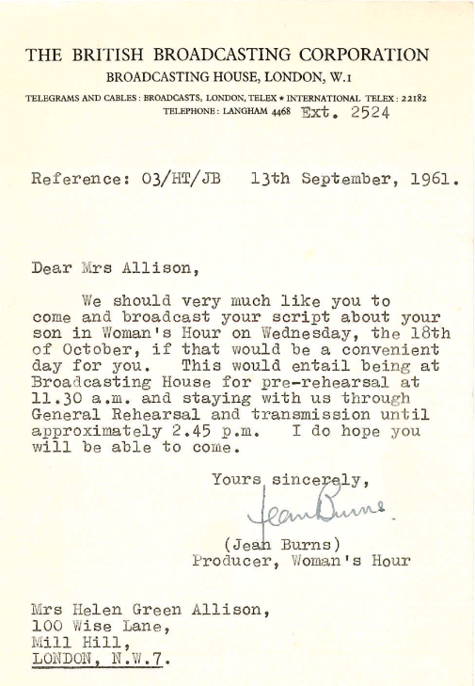
In our Words archive
Aims of the project:
curate
celebrate
preserve

Slide 3
The National Lottery Heritage Fund supports projects that connect people and communities with the UK’s heritage.
The National Autistic Society’s ‘In our Words: Sixty years of the National Autistic Society and the story of autism in the UK’ project has been made possible thanks to money raised by National Lottery players.

Slide 4
In our Words archive
Main outcomes
Heritage:
empower and amplify the voices
inform the strategic direction of the National Autistic Society
reach new audiences.
People and communities:
volunteers: develop skills that can be useful elsewhere in life; volunteers’ contributions will be meaningful and highly valued
contributors: provide a sense of community and connection
people viewing the archive:
improve wellbeing and connectivity
develop understanding of autism, leading to improved practices
grow awareness and acceptance of autism.
Partners: worked with partners to develop their autism knowledge and practice.
Notes:
Heritage
Empower and amplify the voices, stories and experiences of an otherwise marginalised and silenced group, giving them a platform to share their history, creating a benefit to wellbeing but also acceptance, as wider communities become more aware.
Inform the strategic direction of the NAS by allowing us to reflect on how far we have come, and what can be achieved..
Reach new audiences. We have not previously delivered a project like this, and so we will be able to expand our networks and engage new people with our work, such as through the creation of videos and shareable web content.
People and communities
Volunteers: develop skills that can be useful elsewhere in life, volunteers’ contributions will be meaningful, and highly valued. Furthermore, and in particular for autistic individuals, we hope that volunteers will develop connections between themselves and within the autistic community and their shared history, creating a positive impact on wellbeing.
Contributors: provide a sense of community and connection, but also, as many autistic people have faced a lifetime of marginalisation and exclusion, this project will likely be useful in terms of processing and accepting what has happened, and creating hope for the future.
Visitors and audiences of the heritage project: For autistic people and their families, we hope that a familiarisation and understanding of their history will improve wellbeing and connectivity. For professionals, we hope that they will develop their understanding of autism, leading to improved practices and a cyclical positive impact for autistic people. For members of the public, we hope that they will grow in awareness and acceptance of autism.
Partners: we will review On the Record’s training Heritage

Slide 5
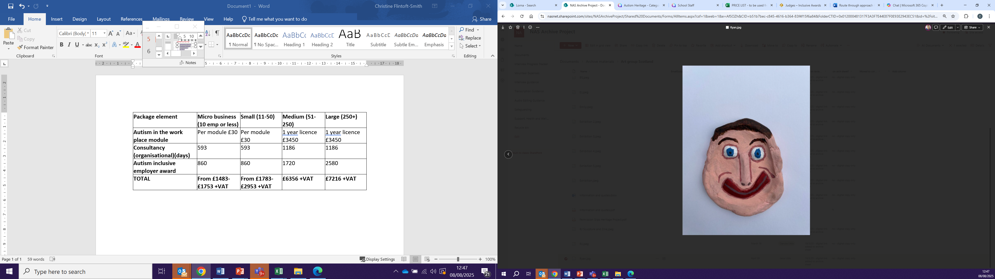
Autistic voice
Public surveys
Project officer
Steering group
Volunteers
Evaluator
Interviews, art work, podcast and films

Slide 6
Volunteers
Over 20 volunteers took part in the project.
Roles included:
interviewers
transcribers
digital editors
cataloguer.
“This all seems applicable to any oral history project with any group of people. The most important thing remains, after all, building what you do around the people you are doing it with, and not making any assumptions about the best way to communicate. I’ve incorporated most of the feedback from the NAS into my oral history training and hope it is more accessible to more people as a result.”
Rosa Schling, On the Record Trainer
“A rewarding part was the people who I was able to meet over the course of this project - they had hugely varied connections to the National Autistic Society, from teachers and carers to campaigners, researchers, politicians and charity executives.”
Oscar Hilder, Volunteer

Slide 7
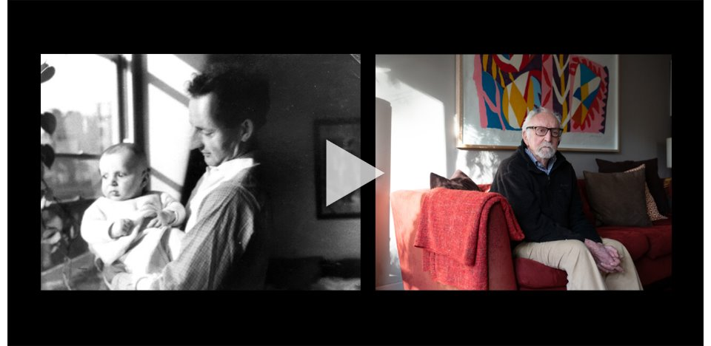

Slide 8
What we achieved
Over 20 volunteers
Over 1,000 volunteer hours
Support from across the National Autistic Society
90 interviews recorded
Five-part film
Four-part podcast
Over 1,500 individual assets in the archive
Over 30 autistic voices and participants
Website went live 19 May 2025

Slide 9
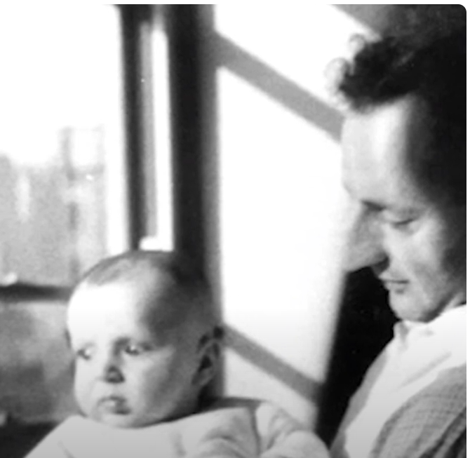
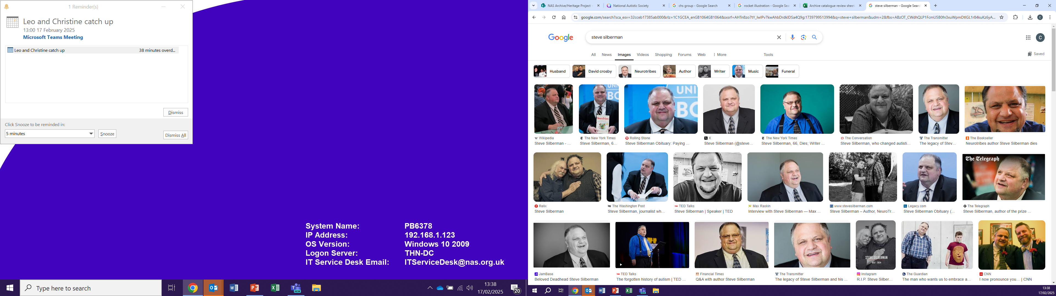
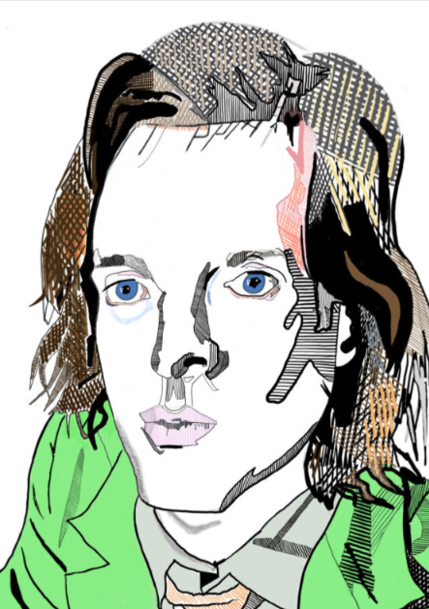
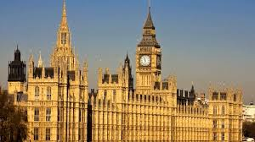
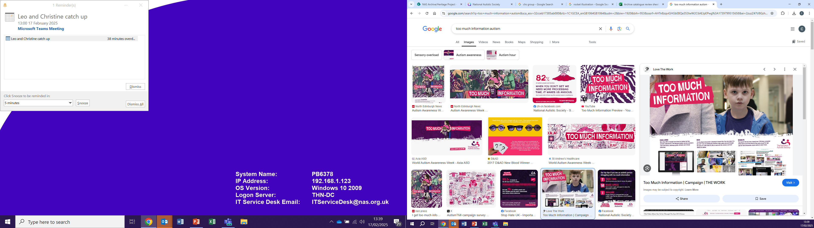
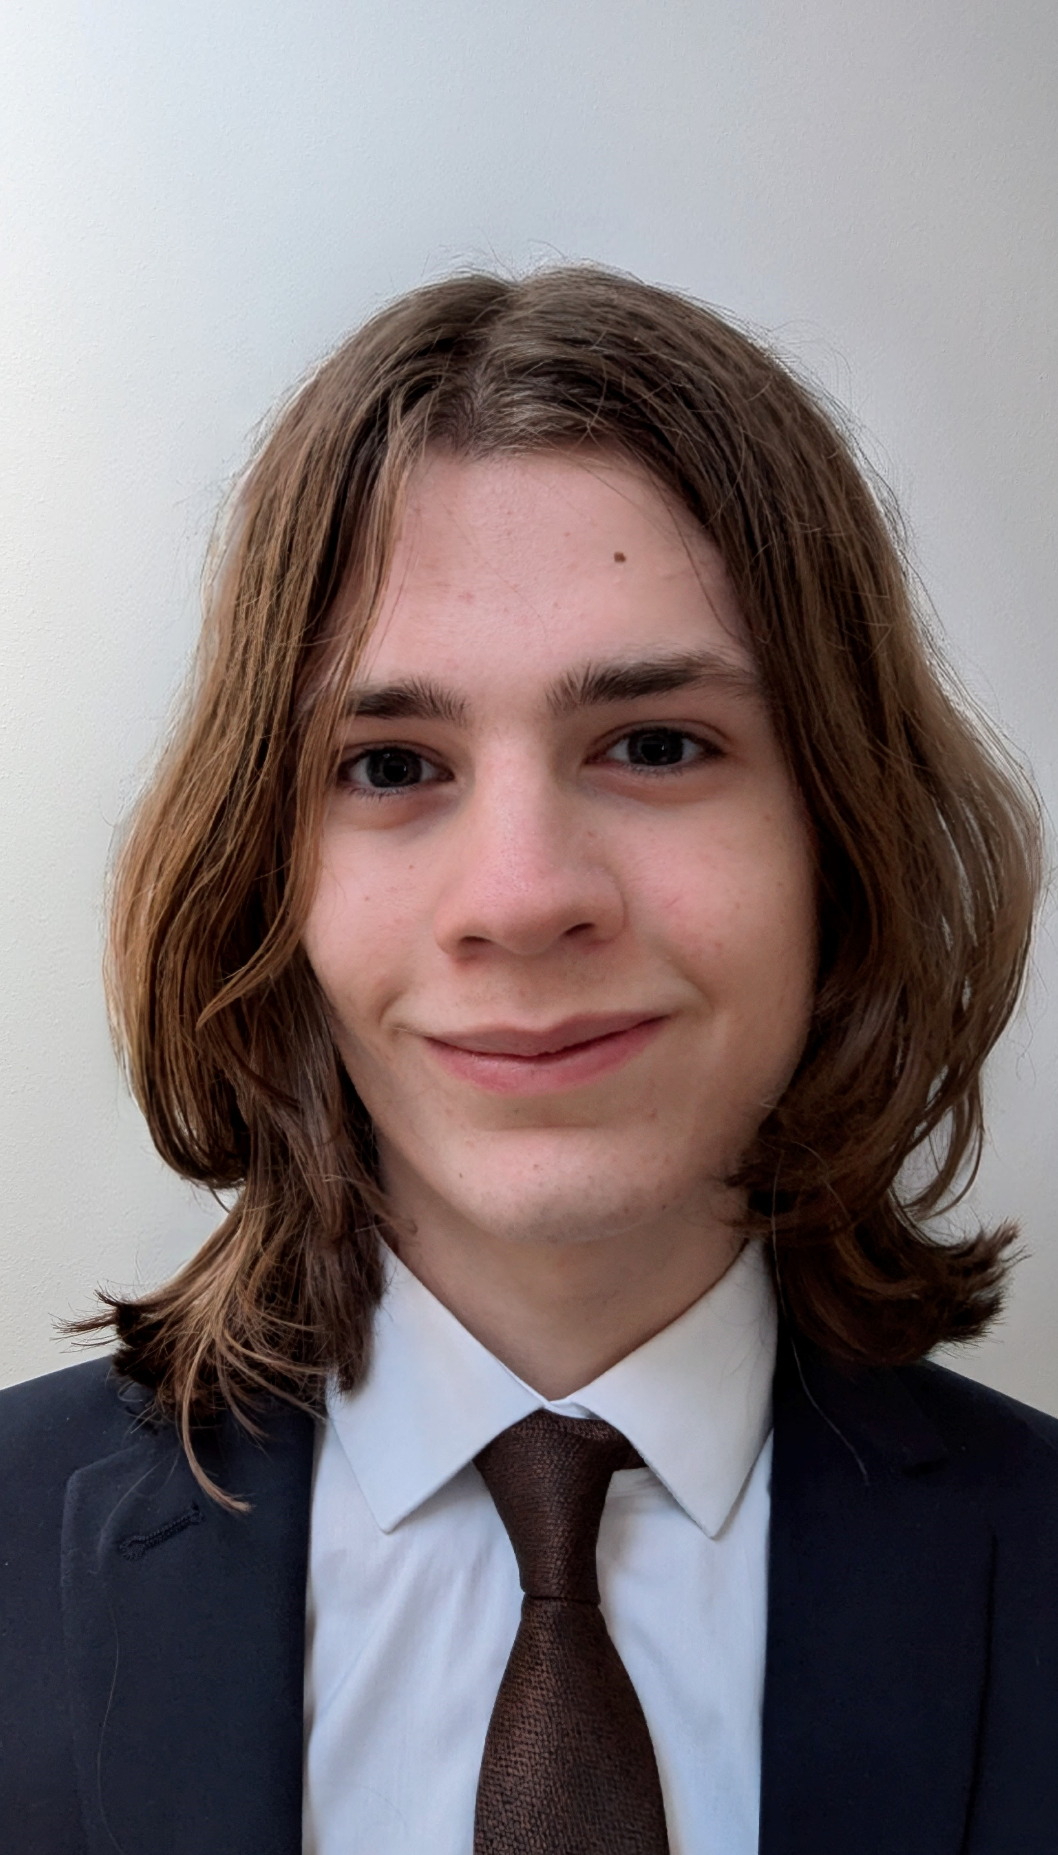
Special moments
Interview with
founder
Michael Baron
Last known interview with Steve Silberman
Interview
with Baroness
Browning at the
Houses
of Parliament
Fabulous artwork from the Scottish
Re Imagining Arts Group
Catch up and follow on with Alex from our Too Much Information campaign

Slide 10
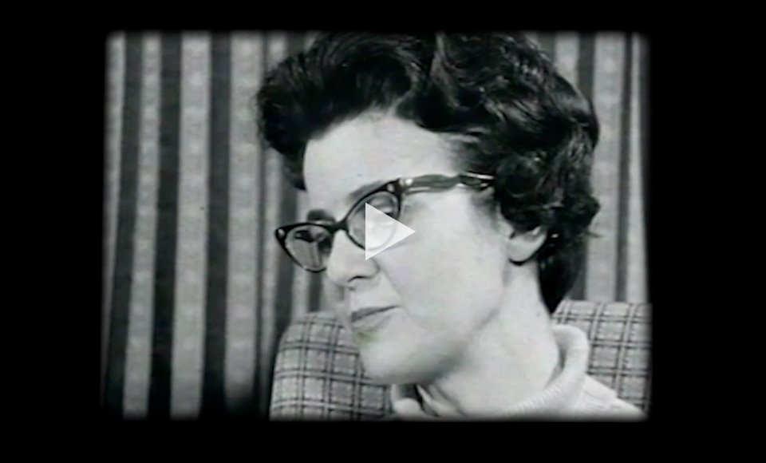

Slide 11
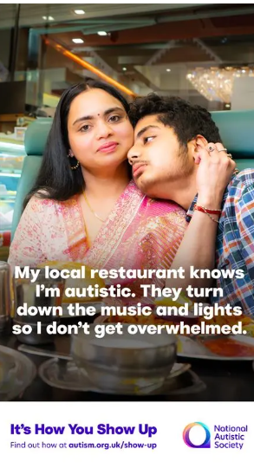
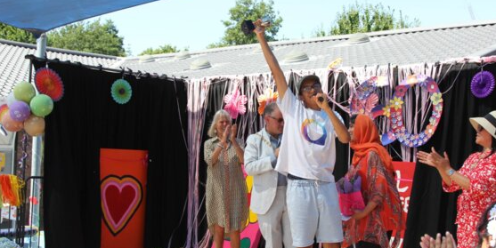
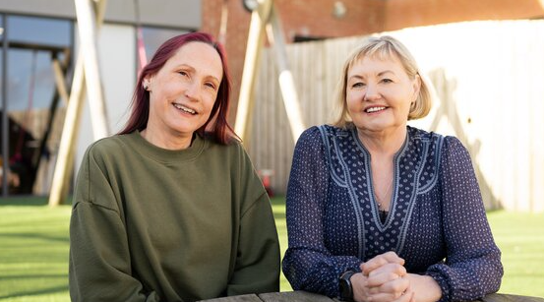
What’s next?
Sybil Elgar School
and Radlett Lodge
School anniversaries
National Autistic Society Northern Ireland anniversary
Campaigns

Slide 12
autism.org.uk/in-our-words

