Slide 1

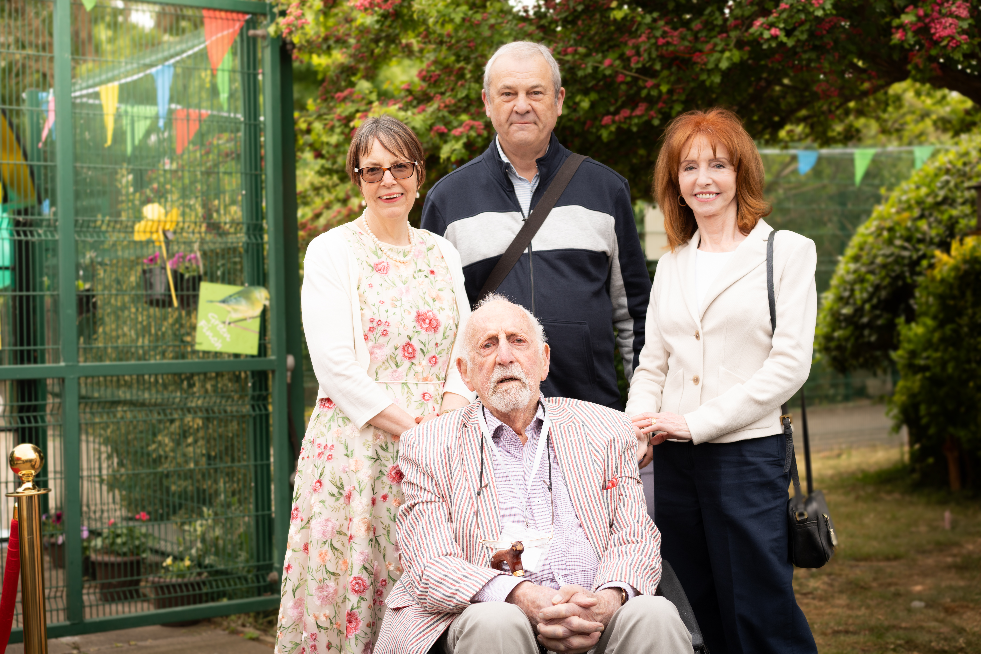
Michael Baron MBE
1928 – 2025
Notes:
Thank you everyone for joining us here this morning.
I wanted to start by sharing some sad news of the death of Michael Baron, who died last Sunday at the age of 96. Michael was one of the founders of the National Autistic Society over 60 years ago.
Michael’s tireless work, alongside that of Helen Allison, Lorna Wing, Sybil Elgar and other parents of autistic children in the 1960s and 70s, changed the lives of autistic people in this country forever. Their legacy and the impact of their work continues through the National Autistic Society.
Today, our charity is incredibly proud to continue Michael’s work.

Slide 2
Our impact in 2024-25
Caroline Stevens
Chief Executive
Notes:
I’m going to talk about the impact of our work over the last financial year, and the progress we’ve made in the second year of our Vision to Reality strategy.

Slide 3
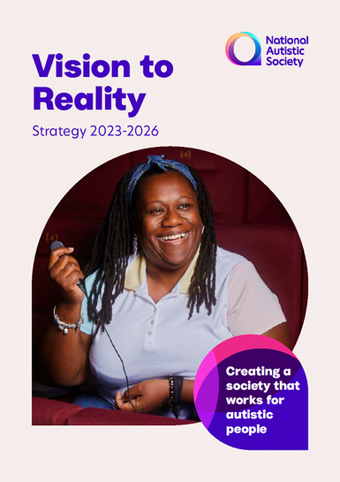
Vision to Reality
Our Vision to Reality strategy sets out what we want to achieve as a charity from 2023-26.
It is guided by our three Beliefs:
  Belief 1: Support all autistic individuals and their families to live a fulfilled life on their terms
  Belief 2: Influence and collaborate with others to improve standards and adjustments
  Belief 3: Transform society by building understanding, acceptance and respect for all autistic people.
Notes:
Our Vision to Reality strategy, which runs from April 2023 to April 2026, sets out what we want to achieve as a charity.
First of all, it says our role is to support all autistic people and their families to live a fulfilled life on their terms.
Secondly, our role is to influence and collaborate with other professionals who work with autistic people. That’s where we train and work with teachers, healthcare workers, companies and employers to help them understand more about autism and the adjustments that autistic people need.
Thirdly, we work to transform society by building understanding, acceptance and respect for autistic people. And that's very much our awareness and campaigning work.
So, let’s look at our impact in these three areas over the last year.

Slide 4
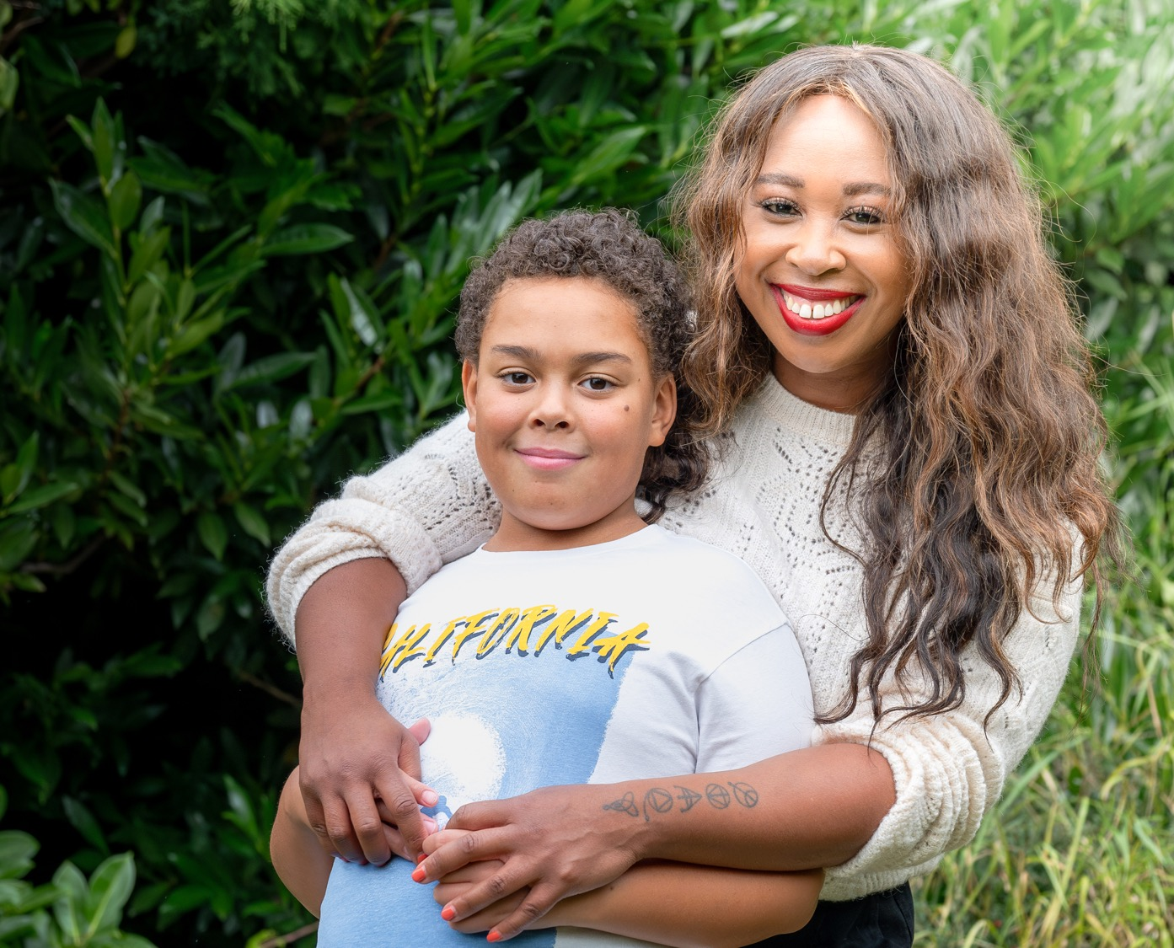

We helped support more than 1.3 million people
Notes:
So, we start off with our work supporting autistic people and their families to live a fulfilled life on their terms.
One of the major ways we do this is with our expert advice and guidance.
Last year, through the advice on our website, we reached more than 1.3 million people, providing essential support and evidence-based information about autism.
I would stress that all of our advice and guidance is based on detailed evidence reviews. We examine the latest research on each topic and autistic people’s lived experiences, and write our advice and guidance from that. This is vitally important when there is so much damaging misinformation about autism in the media, and it means that we are an expert and trusted source of information.
This year, we launched information hubs about diagnosis and employment, with a number of practical tools and resources, and these were very well-received.

Slide 5
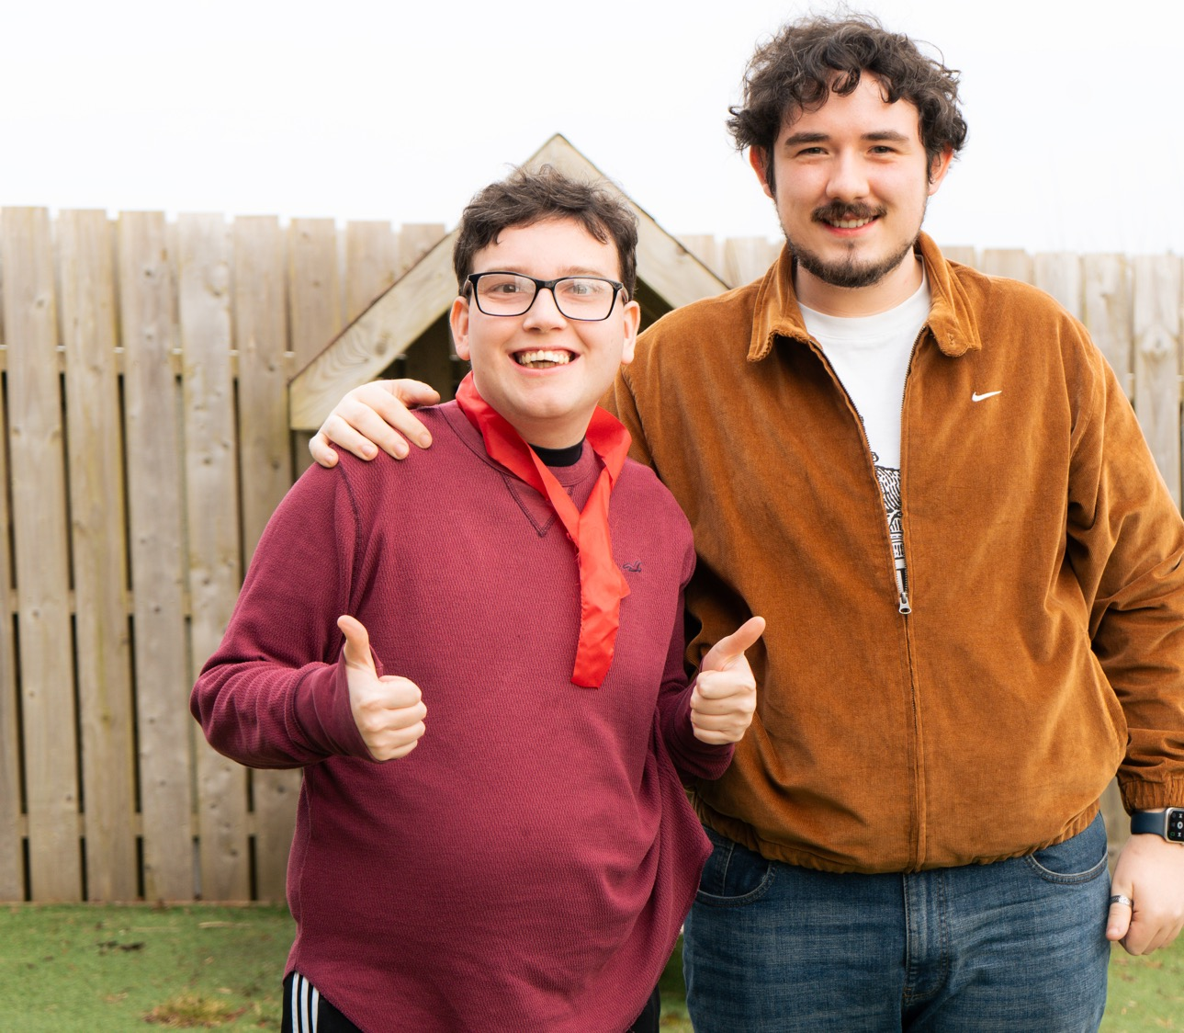
Belief 1: Support
Over 400+ autistic
people were supported by our adult services, helping them build a better quality of life.
Notes:
Our specialist residential, supported living and centres for autistic adults supported over 400 autistic people last year. Many of the autistic adults who use our services have complex needs, and our staff are focused on meeting their individual needs and helping them build a better quality of life.
You can see Peter pictured here with his support worker, Sean, who were in Your Autism magazine recently. Peter says he loves coming to our Belfast Centre, especially doing crafts with Sean, who has worked with him for an amazing 12 years.
Our adult services have been delivered in what continues to be a very challenging financial environment for all adult social care providers. Council funding pressures and cuts have affected us, and we've continued to have to make some difficult decisions about services to ensure our future stability. Paul Robinson will tell us more in his presentation.

Slide 6
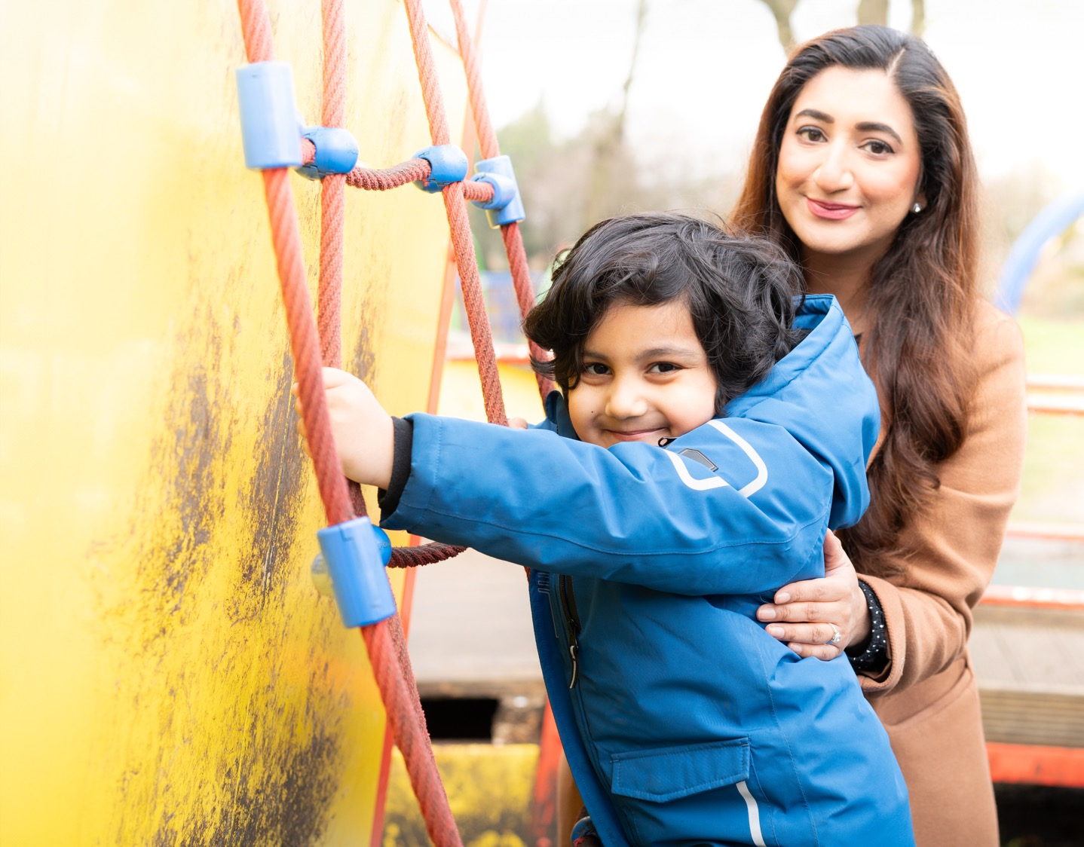
Belief 1: Support
In Scotland, we supported more than 600 autistic children, young people, adults and their families through a range of programmes, including peer support, mentoring, social groups and post- diagnostic support.
Notes:
In Scotland, our Growing Up, Embrace Autism, Empower Up, Moving Forward and other support programmes helped 600 autistic people.

Slide 7
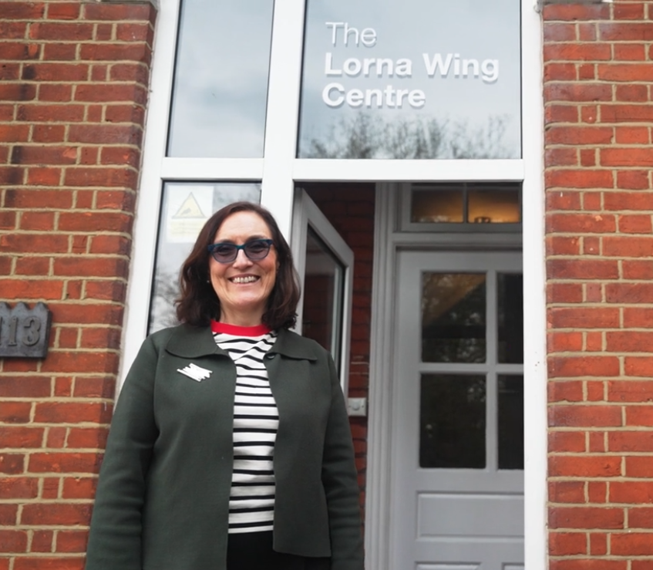
Belief 1: Support
We helped bring clarity and answers
to over 5,200 people seeking a diagnosis.
Notes:
We all know how life-changing and transformational an autism diagnosis can be. In 2024-25, our Diagnostic and Assessment Service assessed 220 potentially autistic people, and provided advice to over 5,000 others on the diagnosis process.
We made substantial progress this year in increasing our diagnostic and assessment capacity. There are now three independent service providers that have been closely vetted by us, working in partnership with our service to deliver autism assessments.

Slide 8
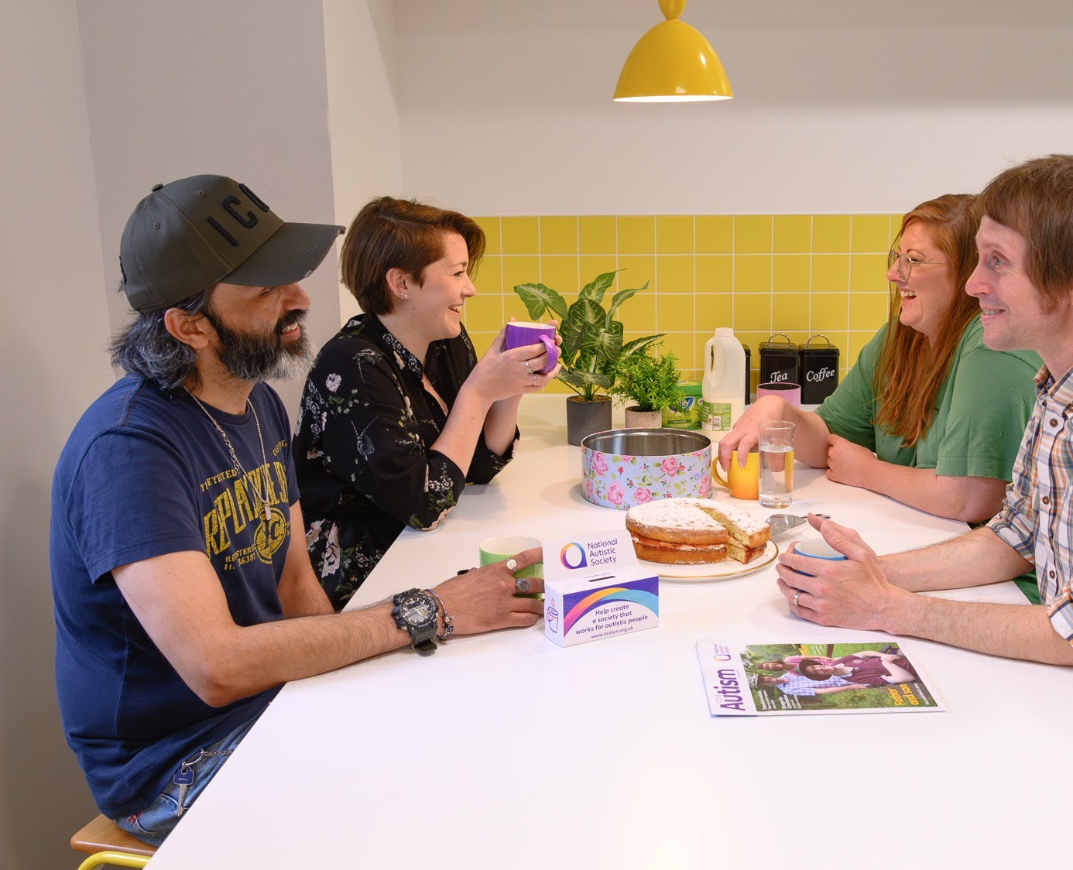
Belief 1: Support
Our 83 volunteer-led branches supported thousands of autistic people and their families through social groups, peer support, trips out, local campaigning and much more.
Notes:
Our branch network continues to demonstrate remarkable strength and commitment, with 83 branches supported by over 750 dedicated volunteers. These volunteers serve as the backbone of our organisation, and they support thousands of autistic people and families in local communities across the UK.
In 2024-25, we launched four additional branches across England, Wales and Scotland.
Our online branches also experienced significant growth. These digital communities, including our LGBTQ+ support group, book club, running club, and arts and crafts group, have established themselves as vibrant, active groups.
A particular highlight this year was our North Northumberland Branch volunteers receiving the King’s Award for Voluntary Service. This prestigious award is equivalent to an MBE and is the highest award given to local voluntary groups in the UK. The branch has 500 members and offers activities including monthly support groups with speakers, craft groups, girls, women and autism sessions, ‘understanding autism’ training to families, and autism-friendly forest schools.

Slide 9

Belief 1: Support
Our Online Community provided a safe space for 869,000 people to share and be heard.
Our Online Community is available 24/7, ensuring no one faces challenges alone.
Notes:
Last year, our Online Community was a safe space for 869,000 autistic people and their families to share experiences with others who understand.
We get a lot of feedback about the immense impact of our Online Community, and I wanted to share just two quotes today:
One person told us: “It’s great to have positive and life-affirming conversations. It’s also amazing that people are so open about their struggles as autistic people, and I want to thank everyone because you never know how much you’re helping people by simply sharing your stories.”
Another said: “I don’t know where I would be without you all! This is the autism community! We should all be here to support each other.”

Slide 10
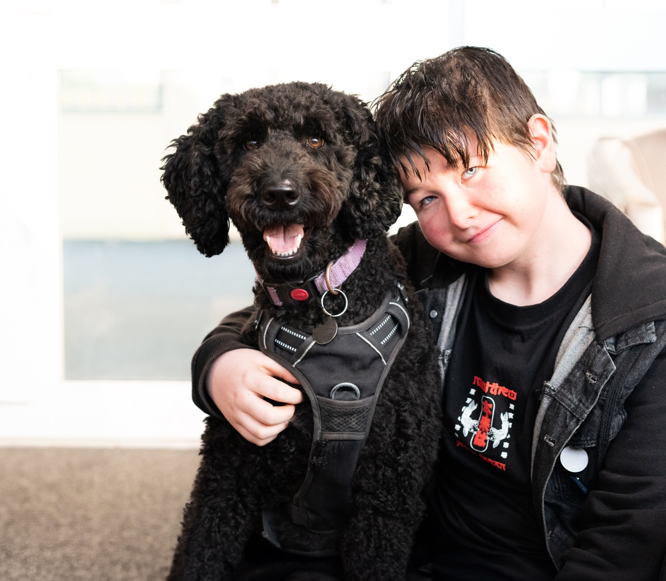
Belief 2: Influence and collaborate
We helped give almost 500 autistic children amazing places to belong and learn.
Notes:
So, moving on to our role in collaborating with others who work with autistic people and their families. Last year, almost 500 autistic children received specialist education in our schools and Cullum Centres − with spaces built around their needs and potential.
In our four schools, we have shaped our schools’ curricula with innovative approaches. Our success in all Ofsted inspections demonstrates that we engage autistic young people in a love for learning.
After 10 years of the Cullum Centre project, we have taken some time to reflect on the changing landscape of education and how this may impact on the project. Presently, we are working with three new potential centre sites in Norfolk and East Sussex, with the hope that builds can start by 2026.
This year saw the start to an Inclusive Spaces concept and a pilot within a school in Bath. This supports mainstream schools to develop inclusive learning environments and the teaching staff to increase their autism knowledge and embed practice to support autistic pupils to have a more positive educational experience.

Slide 11
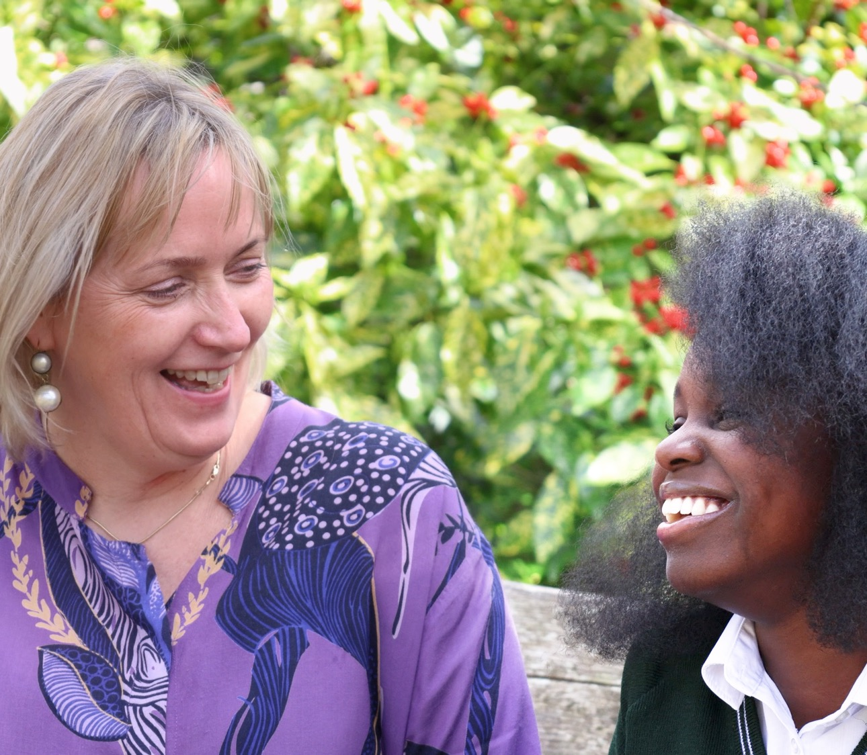
Belief 2: Influence and collaborate
We trained 15,500 frontline staff, creating ripple effects of awareness and empathy across services.
Notes:
In 2024-25, 15,500 delegates were trained by our charity. That’s thousands of professionals like teachers, healthcare workers and employers knowing more about autism.
In addition, 13,415 people accessed our online training modules, which are all written and designed by autistic people and other autism specialists.
Lastly, over 91,000 education professionals received training from the Autism Education Trust, ensuring they are better equipped to support autistic students.

Slide 12
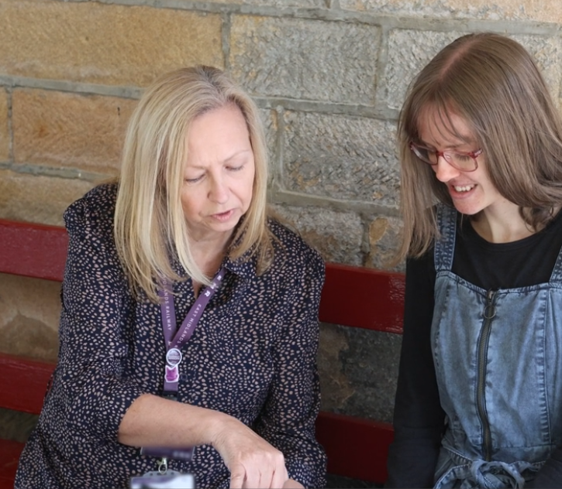
Belief 2: Influence and collaborate
Over 100 organisations became more inclusive by earning our Autism Accreditation Award.
Notes:
Over 100 organisations earned our Autism Accreditation Award in 2024-25, raising the standard of care and understanding across the UK.
This included hospitals, transport providers and schools, creating more understanding and better experiences for autistic people and their families.

Slide 13

Belief 3: Transform
Together, we changed the law. After years of tireless campaigning, the Mental Health Bill will pass through the House of Lords this winter, changing the law so autistic people will not be allowed to be sectioned simply for being autistic
Notes:
So, moving on to our work to transform society by building understanding, acceptance and respect for autistic people. And that is our campaigning and public awareness work.
In 2024-25, the Mental Health Bill was brought through Parliament, and it will pass through the House of Lords this winter. While we still wish to make it stronger, in its current form, it will remove autism from the definition of mental health that allows people to be detained just for being autistic. This is a major win and a change that we have been campaigning on for many years.

Slide 14
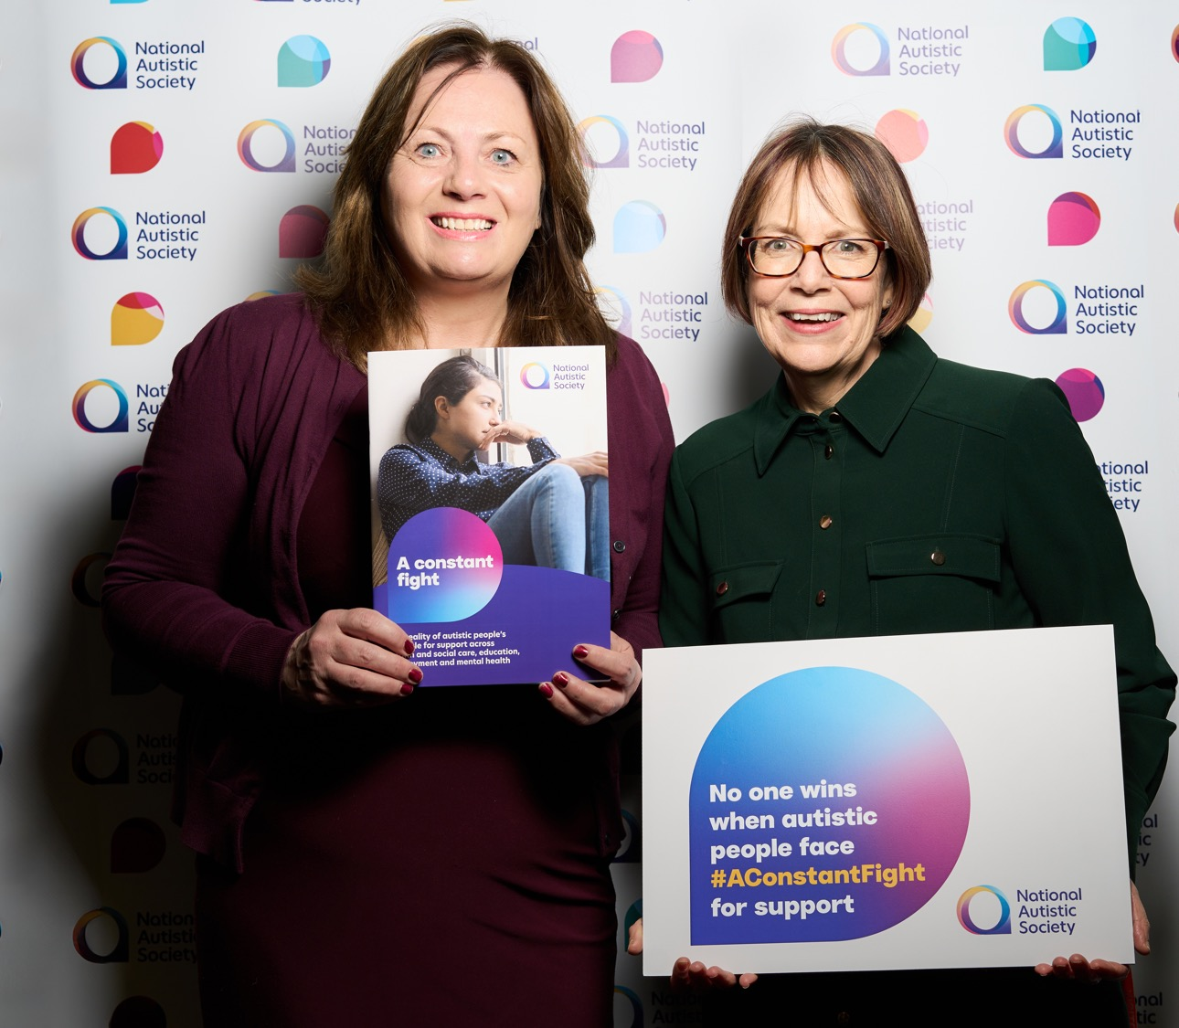
Belief 3: Transform
You turned 3,000 voices into action. Our passionate campaigners emailed their MPs after our Constant fight report – demanding change and opening
the doors to political conversations that matter.
Notes:
In January 2025, we published a report highlighting the ‘constant fight’ that autistic people and their families face to get the right support across education, employment, diagnosis, mental health and social care. To support the launch, we asked our campaigners to invite their MPs to come to our Parliamentary event and learn more about the issues and what could make a difference. 3,327 campaigners sent an invite to their MP.
In Northern Ireland, in September 2024, we launched the Forgotten Voices campaign, highlighting the catastrophic failure of Northern Ireland’s health and social care system to provide residential care and short breaks to struggling families of autistic young people with high support needs. This campaign was launched to accompany the Spotlight TV programme, I am not OK. After this aired, we and the families involved worked tirelessly to ensure that the campaign delivers real change. We were delighted when the Minister announced additional budget of £2m for children’s disability services in this financial year and recurrent funding of £13m thereafter. That will have a huge impact on the families struggling to find care for their young people.
In Scotland, we had 19 meetings with MSPs on various issues affecting autistic people, and hosted a parliamentary roundtable about the Learning Disabilities, Autism and Neurodivergence Bill with our campaigners.

Slide 15
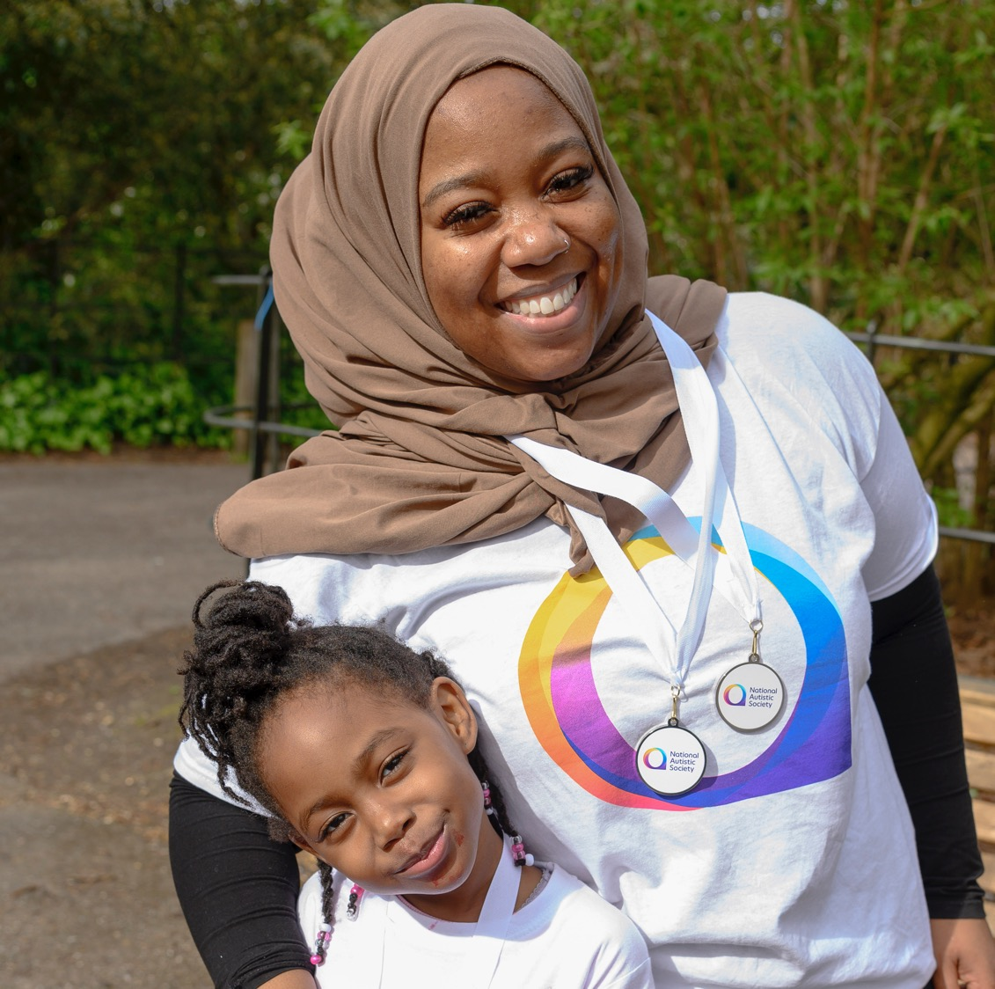
Thank you
Notes:
None of this work would be possible without you. So much of the impact we had last year is a direct result of the generosity, dedication and drive of our members, donors and fundraisers. We are deeply grateful for your support.
Together, you helped us raise £10.4 million to fund our vital work to make society work better for autistic people and their families.

Slide 16
There’s so much more to do
The situations faced by many autistic people are as difficult as ever:
In June 2025, 236,225 people were waiting for an autism diagnosis assessment in England. Of these, 211,104 had been waiting over three months.
In August 2025, 2,025 autistic people and people with learning disabilities were in mental health hospitals in England.
The most recent Government data shows the employment rate for autistic people is only 29%.
We have so much more work to do to create a society that truly works for autistic people – and the plans to do it!
Notes:
We are immensely proud to reflect on the success and impact we have had in the second year of our Vision to Reality strategy. But there is much more to do to create a society that works for autistic people. To give just a few statistics:
•In June 2025, 236,225 people in England were waiting for an autism diagnosis assessment.
•In August 2025, over 2,000 autistic people or people with a learning disability were in mental health hospitals.
•And, the most recent Government data shows the employment rate for autistic people is at only 29%.
We’re ready to take on these inequalities and won’t stop fighting for change. Thank you for your vital support for our work and for helping us make a huge impact last year.

